Slide 1

Costume Design
Ernie Incredible Illucinations
Learning Objective: To design a costume for your character/s in your own Illunication

Slide 2
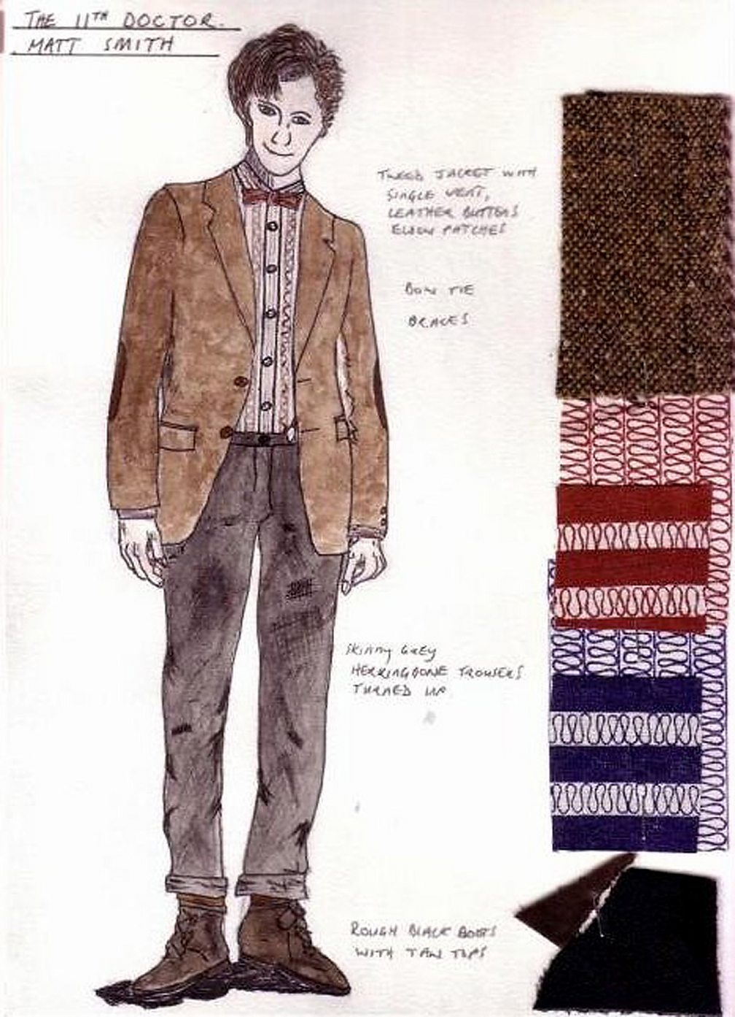
Selecting a costume
Usually costume designers will present sketches to the director to show their ideas on how the character should be dressed.
The director can then visualise the character’s appearance and suggest any amendments. Look at this sketch by costume designer, Ray Holman for Matt Smith’s portrayal of Doctor Who. Note the inclusion of the bow tie, a unique costume element for this incarnation of the character.
Does the costume and fabric choice reflect the character’s persona accurately? And if so, why?

Slide 3
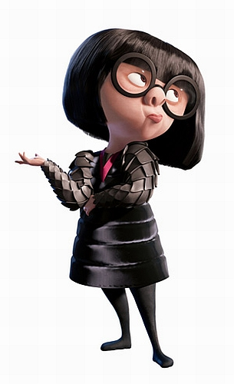
Designing a Costume
Colour
Colour is a very important aspect of a costume, it can convey a symbolic idea or reveal something about the character wearing the costume.
It can also help the audience see the similarities or differences between characters. For example, where two families are feuding, the performers may be dressed in different colours to help the audience differentiate.
Condition
The condition of the costume can convey information about the characters circumstances to the audience. For example, a street beggar may wear dirtier, more worn clothes and appear dirty
Cut
The way a costume is cut refers to the shape of fabric pieces used to construct it. For example, a suit can be cut in different ways to help change the performer’s physical appearance.
Fabric
The most appropriate fabrics to suit the character, setting and style of the production should be considered.
Fit
The fit of the costume refers to how the clothing fits, it can reveal a character’s personality or the context of the play.

Slide 4
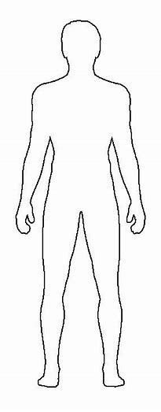
Task 1
Design your costume for Ernie or Main character
Name
Age
Colour
Condition
Cut
Fit
Fabric
Era
Style

Slide 5
Task 2
Design your costume for Another character from the play
Name
Age
Colour
Condition
Cut
Fit
Fabric
Era
Style

Slide 6

Don’t forget to submit ALL your Ernie design work at the end of this lesson
(Own illunication, Set, Lighting and Costume designs)
Upload your work to Class charts
Thank you

Slide 7

Ernies Incredible Illucinations Storyboard by b7625904 (storyboardthat.com)
Click the link for a story board of the play and characters.
It will also be added on CC as a link

