Slide 1
Lesson one this week
I live in a bungalow
LO: we are learning the types of houses
I can
say the names of different houses
write these words down correctly
say what type of houses I live in
Challenge: write the words in characters from memory

Slide 2
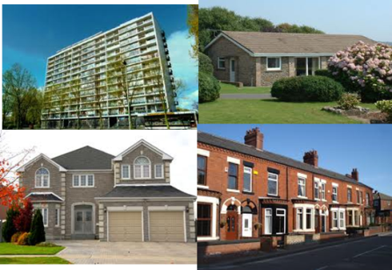
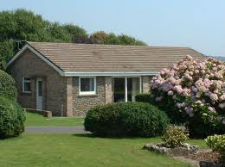
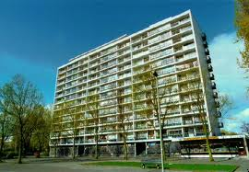

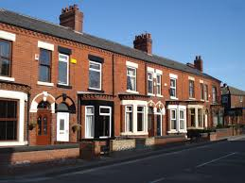
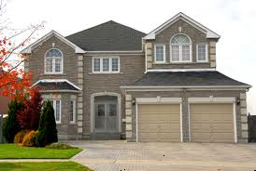
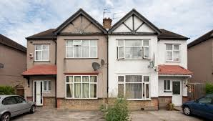
Task 1 Learn to say these words and copy them down
平房
píng fáng
公寓
gōng yù
房子 fáng zi
houses
bungalow
Flat
独栋楼房
半独立楼房
联排楼房
lián pái lóu fáng
dú dòng lóu fáng
bàn dú lì lóu fáng
terraced house
detached house
semi-detached house

Slide 3

你住什么房子？
nǐ zhù shén me fáng zi
Task 2 Copy down the question and answer the question with your own answer by replacing the type of dwelling.
You live what house
What type of houses do you live in?
我住公寓。
wǒ zhu gōng yù
什么shén me what
住 zhù live
房子 fáng zi houses

Slide 4

你住什么房子？
nǐ zhù shén me fáng zi
You live what house
What type of houses do you live in?
我住公寓。
wǒ zhu gōng yù
Task 3
Read aloud the question and answers you give and record your speaking
什么shén me what
住 zhù live
房子 fáng zi houses

Slide 5
Lesson 2 this week
Practice of reading and listening about type of house
LO: We are practising listening and reading about type of house
I can
recognise types of houses by listening
complete reading tasks with confidence

Slide 6
a
Task 1 Listen and put the letter of the picture after each question. You have 6 questions.
b
1
2
3
4
5
6
c
d
e

Slide 7
Task 2 Read and translate the text into pinyin and English.
我叫大山，我和我的爸爸妈妈住在一座独栋楼房。
我叫小明，我和妈妈和姐姐住在一套公寓里。
我叫英英，我和我的家人一起住在一栋很漂亮的半独立楼房。
我叫立新，我和爸爸、妈妈和弟弟住在一套联排楼房里。我爱我的家。
我叫海燕，我二十五岁，我住在一套平房里。
套 tào measure word for flats, terrace houses
栋 dòng, measure word for semi-detached or detached houses
座 zuò, same as dòng, it can be also used for bridges and buildings

