Slide 1
I am now in the living room
Lesson 1 this week
LO:
We are learning rooms in the house
I can
say the rooms in the house and
use them with “I am now in…”

Slide 2

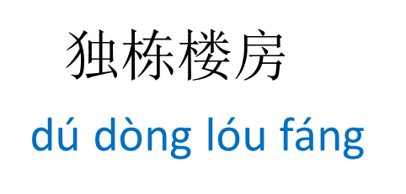
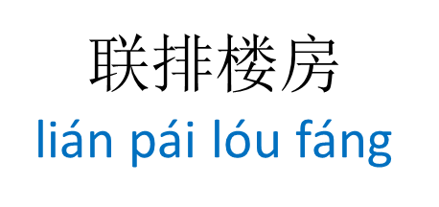
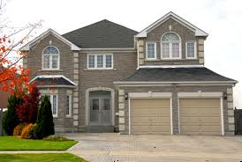
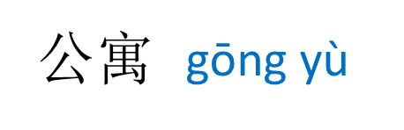
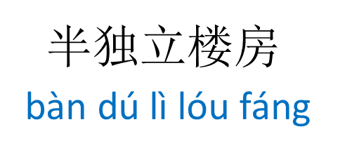

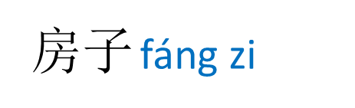
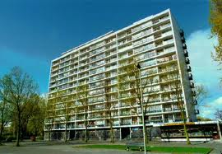
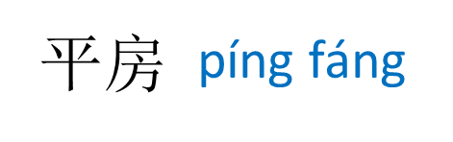


Task 1 Match the pictures to the words
5 minutes
1
2
3
4
5
Example: 1= 房子
6

Slide 3

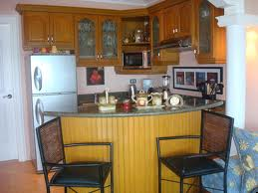
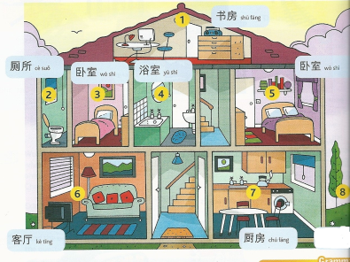

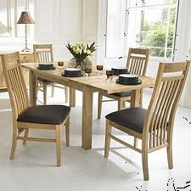
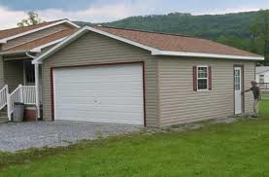

Task 2 Learn to say these words and copy them down in characters, pinyin and English. Continue next page
房间
fáng jiān
客厅
kè tīng
厨房
chú fáng
room
living room
kitchen
餐厅
车库
花园
huā yuan
cān tīng
cè suǒ
dining room
garage
garden

Slide 4

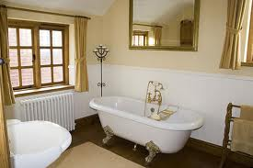
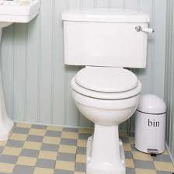
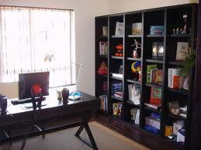
浴室
yù shì
卧室
wò shì
bathroom
bedroom
厕所
cè suǒ
书房
shū fáng
toilet
study

Slide 5


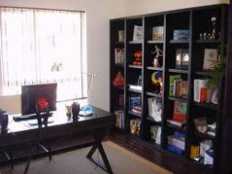



Task 3 Copy down the question and answer. Then write two answers of your own.
你现在在哪里？nǐ xiàn zài zài nǎ lǐ Where are you now?
我现在在客厅里。wǒ xiàn zài zài kè tīng lǐ
I now in living room

Slide 6
我现在在客厅里。wǒ xiàn zài zài kè tīng lǐ
I now in living room
车库
客厅
厨房
餐厅
cè suǒ
cān tīng
kè tīng
chú fáng
花园
浴室
厕所
书房
卧室
yù shì
che kū
shū fáng
huā yuan
wò shì

Slide 7
Lesson 2 this week

Slide 8





Task 1 Match the words with the pictures
2
3
4
5
1
6
7
8
9
厨房
餐厅
车库
客厅
cè suǒ
cān tīng
kè tīng
chú fáng
花园
浴室
厕所
书房
卧室
yù shì
che kū
shū fáng
huā yuan
wò shì

Slide 9
Task 2 Read the text on next slide and translate it into Pinyin and English

Slide 10
你好！我叫小海。我家有三口人。我家住两层的楼房。我家不大。我家楼上有两个卧室，一个厕所和一个浴室。我爸爸妈妈的卧室比我的大。我家楼下有一个客厅，一个餐厅和一个厨房。我家有花园。花园在房子的后面。花园很漂亮。
liǎng céng de
两层的楼房
two-storey house
楼上 lóu shàng upstairs
楼下 lóu xià downstairs
……比…… 大
...bigger than…
漂亮 piào liàng beautiful
zài de hòu miàn
在……的后面
behind……

Slide 11
Task 3 Play a speaking game on next slide using the contents on Slide 12

Slide 12
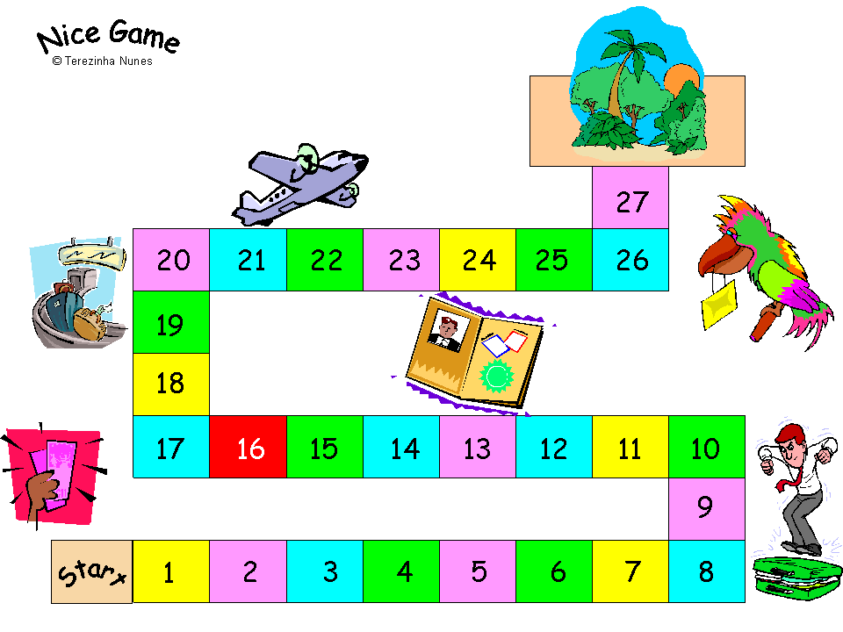

Slide 13
Say a word you learned today. | Go back 3 steps. | Go forward 1 step. | Say a different word you learned today.
Say a sentence you learned today. | Smile at your friends. | say “now” in Chinese. | Say “ I am in the bathroom” in Chinese.
Say “wǒ zhù píng fáng” to the person on your right hand side, and ask him/her to translate it in English. | Go forward 2 steps. | Say Ï am now in the kitchen "to the person on your left hand side, and ask her/him to say it in Chinese. | Do a twirl.

