Slide 1
Week commencing 29/03/21

Slide 2
Furniture in my room
LO:
We are leaning furniture in my room so that we can say what there are in a place
Success:
1. Be able to say at least 3 pieces of bedroom furniture with correct measure words
2. Be able to say in my room there is /are ….
3. Be able to complete translation from Chinese to English

Slide 3
Task 1 Learn to say the words on next few slides and copy them down

Slide 4

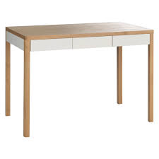
zhè shi shén me? What is this?
一张桌子
yì zhāng zhuō zi

Slide 5
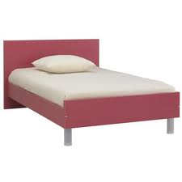
zhè shi shén me? What is this?
一张床
yì zhāng chuáng

Slide 6



zhè shi shén me? What is this?
三张海报
sān zhāng hǎi bào

Slide 7
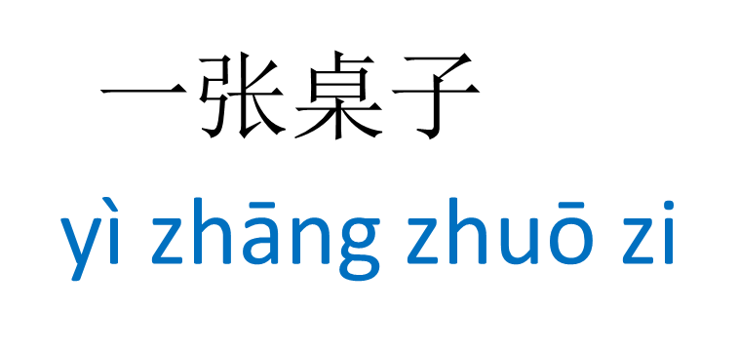

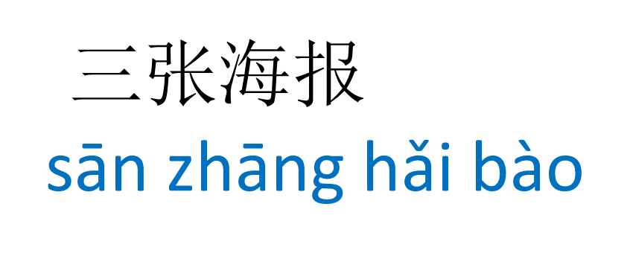
zhè shi shén me? What is this?

Slide 8
zhè shi shén me? What is this?
What’s in common?
张
zhāng
It is a measure word for flat square things

Slide 9

zhè shi shén me? What is this?
一个书架
yí gè shū jià

Slide 10
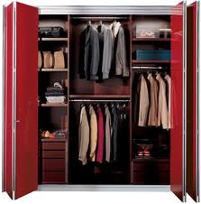
zhè shi shén me? What is this?
一个衣柜
yí gè yī guì

Slide 11
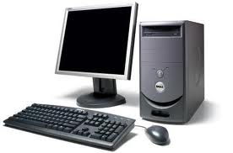
zhè shi shén me? What is this?
一个电脑
yí gè diàn nǎo

Slide 12
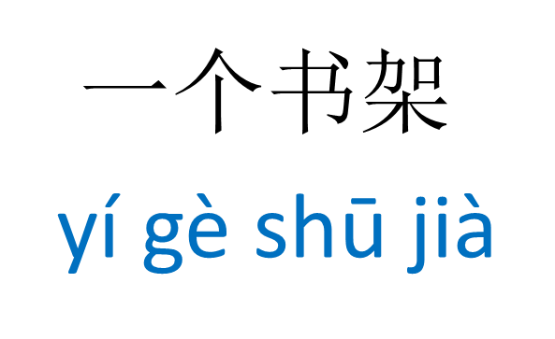
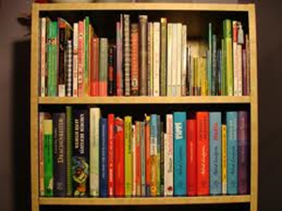

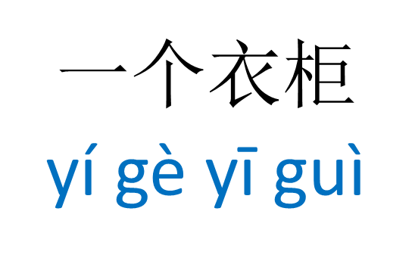

zhè shi shén me? What is this?

Slide 13
zhè shi shén me? What is this?
What’s in common?
个
gè
It is the most frequently used measure word

Slide 14
What does this sentence starter mean?
有 to have, there is/are
wǒ de fáng jiāng lǐ yǒu
我 的 房 间 里有…
…里 in

Slide 15
Task 2 Write 3 few sentences to say what you have in your room. See next slide for examples
wǒ de fáng jiāng lǐ yǒu…
我 的 房 间 里有…

Slide 16
Task 3Translate the text into English
wǒ de fáng jiǎn lǐ yǒu yì zhāng chuáng yí gè yī guì
我的房间里有一张床、一个衣柜、
yì zhāng zhuō zi yì bǎ yǐ zi yí gè diàn shì
一张桌子、一把椅子、一个电视、
yí bù diàn huà yí jià gāng qín
一部电话、一架钢琴。

