Slide 1
Vocab test
I not only quite like…. But also especially like…; In addition, I relatively like…
Although… but…
because… so
too
in my room
On the table
Under the bed

Slide 2
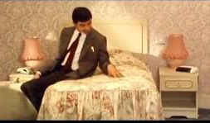
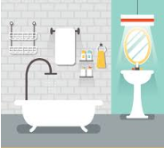
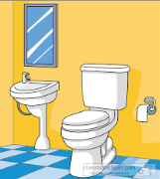
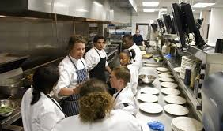
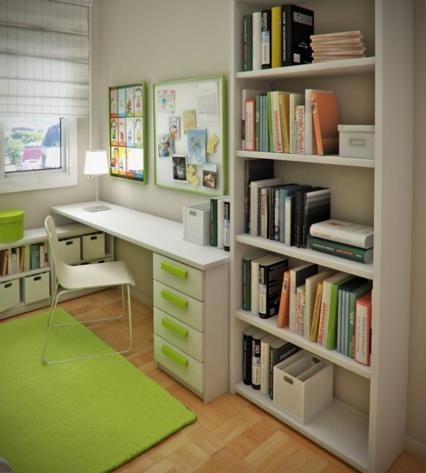
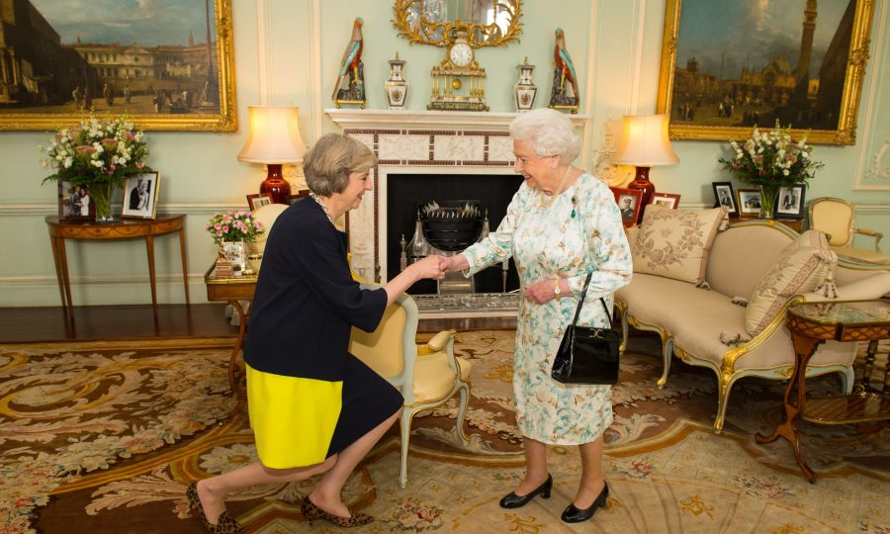
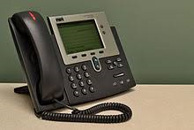
wòshì
yùshì
cèsuǒ
chúfáng
卧室
浴室
厕所
厨房
shūfáng
kètīng
diànhuà
书房
客厅
电话

Slide 3
Learning Objectives
To talk about what rooms there are in a house;
To talk about what rooms and other items there are in my house with 和 and 也;
To talk about what rooms there are in my house and what items there are in different rooms with 和,也,不但…而且…,虽然…但是…;

Slide 4
wòshì
yùshì
cèsuǒ
chúfáng
卧室
浴室
厕所
厨房
shūfáng
kètīng
diànhuà
书房
客厅
电话

Slide 5
wòshì
yùshì
cèsuǒ
chúfáng
卧室
浴室
厕所
厨房
shūfáng
kètīng
diànhuà
书房
客厅
电话

Slide 6

对 or 不对？

Slide 7
一
二
三
四
卧室
浴室
厕所
厨房
cāi
In English: Which picture is missing?
In Chinese: Which word is missing?
In Chinese: Can you remember what word is number…?
五
六
七
书房
客厅
电话

Slide 8
一
二
三
四
卧室
浴室
厕所
厨房
In English: Which picture is missing?
In Chinese: Which word is missing?
In Chinese: Can you remember what word is number…?
cāi
五
书房
客厅
六
七
电话

Slide 9
一
二
三
四
cāi
In English: Which picture is missing?
In Chinese: Which word is missing?
In Chinese: Can you remember what word is number…?
五
六
七

Slide 10
You will hear 5 words in Chinese, write down the English in your book.
1
2
3
4
5

Slide 11
zài wǒdejiā lǐ yǒu yígè fángjiān
在我的家里有一个房间。
At my house inside, there is a room.
yígè
一个
浴室
chúfáng
厨房
厕所
yùshì
cèsuǒ
shūfáng
书房
wòshì
卧室
电话
客厅
diànhuà
kètīng

Slide 12
zài wǒdefángzi lǐ yǒu liǎnggè fángjiān
在我的房子里,有两个房间。
At my house inside, there is two rooms.

Slide 13
Successful Criteria:
can pronounce the preposition word “in”,”my”,”house”,”one” and different rooms;
can read/listen and understand “in”,”my”,”house”,”one” and different rooms;
can listen to/read sentences and understand “in”,”my”,”house”,”one” and different rooms;
can say/ write about what rooms there are in my house;
can say/write about what rooms and what other items there are in my house with和 and 也;
can say/write about what rooms there are in my house and what items there are in different rooms with 和,也,不但…而且…,虽然…但是…;

Slide 14
Please stick the 汉字(Hanzi) slip in your book.
Write down English and Pinyin to the slip.
1.chúfáng/kitchen
2.kètīng/sitting room
3.diànhuà/telephone
4.cèsuǒ/toilet
5.wòshì/bedroom
6.yùshì/bath room
7. shūfáng/study room
a.卧室
b.浴室
c.厕所
d.厨房
e.客厅
f.书房
g.电话
Ext 1. Mix and Match.
Ext 2. Translate into Hanzi and pinyin.
a. room to sleep; b. room to study; c. room to cook; d. device to call someone

Slide 15
Task 1: Please write a sentence about what rooms you have in your house;
Task 2: Please write a sentence about what furniture and items there are in the room;
Extension 1:
Use connective words 和、也 to upgrade your sentence
Extension 2:
Use 不但…而且…, 因为…所以…, 虽然…但是…; to make your sentences as high level as possible.

