Slide 1
Mandarin Work for Week commencing 8th March 2021

Slide 2
I play computer games
Lesson 1 in this week
LO： We are revisiting hobbies and practice writing the characters for hobbies
I can
recognize the words for hobbies
write the characters from memory
do vocabulary –learning on Quizlet

Slide 3

Task 1 Match the characters with Pinyin and English
Example: 1. 看书 kàn shū – to read a book
看书
看电影
看电视
买东西
玩滑板
玩电脑游戏
上网
听音乐
tīng yīn yuè
shàng wǎng
kàn diàn shì
wán diàn nǎo yóu xì
kàn diàn yǐng
mǎi dōng xī
kàn shū
wán huá bǎn
to read a book
do shopping
to do skateboarding
to listen to music
to watch TV
to surf the internet
to watch a film
to play computer games

Slide 4
Practise writing these words on next few slides until you can write them from memory.

Slide 5

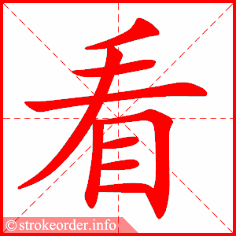
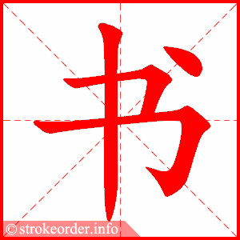
看书 kàn shū –
to read a book

Slide 6
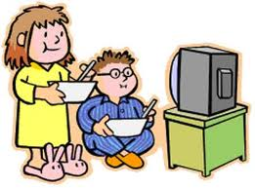
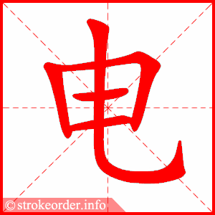
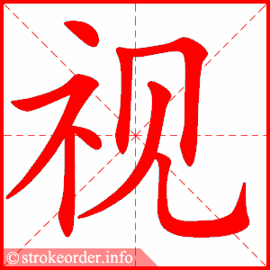
看电视 kàn diàn shì
Watch TV

Slide 7
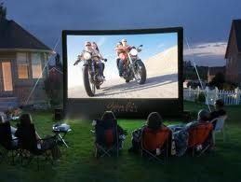
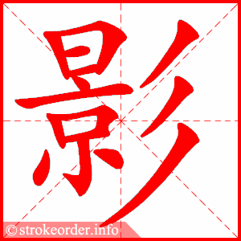
看电影 kàn diàn yǐng
watch a film

Slide 8
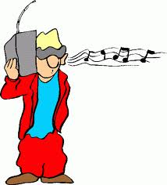
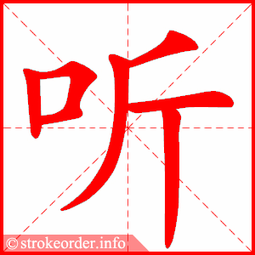
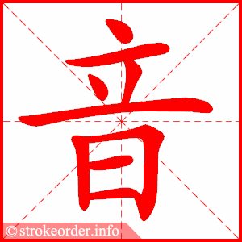
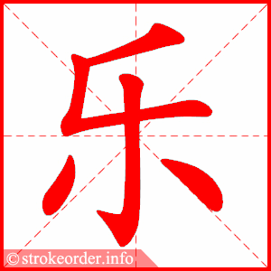
听音乐 tīng yīn yuè
to listen to music

Slide 9

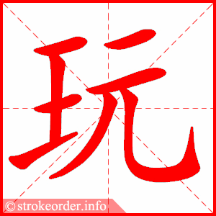
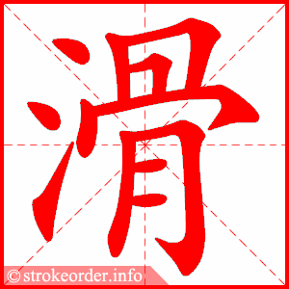
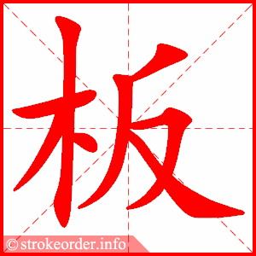
玩滑板 wán huá bǎn
to play skateboard
to do skateboarding

Slide 10

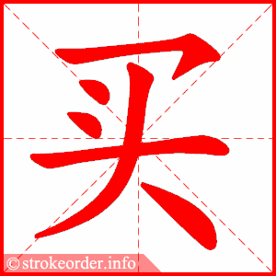
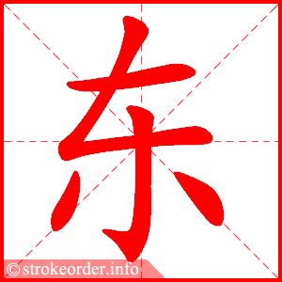
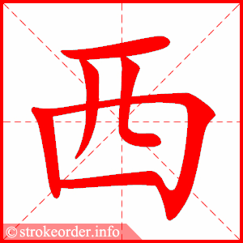
买东西
mǎi dōng xī
to buy things
to do shopping

Slide 11

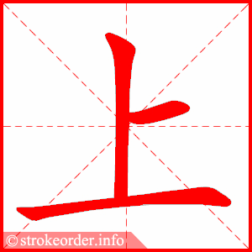
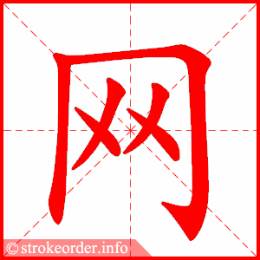
上网 shàng wǎng
to surf the internet

Slide 12
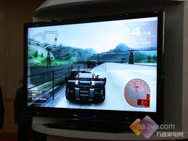
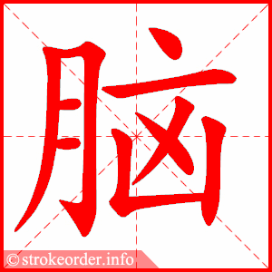
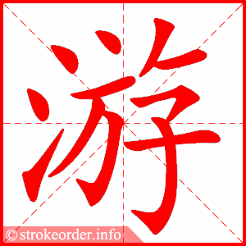
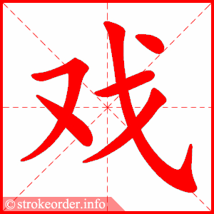
玩电脑游戏
wán diàn nǎo yóu xì
to play computer games

Slide 13
I play computer games on Monday
Lesson 2 in the Week
LO： We are learning PTA structure and to use 不 to form negative sentence
I can
use PTA structure to make at least 2 sentences
add 不to make a negative sentence

Slide 14
Task 2 Do you still remember the days of the week? Write them down.
Example
星期一: Monday

Slide 15
Task 3 Use PTA structure – the most common structure in Chinese to write two sentences.
Person
我
我爸爸
我妈妈
我哥哥
我姐姐
Time
星期一
星期二
星期天
Action – verb + object
看书
看电影
买东西
Example:
我星期一看书。 I read on Monday.

Slide 16
Task 4 Add 不 bù before the verb to make a negative sentence
Person
我
我爸爸
我妈妈
我哥哥
我姐姐
Time
星期一
星期二
星期天
不
bù
Action – verb + object
看书
看电影
买东西
Example:
我星期一 不看书。 I don’t read on Monday.

