Slide 1
Week Commencing 15-03-21
Year Mandarin – Non MEP

Slide 2
I like watching TV
Lesson 1 this week
LO: We are learning to give opinions
I can
use like and dislike to give my opinions about hobbies
replace phrases to make my own sentences

Slide 3

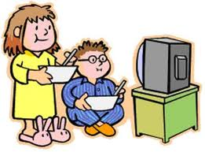
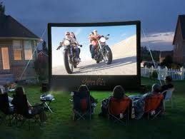

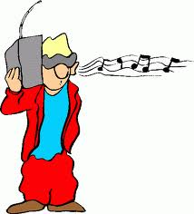



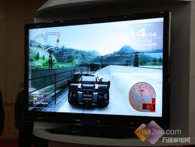
Match the pictures with the words, then practice saying the words. Click the speaker for pronunciation
5
1
a. 看书
e. 上网
f. 买东西
6
2
b. 看电视
c. 听音乐
g. 看电影
7
3
d. 玩滑板
h. 玩电脑游戏
4
8

Slide 4


喜欢
xǐ huān
不喜欢
bù xǐ huān
“不” makes things negative

Slide 5
Give your opinions. Make a positive and a negative sentence.
我喜欢看书。
wǒ xǐ huān kàn shū
我不喜欢看电视。
wǒ bù xǐ huān kàn diàn shì

Slide 6
Lesson 2 this week
Do you like to watch TV?
LO: We are learning to form Yes/No questions
I can
understand how to form a Yes/No question
ask and answer the question

Slide 7
Grammar: Form a Yes/No question
Use question word 吗 (ma) to make a Yes/No Question. 吗 is placed at the end of the sentence.
你喜欢看书吗？nǐ xǐ huān kàn shū mā
Do you like reading?
Translate the following questions:
Do you like shopping?
Do you like watching TV？
Do you like surfing the internet?

Slide 8
Grammar: Answer a Yes/No question
Repeat the verb in the question to say “yes”, and put 不 before the verb to say “no”。
你喜欢看书吗？nǐ xǐ huān kàn shū mā
Do you like reading?
喜欢，我喜欢看书。Yes, I like reading.
不喜欢，我不喜欢看书。No , I don’t like reading.
Answer the Questions you just made on last page. Write your answers down.

Slide 9
 | ?
看电影
买东西
上网
玩滑板
看电视
看书
听音乐
玩电脑
游戏

