Slide 1
Week commencing 22/03/21
Year 7 Non – MEP Mandarin

Slide 2
Do you like swimming?
Lesson 1 this week
LO:
We are revisit sports and learn some radicals
I can
recognise and write the words for sports more confidently
understand what radical means in Chinese

Slide 3

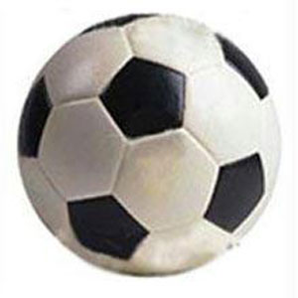
足球 zú qiú
Click the speakers for pronunciation and explanation

Slide 4
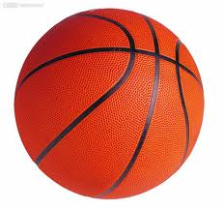
篮球 lán qiú
Click the speakers for pronunciation and explanation

Slide 5

乒乓球 pīng pāng qiú
Click the speakers for pronunciation and explanation

Slide 6

网球 wǎng qiú
Click the speakers for pronunciation and explanation

Slide 7

橄榄球 gǎn lǎn qiú
Click the speakers for pronunciation and explanation

Slide 8
足球
zú qiú
篮球
lán qiú
乒乓球
pīng pāng qiú
Practise writing these words
Write each words three times.
网球
wǎng qiú
橄榄球
gǎn lǎn qiú

Slide 9
Practise recognising these words on next few slides

Slide 10
zú qiú
lán qiú
pīng pāng qiú
wǎng qiú
gǎn lǎn qiú

Slide 12
足球
zú qiú
篮球
lán qiú
乒乓球
pīng pāng qiú
网球
wǎng qiú
橄榄球
gǎn lǎn qiú

Slide 13
足球
篮球
乒乓球
网球
橄榄球

Slide 14
足球
篮球
乒乓球
橄榄球
网球

Slide 15
踢 tī
踢
足球 zú qiú
foot

Slide 16
打 dǎ
篮球
lán qiú
乒乓球
pīng pāng qiú
打
hand
网球
wǎng qiú
橄榄球
gǎn lǎn qiú

Slide 17
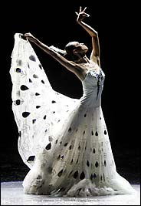
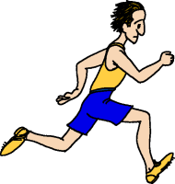
跑步 pǎo bù
跳舞 tiào wǔ

Slide 18
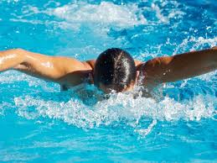
游泳 yóu yǒng
游
water

Slide 19
游泳
yóu yǒng
跳舞
tiào wǔ
跑步
pǎo bù
Write these words in characters 3 times and write pinyin and English for them

Slide 20
yóu yǒng
tiào wǔ
pǎo bù

Slide 22
游泳
yóu yǒng
跳舞
tiào wǔ
跑步
pǎo bù

Slide 23
游泳
跳舞
跑步

Slide 24
游泳
跑步
跳舞

Slide 25
Lesson 2 this week
What sports do you like?
LO:
We are learning to form questions with “what”
I can
form a question with what
complete a reading task

Slide 26
Can you use these characters to make words?
橄
网
乓
Write the words down
球
足
篮
球
球
乒
榄
球
球

Slide 27
Can you use these characters to make words?
喜
步
Write the words down
跳
喜
跑
游
泳
欢
舞
不
欢

Slide 28
你喜欢什么运动？nǐ xǐ huān shén me yùn dòng
我喜欢打篮球。wǒ xǐ huān dǎ lán qiú
Write down the question and two answers.
Translate the following question into Chinese.
What pet do you like?

Slide 29
Translate the following sentences into Pinyin and English.
1.你好！我叫Kate。我今天打乒乓球，不打网球。
2.早上好！我叫Sam，我今天不踢足球，我去买东西。
3.早上好！我叫Lili. 今天我跳舞， 不游泳。
今天 : today, jīn tiān 去买东西: go shopping, qù mǎi dōng xī
不: not, bù

