Slide 1
Mandarin Year 7
Week 29/03/21

Slide 2
Days of the week
Lesson 1 this week
We are recapping days of the week
LO:
I can understand where the time phrase is placed in a sentence
talk about when I do an activity confidently

Slide 3
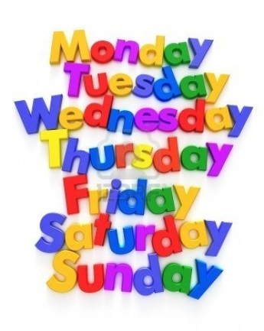
Days of the week
星期一 | 星期二 | 星期三 | 星期四 | 星期五 | 星期六 | 星期天
Can you work out the patterns?
Worksheet
Fill in the week days

Slide 4
The position of Time Phrases
星期一 | 星期二 | 星期三 | 星期四 | 星期五 | 星期六 | 星期天 星期日
xīng qī yī | xīng qī èr | xīng qī sān | xīng qī sì | xīng qī wǔ | xīng qī liù | xīng qī tiān xīng qī rì
我星期一打网球。
I Monday play tennis.
Person + time phrase+ verb + object

Slide 5
Use this sentence pattern to write 3 sentences with different time phrases and activities. At least 1 in characters.
Person + time phrase+ verb + object
我星期一打网球。
I Monday play tennis.
今天：jīn tiān , today
星期一 | 星期二 | 星期三 | 星期四 | 星期五 | 星期六 | 星期天 星期日
xīng qī yī | xīng qī èr | xīng qī sān | xīng qī sì | xīng qī wǔ | xīng qī liù | xīng qī tiān xīng qī rì
Tell your imaginary friend/friend what sentences you have got in Chinese and English.

Slide 6
Lesson 2 this week
I play table tennis on Monday
LO: Practise to use PTA structure
I can
rearrange words in a correct order and translate these sentences into English
use Study Stack online to practice PTA structure
use online tool to practise my Pinyin skills

Slide 7
Rearrange the words to form a correct sentence.
我
打
。
星期一
乒乓球

Slide 8
Rearrange the words to form a correct sentence.
我
踢
。
星期二
乒乓球

Slide 9
Rearrange the words to form a correct sentence.
妈妈
。
看电视
星期三

Slide 10
Rearrange the words to form a correct sentence.
妈妈
。
看电视
星期三

Slide 11
Rearrange the words to form a correct sentence.
姐姐
。
游泳
星期四

Slide 12
Rearrange the words to form a correct sentence.
哥哥
玩电脑游戏
星期五
。

Slide 13
Rearrange the words to form a correct sentence.
Sophie
看电影
星期六
。

Slide 14
Rearrange the words to form a correct sentence.
跑步
Amber
星期天
。

Slide 15
Tick any sets in JINBU 3 and Choose “unscramble” at the bottom to play the game.
unscramble

Slide 16
Pinyin
Practice1
Practice2
Vowel yùn mǔ
Single vowel
a o e i u ü
Double vowel
ai ei ui ao ou iu ie üe er
Front Nasal vowel
an en in un ün
Back Nasal vowel
ang eng ing ong
Consonants shēng mǔ
Similar to English:
b p m f d t n l
g k h j s y w
different from English:
q=ch
x=sh with the tongue flat
z=ds
c=ts
Not in English:
zh ch sh

