Slide 1
Pets
汉字故事：
狗
https://www.youtube.com/watch?v=tbsW0bjgFZo
蛇
https://www.youtube.com/watch?v=25PeRyGtc-Q

Slide 2


māo
gǒu

Slide 3

shé

Slide 4

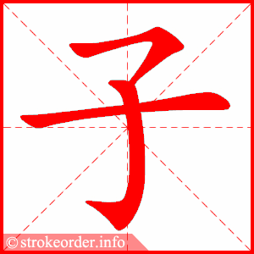
tù zi

Slide 5
Guess
猜一猜
鸟
鱼
Fish? Bird?
Fish? Bird?

Slide 6


Guess
猜一猜
niǎo
yú
鸟
鱼

Slide 7
māo
gǒu
tù zi
猫
狗
兔 子

Slide 8
Teacher’s Game: Repeat+1
Rules:
-Students look at teacher’s flashcards(number and word)and then repeat the word together
-if the number is 三（3）, students should repeat one more time——四（4） times together
-the teacher wins if students make mistakes, and vice versa

Slide 9
Repeat+1
māo
gǒu
tù zi
猫
狗
兔 子

Slide 10
Repeat+1
shé
yú
niǎo
蛇
鱼
鸟

Slide 11
Which one is missing?

Slide 12


chǒng wù

Slide 13
chǒng wù
他有什么宠物？
他有……

Slide 14
chǒng wù
她有什么宠物？
她有……

Slide 15
chǒng wù
他有什么宠物？
他有……

Slide 16
chǒng wù
妹妹有什么宠物？
妹妹有……

Slide 17
chǒng wù
你有什么宠物？
我有……

Slide 18
“你做我猜” guessing game
Rules:
-one student read teacher’s flash card and act it
-the other students guess what word he/she acts
-then speak out what kind of pet he/she act, use the structure“他/她 有……”and let the student who act judge if correct.

Slide 19
gǒu
māo
tù zi
Task 1 : Copy down the Hanzi, Pinyin 1 times each, then add English for them.
CH: write down your pet or your family member’s pet，use the sentence structure like below:
我有......
EX CH: write down:
I don’t have +Pet
Super Challenge:
Translate：My family has cat, also has dog. (use“也”)
shé
yú
niǎo

