Slide 1
Pets(3)
汉字故事爱
https://www.youtube.com/watch?v=8w9NM18hrXI

Slide 2


Starter:
1. Write down today’s day, date and weather
2. Copy down the new words three times
二月二十六日 星期三
CH: Use intensifiers to make one phrase with this new word
piào liang
beautiful

Slide 3
L.O. adjective words for pets
-Hot : Have a review of the measure words 只、条;
Learn adj. words 大、小、漂亮、丑、可爱、的
-Hotter: Use number + measure word+ adj.+ Pet in your sentences
-Sizzling: Use 和、也、但是 to to upgrade your sentences level
-CH: Use intensifiers to achieve highest possible level
Notes:
请学生举例 intensifiers
提问：How to say Very good in Chinese?

Slide 4
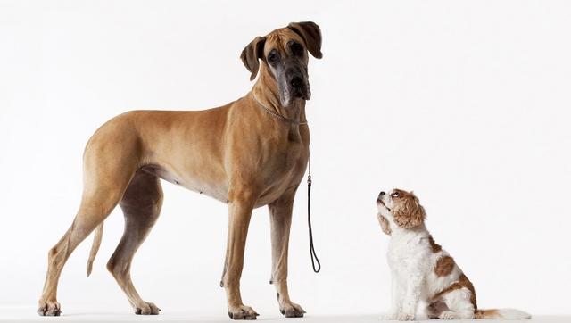
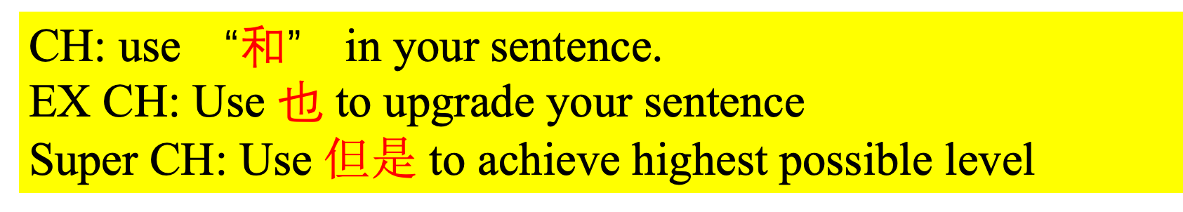
一只大狗
一只小狗
Number + Measure word + Pet
chǒng wù
你有什么宠物？
我有两只狗。
CH：我有一只大狗和一只小狗。
EX CH：我有一只大狗，也有一只小狗。
Super CH：我有一只大狗，但是妈妈有一只小狗。
Notes:
强调“也”的位置

Slide 5
Listening 《进步一》23页 5
Notes:
关于“大”“小”宠物表达的对话录音

Slide 6
Fill in the blanks with measure word.
我叫Lucy。我家有五 人。我有一 猫和一 狗。哥哥也有一 狗。妹妹有两
小鱼。爸爸有三 小鸟，但是（but）妈妈没有宠物。
Lucy家有几只宠物？
CH 1: How to ask “How many pets does Lucy’s family have?” in Chinse.
CH 2: Write down the answer of CH 1 in Chinese.
Tips：口；只；只；只；条；只
Notes:
发Handout和胶棒给学生
怎么问问题？
宠物(collective noun)的量词用“只”
板书示范：一只宠物

Slide 7
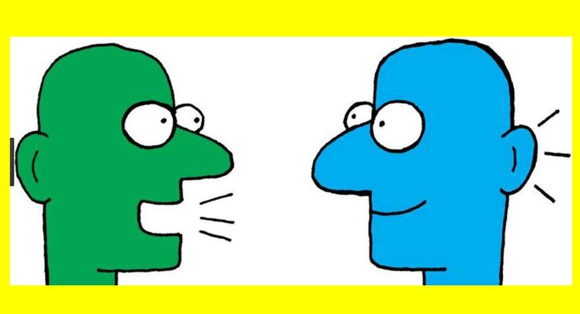
Find out who
CH: Use adj. words we have learned to describe your pets.
EX CH: Use 和、也 to to upgrade your sentences level
Super CH: use intensifiers to achieve highest possible level
-Draw a table like below.
-Interview at least 4 classmates and find out what pets they have.
-you must use measure word when you talk about the quantity.
名字/name | Notes (in English or Chinese)
Student A
Student B
Student C
Student D

Slide 8

piào liang
de
beautiful
猫
一只小猫
一只漂亮的小猫
chǒng wù
你有什么宠物？
我有一只漂亮的小猫。
Number + Measure word +adj. + Pet
Notes:
强调加“的”才是adj
“小猫”联系比较紧密，不加的

Slide 9
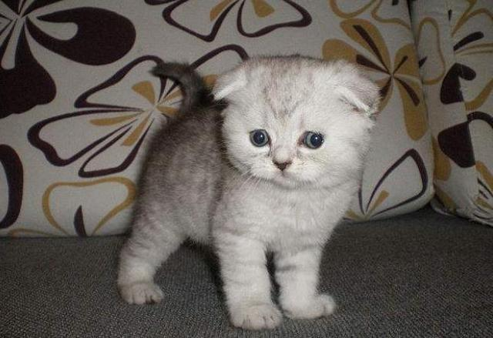





chǒu
de
ugly
kě ài
de
一只丑的小猫
一只可爱的小猫
cute

Slide 10
Number + Measure word +adj. + Pet
Pair Work:
-Look at the pictures
-Ask your partner what pet(s) he/she has
-When you answer, follow the structure above.
EX CH: Use 和、也 to to upgrade your sentences level
Super CH: use intensifiers to achieve highest possible level
我有两只漂亮的小猫。
我有两只可爱的小狗。
Notes:
Running dictation
我家有五口人。
我有一只狗。
姐姐有一只大兔子。
哥哥有一只小猫和一只大狗。
妈妈有两条漂亮的小鱼。
爸爸有三只非常可爱的小鸟。

Slide 11
piào liang
de
Task 1 : Copy down the Hanzi, Pinyin 2 times each, and add English for them.
CH 1: Suppose you are 18 years old now, imagine what pet(s) you have, and use the words above to introduce your pet(s). Eg. 我有一只可爱的小狗。
CH 2: Use 和、也 to to upgrade your sentences level
CH 3: use intensifiers to achieve highest possible level
kě ài
de
chǒu
de
我有三只非常漂亮的小鱼。
Notes:
可爱的小鱼
“小鱼”联系比较紧密，不加的

Slide 12
Running Dictation
Group work! 4 students in one group.
In each round, every group needs choose one runner and one writer and swap roles in next round.
the runner needs to go to find Miss Yan and remember one sentence
then runs back to your partners and dictates the sentence.
the writer needs to write it down.
the runner is allowed to run back and forth if you forget some words.
We will have Four Round.
Each group need to work together for
one passage.
e.g. 我家有六口人。
Notes:
Running dictation
我家有五口人。
我有一只狗。
姐姐有一只大兔子。
哥哥有一只小猫和一只大狗。
妈妈有两条漂亮的小鱼。
爸爸有三只非常可爱的小鸟。
4人一组共6组，共24人
最后一组，3人一组
Choose a short passage or dialogue and make several copies. Put the copies up around the walls of the classroom (or even the school building).
Put the students in pairs or small groups.
The aim is for one of the students in each pair to walk (or run!) to read the passage on the wall.
They remember some of the passage and walk (or run!) back to their partner.
They quietly dictate what they remembered to their partner, who writes it down.
They then swap roles. Over several turns they will build the whole passage. This means they really do have to run back and forth because students will only remember three or four words at a time.
The winning pair is the team that finishes first – although you need to check for mistakes. If there are mistakes, they must keep walking to check!
A good idea is to teach them punctuation vocabulary beforehand if you want them to use the correct punctuation in English. It's a good way to check spelling and fabulous for pronunciation – and great memory training!

Slide 13
Script
我家有六口人。
姐姐有两只大兔子。
我有一条漂亮的鱼，我也有三只小狗。
妹妹有五只可爱的小狗，但是弟弟有八条很丑的小蛇。
爸爸和妈妈没有宠物。
Notes:
姐姐有两只大兔子。
我有一条漂亮的鱼，我也有三只小狗。
妹妹有五只可爱的小狗但是弟弟有八条丑的小蛇
我有一只狗。
姐姐有一只大兔子。
哥哥有一只小猫和一只大狗。
妈妈有两条漂亮的小鱼。
爸爸有三只非常可爱的小鸟。

Slide 14
Write a introduction of the pet(s) you and your family members have
At least 40 words
use suitable measure word
use adj. words to describe the pet(s)
use 和、也、但是 to upgrade your sentences level
use Intensifiers to achieve highest possible level
Notes:
to to upgrade your sentences level
-CH: Use intensifiers to achieve highest possible level

Slide 15
What you have learned today?
Have you achieved the level you want?
-Hot : Have a review of the measure words 只、条;
Learn adj. words 大、小、漂亮、丑、可爱
-Hotter: Use number + measure word+ adj.+ Pet in your sentences
-Sizzling: Use 和、也、但是 to to upgrade your sentences level
-CH: Use intensifiers to achieve highest possible level

Slide 16
END

Slide 17
一只
一条
两只
大的
小的
漂亮的
丑的
可爱的
宠物
猫
狗
鱼
兔子
Task:
1. Draw a grid with 9 boxes
2. Choose words on the left side and fill them into the boxes randomly
3. Cross the words teacher says; if the words in a line, Bingo!
CH 1: Write down the Pinyin of the word on the top
CH 2: Answer the Question 你有什么宠物？Use at least two words on the left side.
Bingo
yī zhī
一只 | 一条 | …
小的 | … | …
… | … | …

