Slide 1
Pets(4)
漢字的故事 : 雨
https://www.youtube.com/watch?v=uGiTr7KGM8s
《两只老虎》
https://www.youtube.com/watch?v=OI9rxLiZWGo
Notes:
60min
10min starter and task
10min Bingo 认+听
10min Writing competition 认+写
10min Running diction 认读+说+听
10min Who can speak more? 说+听
10min 歌曲

Slide 2


Starter:
-Write down today’s day, date and weather
-Copy down the word below 3 times
tiger
CH: Translate: two tiger
EX CH: Translate: Tiger is big.
Super CH: Translate: Tiger is very big. in Chinese.

Slide 3
L.O Make a revision of the topic of Pet(s)

Slide 4
CH: Use 和、也、但是 to make the sentence longer.
Ex CH: Use intensifiers to achieve highest possible level.
Who can speak more?
Group competition! 4 students in one group.
Make an introduction of your and your family members’ pets as long as possible. (If you don’t have pets now, imagine one you may have in the future.)
Every Challenger just has one chance. Speak aloud without a script.
While one Challenger is speaking, the others count the number of characters.
The winner is the Challenger who says most characters.
Notes:
写+说

Slide 5

Let’s sing a song!

Slide 6



yǎn jīng
CH: how to say bird’s eyes in Chinese.
Super CH: how to say Birds has two eyes. in Chinese.

Slide 7



wěi bā
CH: Write two pets which have tail in Chinese.
Super CH: how to say I don’t have tail. in Chinese.

Slide 8
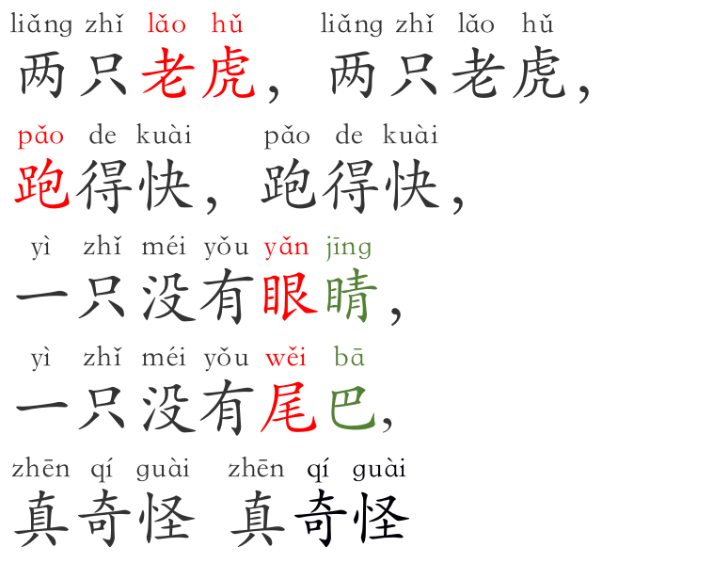

《两只老虎》
pǎo
Run
Notes:
讲解“跑”

Slide 9
《两只老虎》

Slide 10
《两只老虎》
Task:
Use different color to highlight measure word and new words we learned today.
CH: Translate the lyrics into English.
EX CH: Guess what 奇怪 mean.

Slide 11
Let’s sing!

Slide 12

Beat a drum to spread a toy
While one student playing the drum, the other students pass on toys quickly.
When the drum stops, the student who holds the toy becomes a challenger.
He/she needs to pick up a question from the lucky box and answer it. If he/she cannot do it, he can get one student to help him.
The rest of the students will be the judges.

Slide 13
END

Slide 14
Write a introduction of the pet(s) you and your family members have
At least 40 words
use suitable measure word
use adj. words to describe the pet(s)
use 和、也、但是 to upgrade your sentences level
use Intensifiers to achieve highest possible level
Notes:
to to upgrade your sentences level
-CH: Use intensifiers to achieve highest possible level

