Slide 1


Starter:
-Write down today’s day, date and weather
-Copy the word below 3 times.
yán sè
color
CH: How many colors does this rainbow have? (number in Hanzi)
EX CH: Translate dog(s)’ color

Slide 2



color

Slide 3
L.O the words of colour
-Hot: Understand colours
-Hotter: Say them
-Sizzling: Recognize the Hanzi
白色、黑色、红色、蓝色、黄色、绿色
-CH: Be able to talk about what color you like

Slide 4
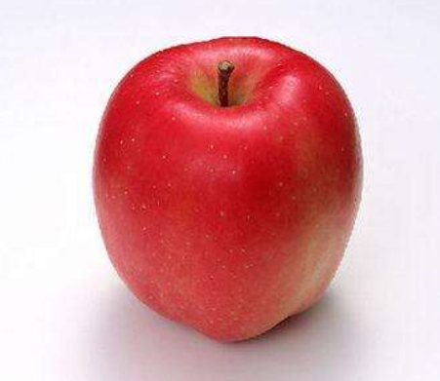
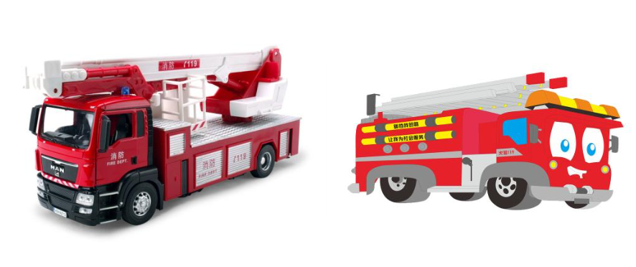


hóng sè
红 色
hóng sè
红 色

Slide 5
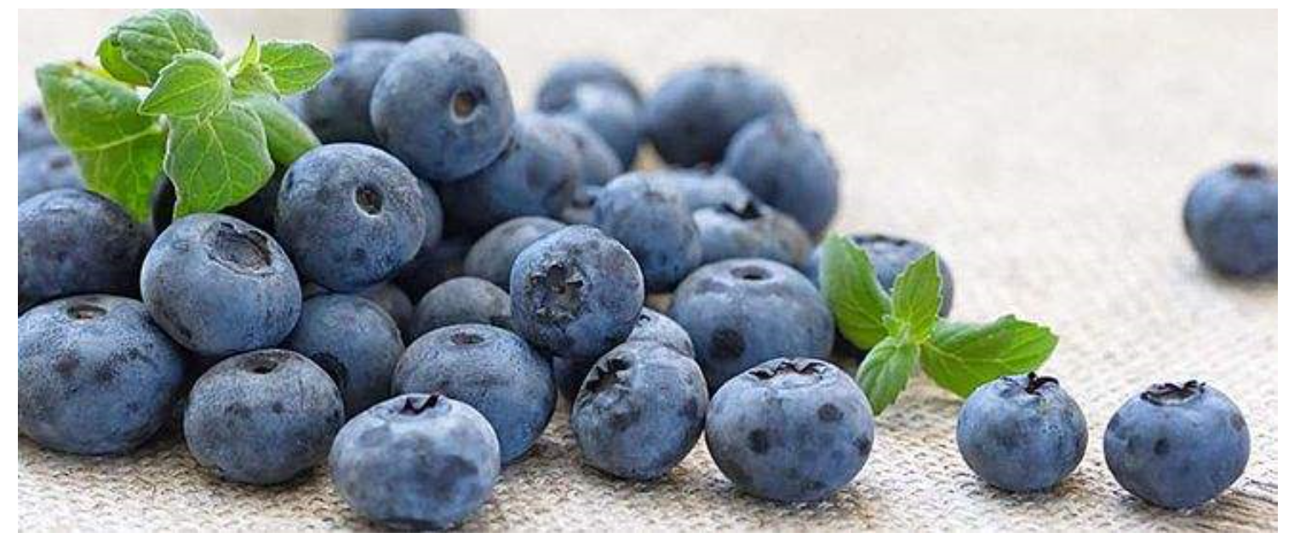


hóng sè
红 色
lán sè
蓝 色

Slide 6



hóng
色
bái
色
lán
色
Notes:
How many color in UK flag?
什么颜色？
带读：红色红色红色
什么是红色的？
什么是白色的？
什么是蓝色的？
白：最简单的字
红：
蓝：
教师问学生
谁有白色的小狗？
你有几只白色的小狗？
谁有蓝色的cup？
谁有白色的bag？

Slide 7
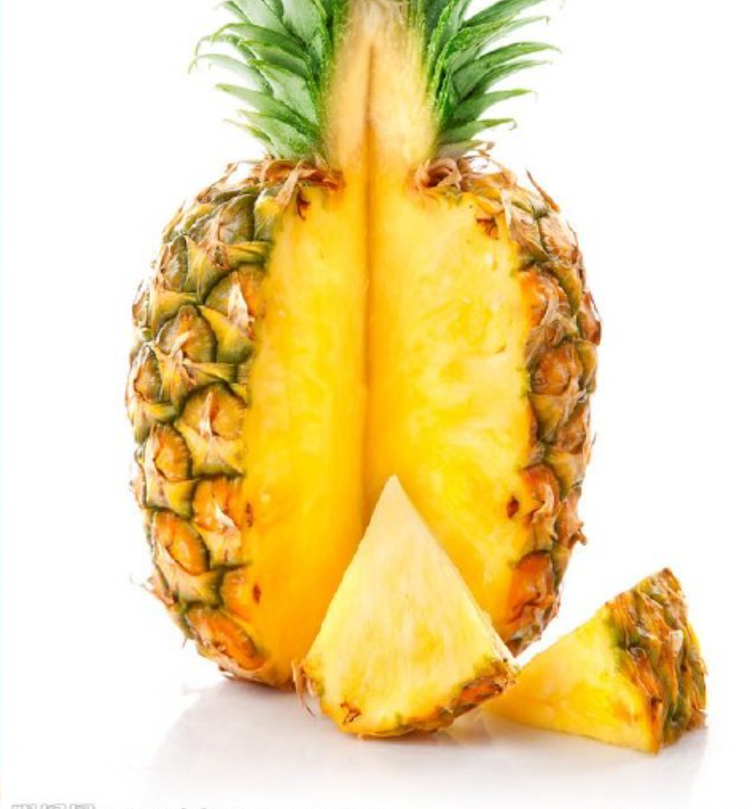
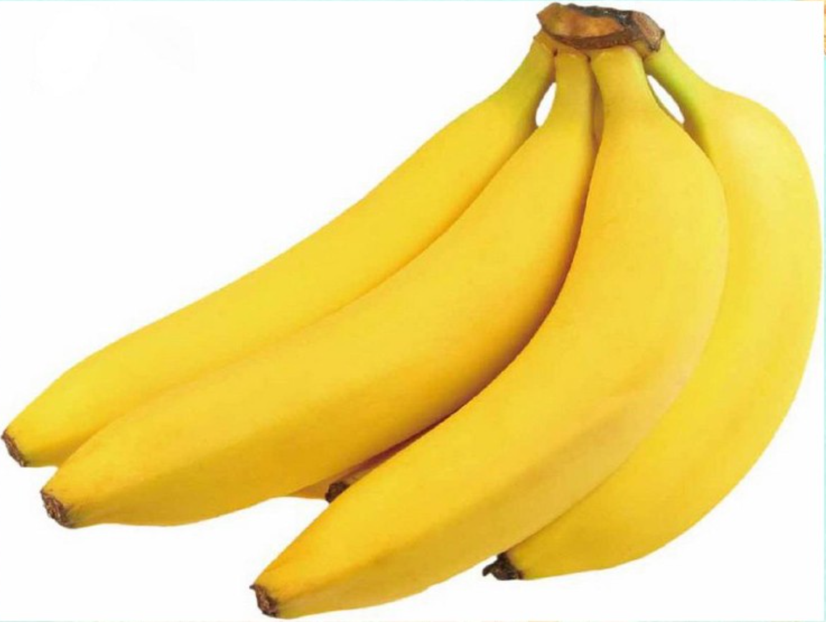

hóng sè
红 色
huáng sè
黄 色

Slide 8
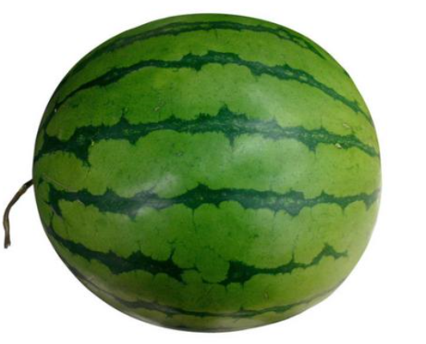

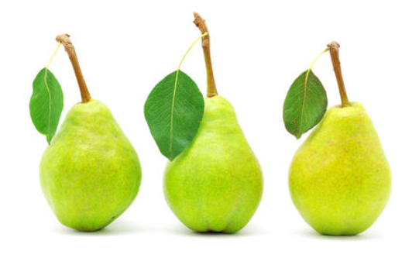
hólǜ sè
绿 色 ng sè
红 色
lǜ sè
绿 色

Slide 9
hēi sè
黑 色

Slide 10
lǜ sè
lán sè
hóng sè
huáng sè
蓝色
红色
黄色
绿色
bái sè
hēi sè
白色
黑色
Notes:
Which one you think is most special to you?
什么颜色？
提问：中国国宝的颜色？

Slide 11
Find out
颜色
六
二
三
lǜ sè
lán sè
hóng sè
huáng sè
蓝色
红色
黄色
绿色
bái sè
hēi sè
白色
黑色
Notes:
Which one you think is most special to you?
什么颜色？
提问：中国国宝的颜色？

Slide 12
Listening
Example:
red
green
yellow
blue
white
black
Draw a box-like left side.
Fill in six colour words in English randomly. If you are not sure their pronunciation in Chinese, write Pinyin to remind yourself.
If the color word teacher says on your box’s top or bottom, delete it. If not, wait next chance.
The winner will be the one who deletes all the words first.
hóng sè
lǜ sè
huáng sè
lán sè
bái sè
hēi sè
CH: Write the pets you hear.

Slide 13
Find out criminal
One student is Police, waiting outside
One student is Criminal, staying inside.
While Criminal saying the word on the top, the other students keep saying the word on the bottom.
When Police coming in, he/she needs to find out Criminal (who says the different word).
When police is close to the criminal, the criminal need to make his voice down.

Slide 14
Find out criminal
huáng sè
黄色
hóng sè
红 色
Notes:
TPR
动觉型

Slide 15
lán sè
蓝色
huáng sè
黄色

Slide 16
hóng sè
红色
lǜ sè
绿色

Slide 17
hēi sè
黑色
bái sè
白色

Slide 18
lǜ sè
绿色
lán sè
蓝色

Slide 19
bái sè
白色
hēi sè
黑色

Slide 20
Find out
颜色
-Work in group! 2 minutes! Find out the colors we just learned.
Challenge: Find out one things you have in 三 colors.
Bigger Challenge: Find out one things you have in 四 colors.
Super Challenge: Find out one things you have in 六 colors.
E.g. This flag has three colors.
CH: Translate the sentence
What color you have? in Chinese.
Notes:
Tips：学生可以自己制作有以上六种颜色的物品
交流
发现
创造

Slide 21
Mix & Match
1 红色
A
B
C
D
E
F
2 白色
Match Letter and number, E.g.A-3
3 绿色
CH: Write English for them.
EX CH: Choose one Character you think most difficult, think of how to remember and
share you experience with the whole class later.
4 黑色
5 蓝色
6 黄色

Slide 22


xǐ huān
CH: use 和
EX CH: use 也
Super CH: Find out how to say dislike
like
你喜欢什么颜色？
我喜欢 ____。
(绿色)

Slide 23
Reading
Task: Highlight the words of color.
CH: Highlight all the intensifiers.
EX CH: What meaning of “黑白色”
Super CH: Write what color of pet(s) you like.
我家有六口人。我喜欢绿色，爸爸也喜欢绿色。但是妈妈很喜欢蓝色。弟弟有点喜欢黄色的兔子。姐姐非常喜欢红色的猫。哥哥最喜欢黑色和白色。他有一条黑白色的蛇。

Slide 24



Task: Copy down these words in 1 time and write Pinyin and English for them.
CH: Answer the question in Chinese: 你喜欢什么颜色？
EX CH:Translate I most like green.
lǜ sè
lán sè
hóng sè
huáng sè
绿色
蓝色
红 色
黄色
bái sè
hēi sè
白色
黑色

Slide 25
END

Slide 26

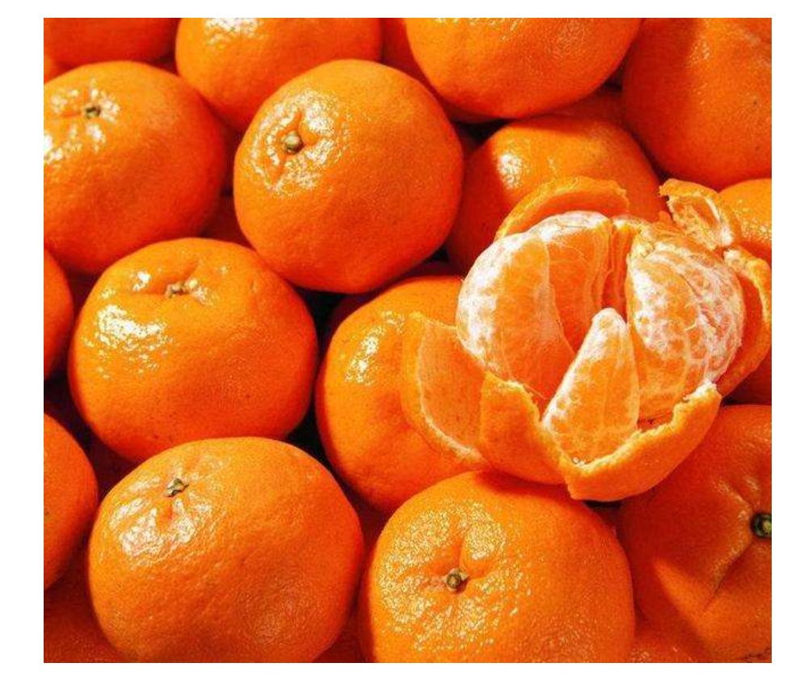
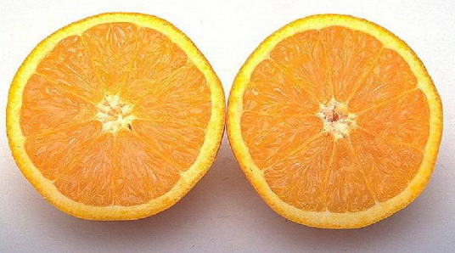
chéng sè
橙 色
chéng sè
橙 色

Slide 27
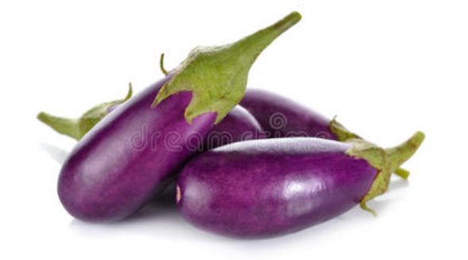
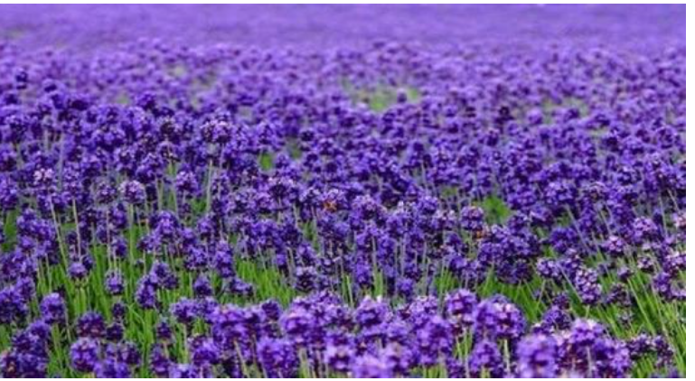
hóng sè
红 色
zǐ sè
紫 色

Slide 28
Let’s sing!

Slide 29

https://www.youtube.com/watch?v=UulTlStNp5k

