Slide 1


Starter:
-Write down today’s day, date and weather
-Copy the word below 3 times.
xǐ huān
like
CH: Translate and write down in Chinese: I extremely like bule.
EX CH: Speak out [ I don’t like white.] in Chinese?
Notes:
Ex Ch:你是让她们做什么呢？写Pinyin？汉字还是就是speak out?

Slide 2
Pets-Color 5.3
Revision
汉字书法-喜
https://www.youtube.com/watch?v=uX4qq6RxO5o
Notes:
60min
7min Starter
3min 快速复习
5min 两个新词
5min Binggo
10min "的"讲解与练习
10min Slap the board
10min Listening
5min Reading
10min Translate
5min 喜欢 问句-讲解
5min 活动
10min 小组展示
你在设计课的时候只能有52分钟左右的时间，

Slide 3
L.O Revision of the topic of Pet(s)
-Hot: review 6 colour words and learn the 2 more colours喜欢白色、黑色、红色、蓝色、黄色、绿色
-Hotter: use colour words to describe pet(s) 的
-Sizzling: use the adj. to talk about what pets you like.
-CH: Use conjunctions and intensifiers to achieve highest possible level

Slide 4
Review
lǜ sè
lán sè
hóng sè
huáng sè
绿色
蓝色
红 色
黄色
bái sè
hēi sè
白色
黑色
Notes:
随机提问
指向具体物体，问颜色

Slide 5

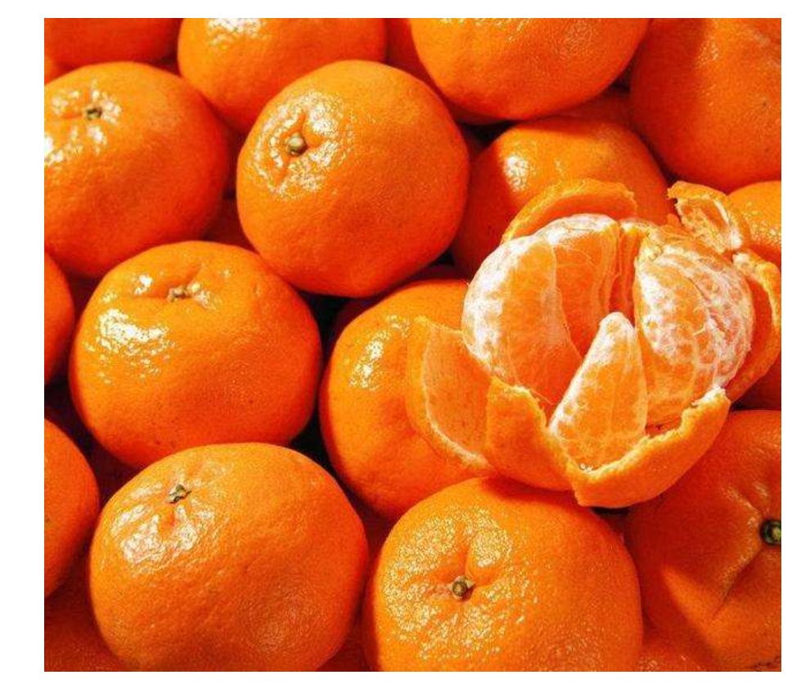
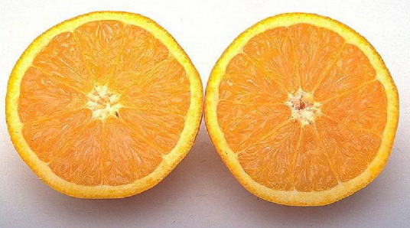
chéng sè
橙 色
chéng sè
橙 色
Notes:
你在这里可以
问他们rainbow都有什么颜色去引出新的颜色

Slide 6
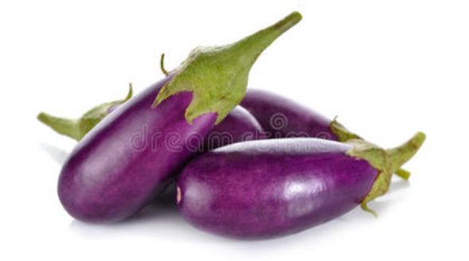
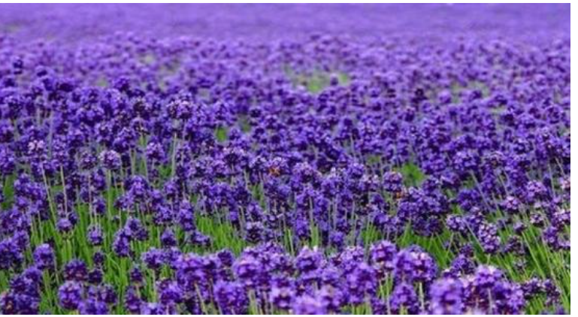
hóng sè
红 色
zǐ sè
紫 色

Slide 7
Describe the pets with colours
colour + 的+ pet
白色
的
狗
CH: How to say Two white dog in Chinese.
EX CH: How to say A cute white dog in Chinese.
红色
的
鸟
的
蓝色
鱼
一只可爱的白色的狗
Notes:
你的生日
他的宠物

Slide 8

the board
& describe the pets
The whole class will be divided into two groups. Every Group picks one challenger . The teacher will choose speaker from two groups randomly.
The challengers should listen to speaker carefully,
then slap the colour as soon as possible.
The challengers only have one chance to slap the board.
The winner stays on the stage, the loser comes back to seat.
1.Speaker:
Use colour+的+pet(s) to describe the picture: 5 score
Use measure word and colour+的+pet(s) : 10 score
2. Challenger: Slap the correct Picture: 5 score

Slide 9

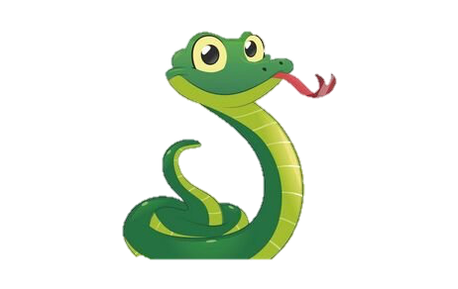
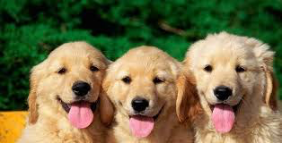

CH: use colour+的+pet(s) (5 score)
EX CH: use measure word + adj.+ pet (10 score)
the board & describe the pets

Slide 10
What …… your like?
xǐ huān
你叫什么？
like
你有什么宠物？
CH: use intensifiers to ask question
EX CH: How to say What color you don’t like? in Pinyin.
你喜欢什么宠物？
你喜欢什么颜色？
你喜欢什么国家？
Notes:
How to say what weather you like?
How to say what pet you like?
你喜欢什么国家？
名字学生没有学
这里的CH最好用不同的intensifies
还可以是否定疑问句

Slide 11
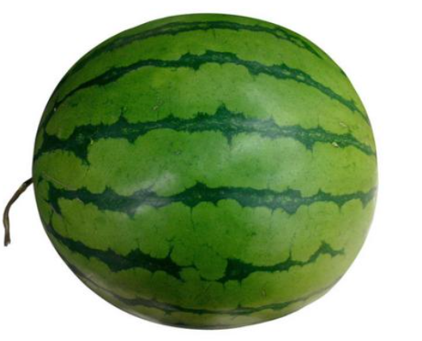
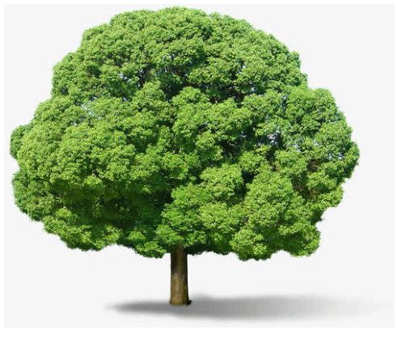
你喜欢什么颜色？
(绿色)
我喜欢 ____。
Notes:
Intensifier

Slide 12
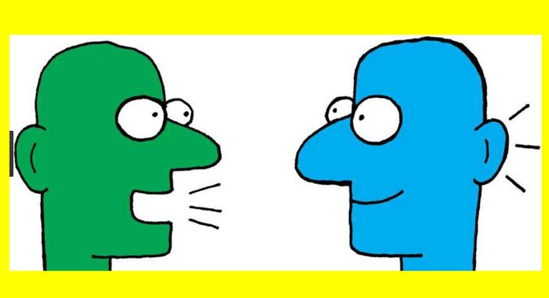
Do a survey: 你喜欢什么颜色？
-Draw a table like below.
-Interview at least 4 classmates and find out what color he/she likes.
名字 | 颜色
Student A
Student B
Student C
Student D
CH: use 和 ; 也
EX CH: use intensifiers
Super CH: use 但是

Slide 13
Reading
CH: Highlight all the intensifiers and connective words.
EX CH: What is the meaning of “黑白色”
Super CH: Translate the last sentence.
我家有六口人。我喜欢绿色，爸爸也喜欢绿色。但是妈妈很喜欢蓝色。弟弟有点喜欢黄色的兔子。姐姐非常喜欢红色的猫。哥哥最喜欢黑色和白色。他有一条黑白色的蛇。我很喜欢漂亮的橙色的鱼。

Slide 14
Translate:
1.我有一只绿色的猫。(in English)
2.哥哥有一只蓝色的狗。(in English)
3.My dad has a purple rabbits.(in Pinyin)
4.She has a cute green tiger. (in Pinyin)
CH: Write a sentence to describe your or your friends’ pet(s) with words of color in Chinese.
EX CH: use adj.+colour to describe the pet(s).

Slide 15
Translate:
1.我有一只绿色的猫。
2.妹妹有两条黑色的鱼。
3.哥哥有一只蓝色的狗。
4.I have three orange birds.
5.My dad has a purple rabbits.
6.She has a cute green tiger.
CH: Write a sentence to describe your or your friends’ pet(s) with words of color in Chinese.
EX CH: use adj.+colour to describe the pet(s).
Notes:
你新教的颜色没有在这里

Slide 16
END

Slide 17
漂亮
的
蓝色
的
鸟
Super CH: How to say I have a extremely beautiful blue bird. in Chinese.

Slide 18

Homework Example
我叫Lily。我十二岁。我有很多朋友。
我的朋友Jack有一条白色的兔子。
我的朋友Lucy有两只黄色的小猫。
我的朋友Sam有一只黑白色的小狗。
我的朋友Cassia有六条红色的小鱼。
我的朋友Beth有两只蓝色的小鸟和一条绿色的蛇。
但是我没有宠物。我有点伤心。
Please draw some pictures to show the passage.（If you are not good at drawing, find the right pictures from the Internet, print them, stick in your book and then fill them into right colour.
CH: find the words’ meaning of 朋友、黑白色
EX CH： Could you help Lily choose a pet? Write its Chinese name and write an introduction of it. Eg. 白色的小猫
Lucy: 两只黄色的小猫

