Slide 1
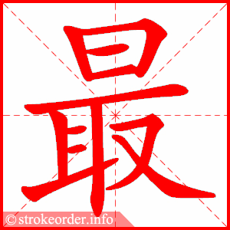
Starter:
-Write down today’s day, date and weather
-Copy the word below 3 times.
zuì
Intensifier: most
CH: translate in Hanzi: most like
EX CH: Write down a sentence to talk about the colour you most like.

Slide 2
Task 1 Translate:
1.我有一只绿色的猫。(in English)
2.哥哥喜欢蓝色的狗。(in English)
3.My dad like purple rabbits.(in Pinyin)
4.She has a cute green tiger. (in Pinyin)
Task2
Write a sentence to describe your or your friends’ pet(s) with words of color in Chinese
CH: intensifiers
EX CH: connective+ negative

Slide 3
Self assessment
www
1. beautiful writing
2. colours to describe pets
3. measure words
4.adj in your sentences
5. intensifier
6. connective words
7. negative sentences
EBI
1. accuracy of characters
____________________
2. measure words
3.adj in your sentences
4. intensifier
5. connective words
6. negative sentences

