Slide 1



Speak out Chinese!
Which one is missing?
开心
累
有点
很
忙
非常
忙
很开心
难过
非常

Slide 2
Which one is missing?
有点
累
开心
很
忙
非常
忙
很开心
难过
非常

Slide 3
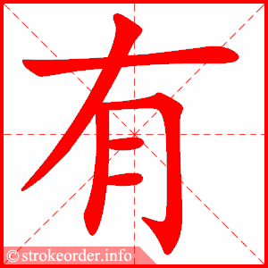
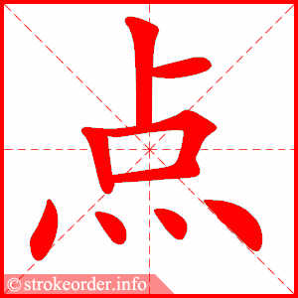
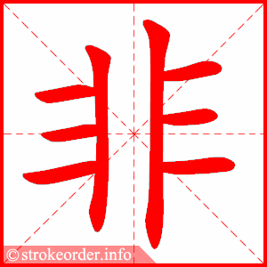
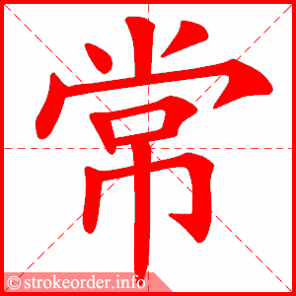
yǒu diǎn
Task 1: Copy down the Hanzi, Pinyin and English 3 times.
a little bit
fēi cháng
CH: Translate“I a little bit busy.”
EX CH: Translate“Today I extremely happy.”
extremely

Slide 4
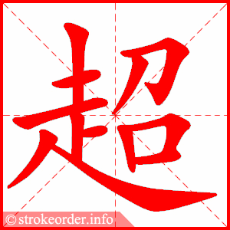
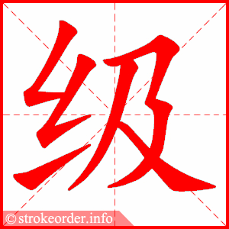
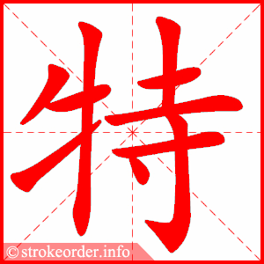
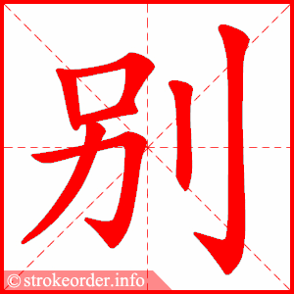
chāo jí
有点
非常
超级
很
super
特别
tè bié
especially

Slide 5
yǒu
fēi cháng
diǎn
Task 1: Copy down the Hanzi, Pinyin 2 times and add English for them.
Chāo jí
Tè bié
CH: Translate“I a little bit busy.”
EX CH: Translate“Today I extremely happy.”

Slide 6



Let’s Bingo!
超级棒！
Draw a Bingo grid with nine boxes.
Fill in boxes with nine words below.
Yan Laoshi will read some words.
If you have the word that Yan Laoshi has said, cross the box.
If you have all words crossed diagonally, across a row or vertically in a column, you should put your hands up and call “超级棒（bàng）”.
开心 | …
有点
特别
难过
忙
非常
很
开心
超级
累

Slide 7
Who can complete the sentence with intensifier?
我开心。（超级）
我快乐。（非常）
妈妈累。（特别）
哥哥忙。（很）
我难过。（有点）
我超级开心。

