Slide 1
学校 设施
Hot: learn some new words
Hotter: Talk about what facility your school has
Sizzling: use measure words
CH: Use connective words

Slide 2
Copy 3 times， write down Pinyin and English if you can.
Xué xiào shèshī
学校设施
School facilities
我的学校有五花八门的/各种各样的设施。
CH: translate: My school has all kinds of facilities.
EX CH: Write down any facilities that you know.

Slide 3
Vocab test
我的学校有五花八门的设施。我们不仅有大的运动场，而且有新的礼堂，另外/此外，我们还有/也有小的游泳池。然而/但是，我最喜欢的地方是图书馆因为我对看书特别有兴趣。

Slide 4
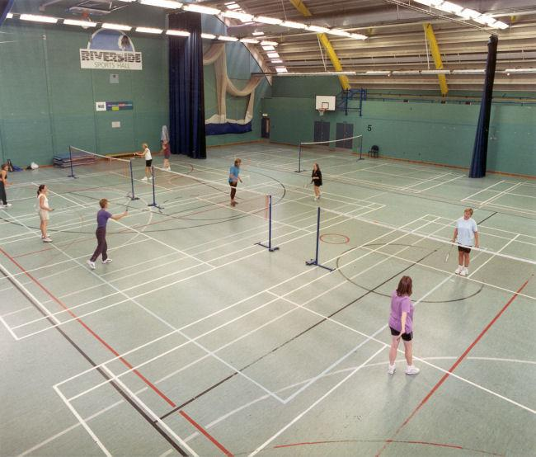
体育馆
guǎn

Slide 5
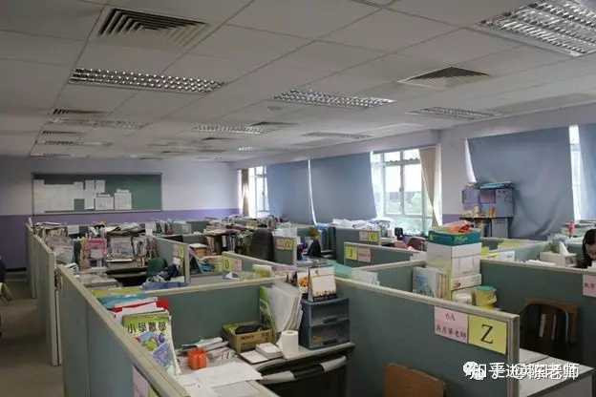
办公室
Bàngōngshì

Slide 6
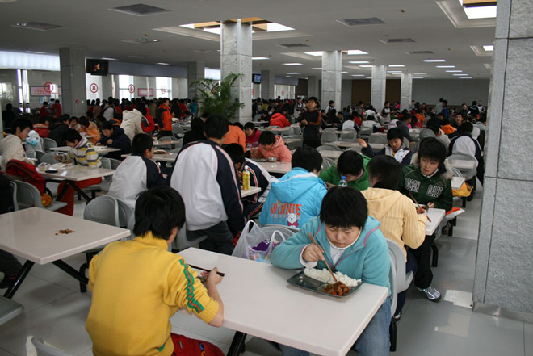
食堂
Shítáng

Slide 7
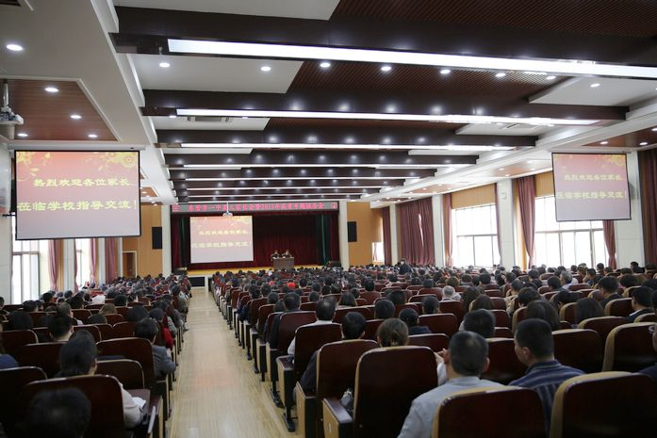
礼堂
Lǐtáng

Slide 8
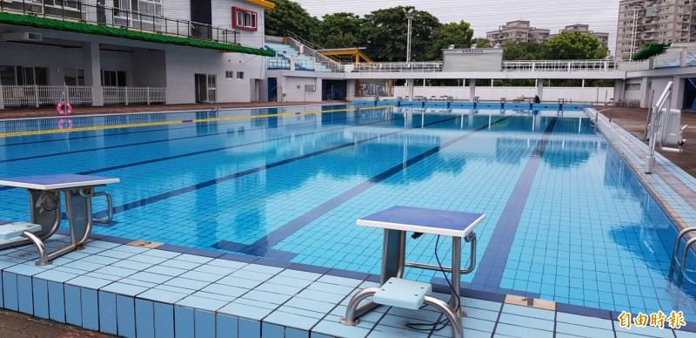
游泳池
chí

Slide 9
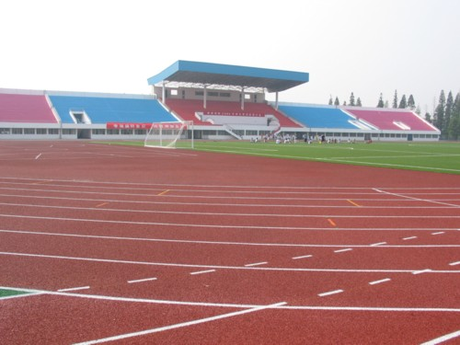
运动场
yùn dòng chǎng

Slide 10
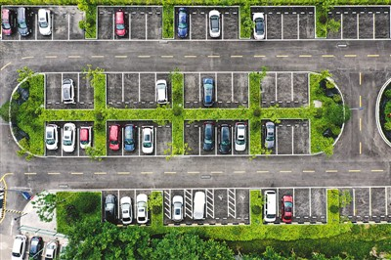
停车场
Tíngchē chǎng

Slide 11
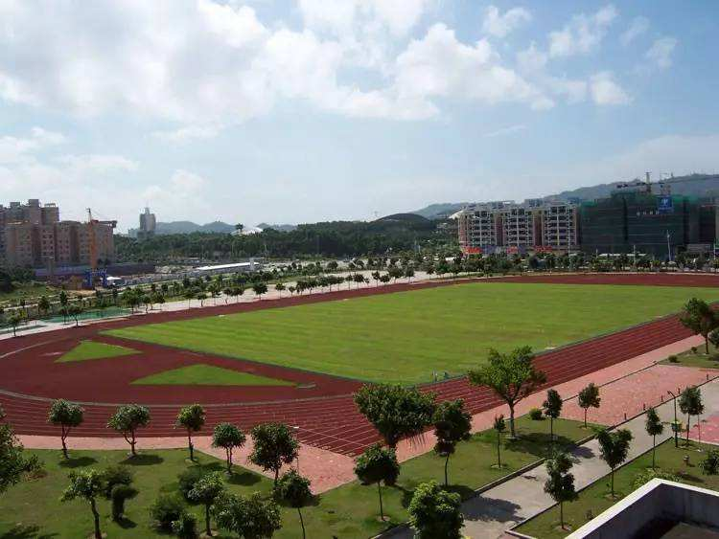
操 场
Cāo chǎng

Slide 12
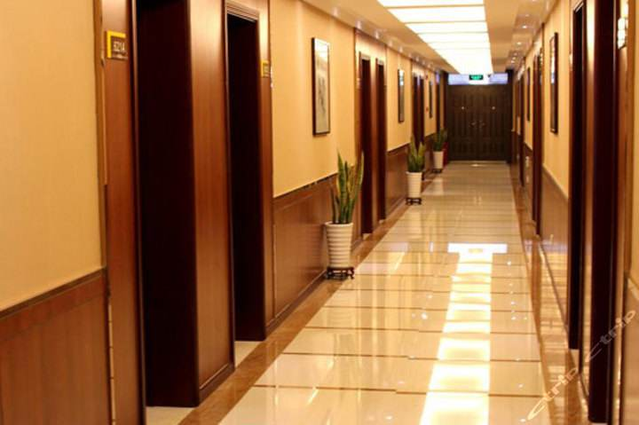
走廊
Zǒuláng

Slide 13
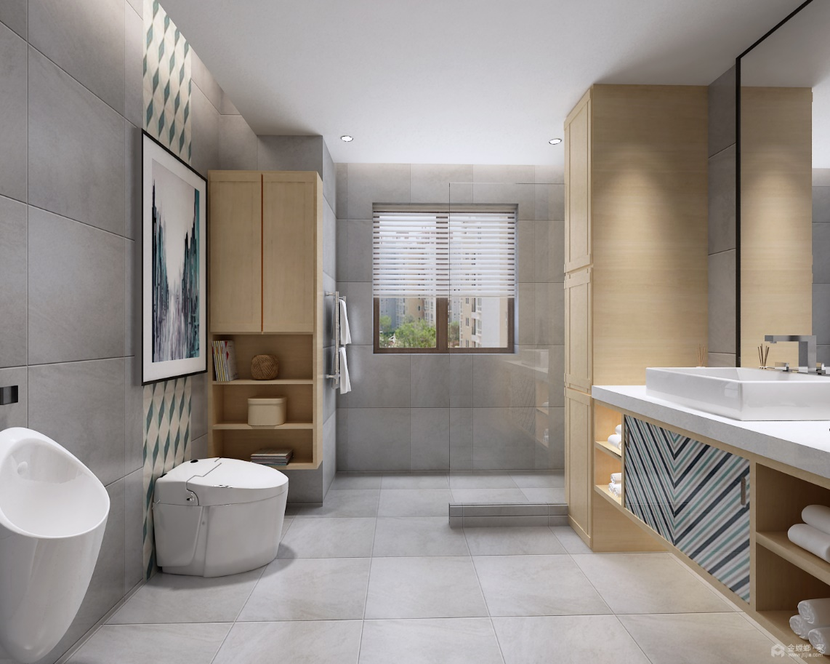
卫生间
Wèi

Slide 15
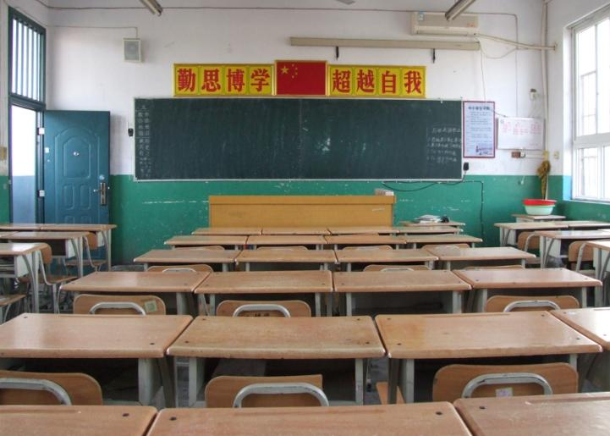

Slide 16
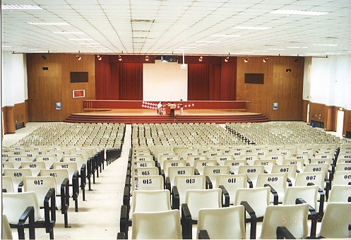
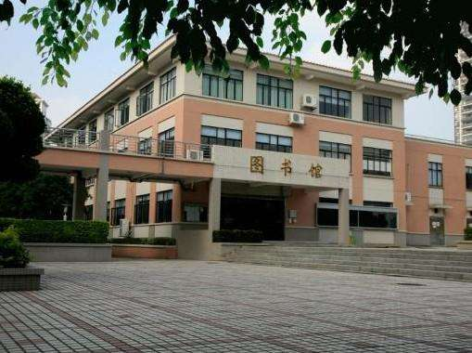

Slide 21


Slide 22
1. Túshū guǎn
2 tǐyùguǎn
3. Yóuyǒngchí
4. Shítáng
5. Lǐtáng
6. Jiàoshì
7. Bàngōngshì
8. Cāochǎng
9. Yùndòngchǎng
10. Jiàoxué lóu
11. Wèishēngjiān
12. Zǒuláng
1. 图书馆
2体育馆
3. 游泳池
4. 食堂
5.礼堂
6.教室
7.办公室
8.操场
9.运动场
10. 教学楼
11. 卫生间
12. 走廊
1.Library
2 gym
Swimming pool
Canteen
5. Auditorium
6. Classroom
7. Office
8. Playground
9. Sports ground
10. Teaching building
11. Bathroom
12. Corridor

Slide 23
Copy all new words in your books 1 time
You need to copy all words on P28 and the following words
学校设施
She shi
游泳池
chi
运动场
yùn dòng chǎng
停车场
tú shū guǎn
CH: Write down any connective words that you can use to connect the school facilities.
EX CH: Write a sentence with connective words to describe what facilities Highdown has

Slide 24
1. Túshū guǎn
2 tǐyùguǎn
3. Yóuyǒngchí
4. Shítáng
5. Lǐtáng
6. Jiàoshì
7. Bàngōngshì
8. Cāochǎng
9. Yùndòngchǎng
10. Jiàoxué lóu
11. Wèishēngjiān
12. Zǒuláng
1. 图书馆
2体育馆
3. 游泳池
4. 食堂
5.礼堂
6.教室
7.办公室
8.操场
9.运动场
10. 教学楼
11. 卫生间
12. 走廊
1.Library
2 gym
Swimming pool
Canteen
5. Auditorium
6. Classroom
7. Office
8. Playground
9. Sports ground
10. Teaching building
11. Bathroom
12. Corridor
CH: Write down any connective words that you can use to connect the school facilities.
EX CH: Write a sentence with connective words to describe what facilities Highdown has

Slide 25
Vocab test 11/02/2020
Translate
I relatively like school swimming pool because I am very interested in swimming; however, my favorite facility is library because I especially like reading.
我相比较喜欢学校的游泳池因为我对游泳很有兴趣。然而，
我最喜欢的设施是图书馆。

Slide 26
成语时间 Fill in the number
_______ 心(heart) _______ 意 (mind)
这个周末我不打算玩电脑游戏， 我一定要一心一意地学中文。

Slide 27
Reading P28 EXECEL Book
1. 1500 students and 95 teachers.
2. big playground
3. relatively small
4. classroom
5. Canteen; library; assembly hall

Slide 28



L.O. Listening , Reading & Writing about school facilities
Copy 3 times
Shí yàn shì
Experiment room
我的学校有六个不大不小的实验室。
CH: Translate: My school has 6 not big not small lab.

Slide 29
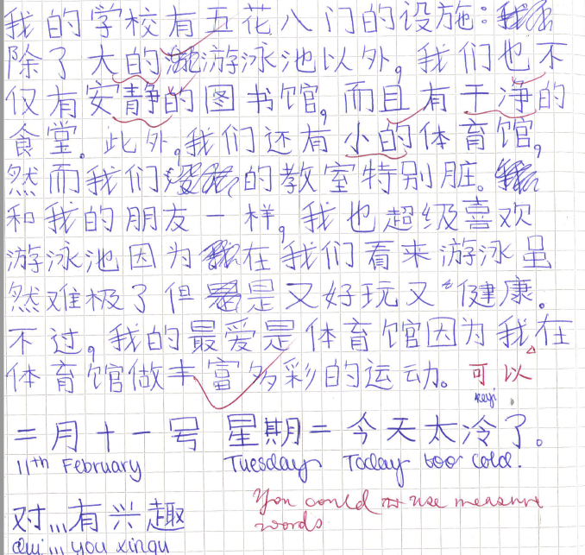

Slide 30
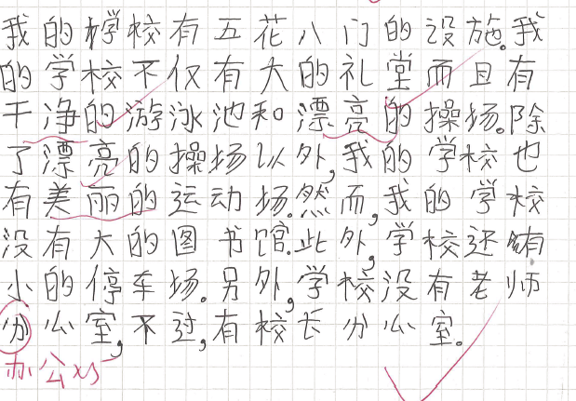

Slide 31
GUWU P27 EX 1
CH: copy and translate
图书馆是我最爱的地方因为
我相当喜欢看书；
所以放学后，如果我不做运动，
我jiu就then去图书馆看书。
EX CH: Translate:
School canteen物美价廉 cheap product good price.
A
B
C
D
E
F
G
H
vii
iii
Vi
V
Viii
I
Iv
ii

Slide 32
鼓舞 P27 Draw the table and write down each floor has what facilities
Lóucéng楼层floor
五楼
四楼
三楼
二楼
一楼
CH: Look at the pink box on the right, copy the words that you don’t know.
Copy the following and translate
做有趣的试验。
提高中文水平。

Slide 33
鼓舞 P27 Draw the table and write down each floor has what facilities
Lóucéng楼层floor
五楼
四楼
三楼
二楼
一楼
Gym, swimming pool, basketball court
library
Office;
Classroom, lab,
Assembly hall, canteen

Slide 34
同学们，早上好
我是你们的班主任王老师现在让我来介绍我们学校的教学楼。
我们的教学楼有五层高。一楼是礼堂。礼堂的右边是食堂，同学们可以在这儿吃午餐。二楼除了教室外，还有一个实验室，让大家上课时做有趣的实验。楼是学校办公室，你们可以在那儿找校长和老师。喜欢看书的同学可以去四楼的图书馆。

Slide 35
你们对中文书感兴趣吗?那儿有很多中文书，是提高中文水平的好地方。五楼是体育馆。里面有游泳池和篮球场。到了夏天，同学们可以来这儿游泳。
听完老师的介绍，同学们喜欢我们的教学楼吗?我们还有一个足球场，在操场旁边。喜欢踢足球的同学一定觉得很有意思。

Slide 36
Starter GUWU P26 EX1

Slide 37
IGCSE Listening p117 True or False
1 你的学校叫什么名字？
2 你们学校一gong共in total有多少老师
3 你们学校有什么设施？
4 游泳池在哪儿？
5 你们学校教学楼一共有几ceng层floor楼？
6 我要去哪一层zhao找look for=see校长？
1 D
2 B
3 A
4 E
5 F
6 C

Slide 38
IGCSE P117 LISTENING Fill in the English for your answers
1. 80
2.1500 一qian千五bai百
3. swimming pool 游泳池
4 gym 体育馆
5 canteen 食堂=饭堂=餐厅

Slide 39
Vocab test
My school has all kinds of facilities. We not only have big sports ground, but also have modern assembly. In addition, we have a small swimming pool. However, the place I most like is library because I am interested in reading.
我的学校漂亮极了因为我们有各种各样的树和五颜六色的花。 我不太喜欢学校的食堂因为我妈妈做的饭比食堂的饭好吃得多。
CH: My school is extremely beautiful because we have all kinds of tree
and colourful flowers. I don’t too much like canteen because
my mum’s cooking is a lot better than canteen’s food

Slide 40
L.O Using direction words to talk about your school facilities
Hot: Recap and learn some new words
Hotter: Understand the meaning of the direction words in sentences
Sizzling: make your own sentences
CH: Use high level expressions

Slide 41
GCSE BOOK p29 Ex3 Listening Fill in the blanks with English
Miss Zhang’s school is very ___1____. The school has ___2___ students. Apart from a big library, every ___3___ has a small library, very ___4___.
They also have two__5___ and a very big __6___.
1. big
2. 3000
3.Corridor
4. convenient
5. Gym, 6. Canteen

Slide 42
direction words
https://www.youtube.com/watch?v=L_4Fg3jpUaM

Slide 43


Copy 3 times
实验室在操场旁边。
CH: translate:
1 学校在公园旁边。
2 Lab is next to play ground.

Slide 44
IGCSE P97 EX 2
If you have any problem about the direction words, please see p96 as your reference
Pángbiān 旁边
北
前边
Duìmiàn 对面
左边
西
东
右边
后边
南
https://www.youtube.com/watch?v=L_4Fg3jpUaM

Slide 45
Copy 1 time and write down PM
大 小
干净 脏
安静 吵闹
漂亮 丑
CH: Use the words to describe your school
我的学校不仅有漂亮的校园，而且有小的游泳池，另外，我们也有大的运动场。但是，如果我们有更干净的教室，就更好了。

Slide 46
如果。。。,Person 就。。。＝If… person then
如果我的学校有更美味的食堂，我就天天在那里吃午饭。
如果我天天吃菜和喝牛奶，我就会非常健康。
如果我总是学习中文，我的中文就会越来越好。
如果我有时间，我就会去咖啡馆一边喝咖啡一边上网。

Slide 47
Vocab test 10/03/2020

Slide 48
GCSE BOOK p29 Ex 4
Zōngjiào＝RE
数学
历史
英语
宗教
戏剧
音乐
办公室
科学
地理
法语
美术
美术
Měishù=art
黄老师的教室在外语办公室的左边；吴老师的教室在外语办公室的右边。我们有时在黄老师的教室上课，有时在吴老师的教室上课。
CH: Mrs Huang’s classroom is on the left of foreign languages’ office. Mr WU’s classroom, is on the right of foreign languages’ office. We sometimes have lessons in Mrs Huang’s classroom; sometimes have lessons in Mr WU’s classroom.

Slide 49

Beat a drum to spread a toy
While one student playing the drum, the other students pass on toys quickly.
When the drum stops, the student who holds the toy becomes a challenger.
He/she needs to pick up a question from the lucky box and answer it. If he/she cannot do it, he can get one student to help him.
The rest of the students will be the judges.

Slide 50
击鼓传球 Y9
你的学校有什么设施？
漂亮的学校
安静的图书馆
人山人海的市中心
现代化的礼堂
我们不仅有大教室。
我们而且有美味的食堂
实验室在操场旁边。
校长办公室在游泳池对面。
你的学校在哪儿？
我的学校有五花八门的设施
我最喜欢的地方是图书馆。
因为我对看书相当有兴趣。

Slide 51
Vocab test
1. assembly hall
2. next to
3. headteacher’s office
4. art
5 drama
6. If I have time, then I

Slide 52


Copy 3 times.
CH: Copy and translate:
吴老师的英文说得特别快。

Slide 53
L.O. Extra curriculum
Mindmap leisure activities that you remember in Chinese
练体操
发邮件看⼩说
说汉语写汉字
娱乐活动
打太极拳
唱歌
跳舞
爬⼭
弹吉他

Slide 54
Verb+得+adj
1 他的吉他弹得非常好。
2 黄老师游泳游得比较慢。
3 她不仅歌唱得好听，而且舞也跳得好看。
4 吴老师跑步跑得相当慢。

Slide 55

Use direction words to make the sentence
Who can speak more?
Group competition! 6 students in one group.
Use (a)Verb+得+adv; or (b)如果。。。就。。。Or (c)一边。。。一边。。。Or (d)place A 在Place B +location words to say a sentence
Each group has only 1:30 minute. When one student finishes the first round, you will have chance to say second time.
The group that can say the most sentences will be the winner.
P2
Notes:
写+说

Slide 56

Running Dictation
Group work! 4 students in one group.
In each round, every group needs to choose one runner and one writer and swap roles in next round.
the runner needs to go to find Miss Yan and remember one sentence
then runs back to your partners and dictates the sentence.
the writer needs to write it down.
the runner is allowed to run back and forth if you forget some words.
We will have Four Round.
The winner is the group that finishes first.
e.g. 食堂在操场旁边。
Notes:
Running dictation
我家有五口人。
我有一只狗。
姐姐有一只大兔子。
哥哥有一只小猫和一只大狗。
妈妈有两条漂亮的小鱼。
爸爸有三只非常可爱的小鸟。
4人一组共6组，共24人
最后一组，3人一组
Choose a short passage or dialogue and make several copies. Put the copies up around the walls of the classroom (or even the school building).
Put the students in pairs or small groups.
The aim is for one of the students in each pair to walk (or run!) to read the passage on the wall.
They remember some of the passage and walk (or run!) back to their partner.
They quietly dictate what they remembered to their partner, who writes it down.
They then swap roles. Over several turns they will build the whole passage. This means they really do have to run back and forth because students will only remember three or four words at a time.
The winning pair is the team that finishes first – although you need to check for mistakes. If there are mistakes, they must keep walking to check!
A good idea is to teach them punctuation vocabulary beforehand if you want them to use the correct punctuation in English. It's a good way to check spelling and fabulous for pronunciation – and great memory training!

Slide 57
Running Dictation
1食堂在运动场对面。
2我的足球踢得相当好
3如果我有时间，我就和朋友一起去公园一边跑步一边聊天。
4 你的羽毛球打得怎么样？
5 礼堂在教室旁边。
6 她的汉字写得很漂亮。
7 我的好朋友歌唱得非常好听。
8如果我是校长，我会有更物美价廉的食堂。

Slide 59
Draw a map of your ideal school layout and describe it by using the following structure
除了。。。以外，
Chá wèi kē
察魏柯

Slide 60
去 qù
我去 运 动 场。
qù yùn dòng chǎng.
＝ I go to the stadium.
Notice that you leave out the word ‘to’.

Slide 61
Sentence Patterns:
1. I go to the library:
我去图书馆。
Ex. She goes to the classroom.
2. Where are you going?
你去哪儿？
Ex. Where is younger sister going?
3. Are you going to the hall?
你去礼堂吗？
Ex. Is Dad going to the sports ground?
她去教室。tā qù jiào shì
妹妹去那儿？mèi mei qù nǎr?
爸爸去运动场吗?
Bà ba qù yùn dòng chǎng ma?

Slide 62
Read and translate
1. 你去哪儿？
2. 我去礼堂。
3. 他不去礼堂，他去图书馆。
4. 我们去教室，我们不去体育馆。
5. 他们不去教室，他们去运动场。

