Slide 1


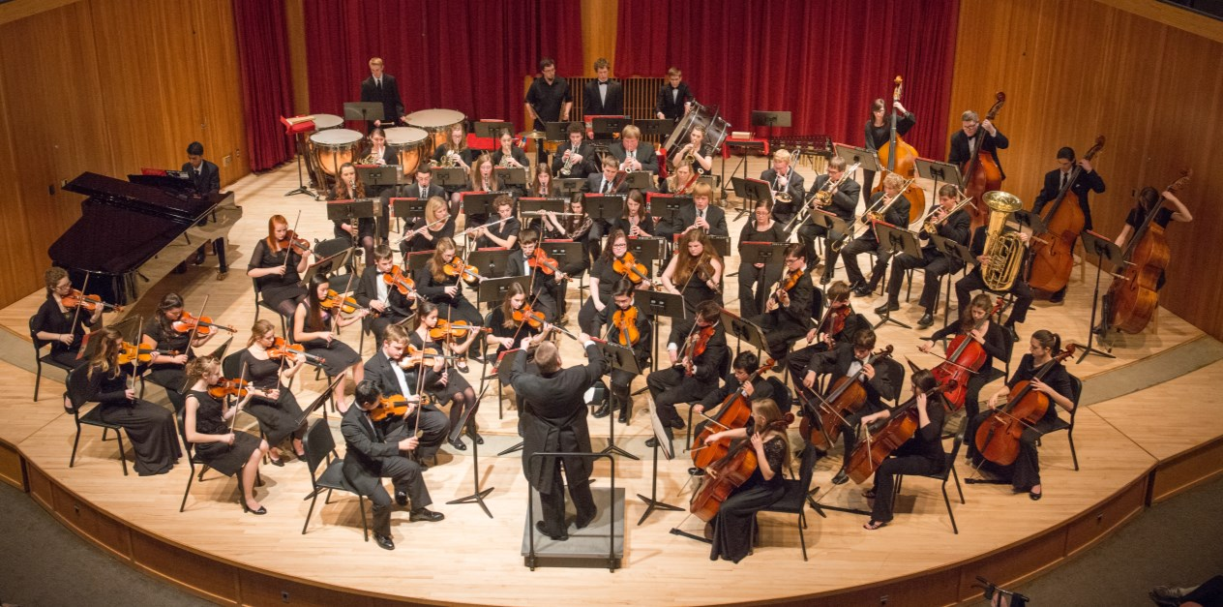
What do you see?
© WWW.MUSICALCONTEXTS.CO.UK

Slide 2
STARTER:
Look at the picture on the previous slide and answer the questions below in your exercise books:
What is the name of the group in the picture?
What do we call the only person not playing an instrument in the picture?
The group is divided into 4 families according to the type of instrument they play e.g. strings. Can you name the other 3 families of instruments?

Slide 3
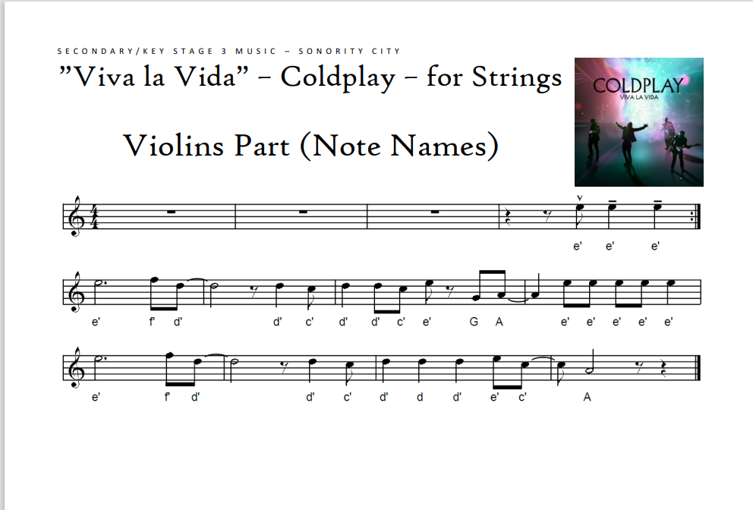
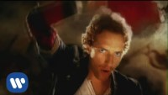
If you have a keyboard, select a string sound and see if you can play the tune below.
You could also use a virtual piano and select a string sound or instrument Virtual Piano - Play The Best Online Piano Keyboard
If you own a violin or cello I would love to hear you play this!
If you are not sure how the tune of Viva la Vida goes, watch the clip below

Slide 4
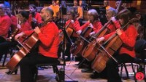
The String Family
Watch the following film about the string family:
In your exercise books write the title:
  The String Family
Using the information from the video, write down the names of the 5 instruments found in this section of the orchestra
For *BONUS POINTS* write down the names of two ways that you can play these instruments – use the internet to help you!

Slide 5
REMEMBER TO UPLOAD YOUR WORK TO CLASS CHARTS
Including any videos of you playing Viva la Vida – this is optional but will gain you a p2!

