Slide 1


Woodwind Family
STARTER:
Click on the yellow link below and play all the string and woodwind instruments. Once you have heard all the different timbres (their individual sounds), have a go at the quiz
Orchestra Games | Inside the Orchestra
© WWW.MUSICALCONTEXTS.CO.UK

Slide 2
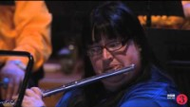
MAIN:
Watch the clip (BBC National Orchestra – Woodwind)
Once you have watched the clip complete the woodwind worksheet (sheet and listening tracks can be found on class charts)

Slide 3

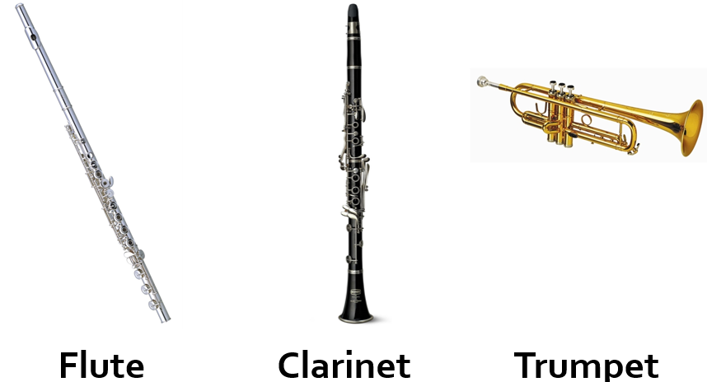
PLENARY- Odd One Out
There are 3 images of musical instruments printed below. Discuss which instrument is the ODD ONE OUT and give a reason why. You may come up with more than one reason HINT: You could think about pitch, size, material it is made from, how it is played and words describing the TIMBRE and SONORITY of each instrument.
© WWW.MUSICALCONTEXTS.CO.UK

