Slide 1



BRASS Family
STARTER:
Watch the following video clip and think about which instruments are the odd ones out………..why?
© WWW.MUSICALCONTEXTS.CO.UK

Slide 2
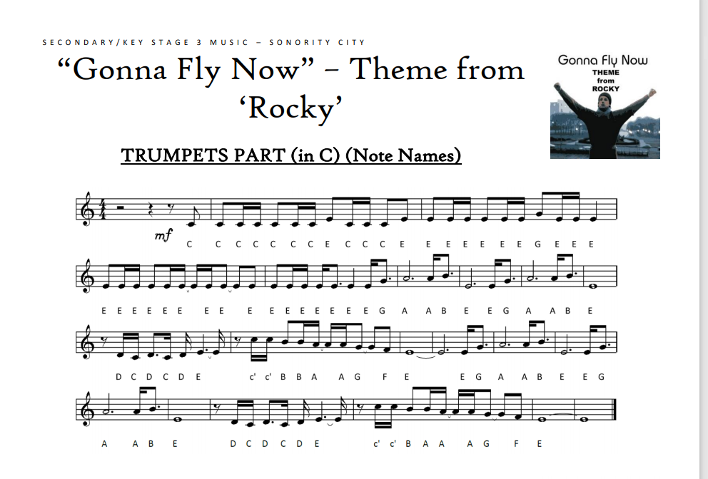

If you have a keyboard, select a brass sound and see if you can play the tune below.
You could also use a virtual piano and select a brass sound or instrument Virtual Piano - Play The Best Online Piano Keyboard
If you own a brass instrument, I would love to hear you play this!
If you are not sure how this melody sounds, watch the clip below:

Slide 3

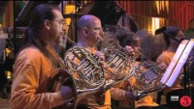
PLENARY
Watch the following clip – BBC National Orchestra Wales- Brass
In your exercise book write the title:
The Brass Family
List all the instruments that are mentioned in the video – check your spelling of their names
© WWW.MUSICALCONTEXTS.CO.UK

Slide 4
REMEMBER TO UPLOAD YOUR WORK TO CLASS CHARTS
Including any videos of you playing Gonna Fly Now – this is optional but will gain you a p2!

