Slide 1


STARTER:
On the following page complete the graphic score for the piece of music Fanfare for the Common Man. Listen to the track in order to do this, the track can be found on class charts.
Remember each symbol represents a different idea
© WWW.MUSICALCONTEXTS.CO.UK

Slide 2
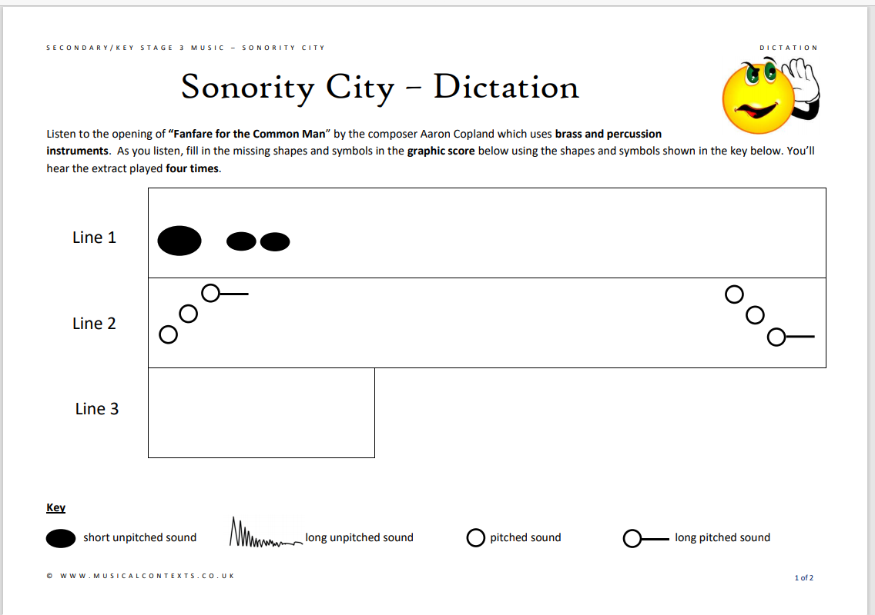

Slide 3
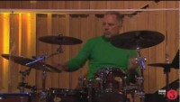
MAIN:
Watch the following film about the percussion family:
In your exercise books write the title:
  The Percussion Family
Using the information from the video, write down the names of all the percussion instruments mentioned

Slide 4
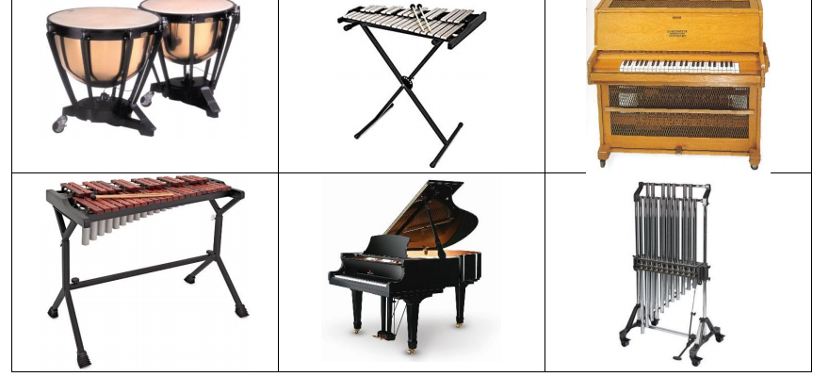
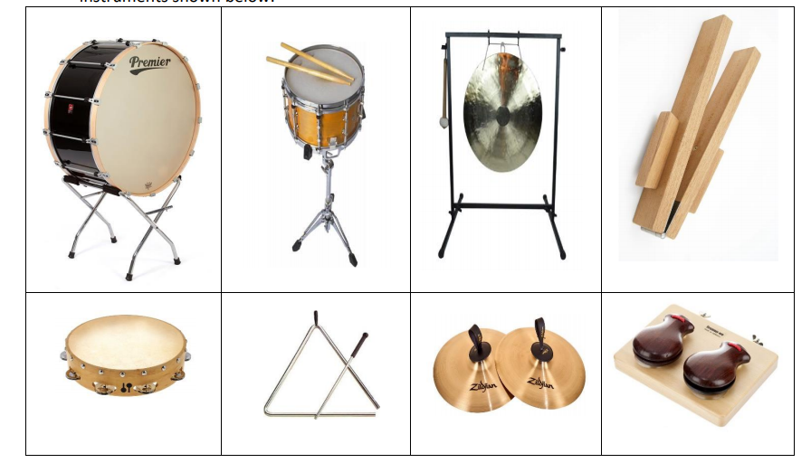
Now look at the pictures of the percussion instruments below:
Name the instruments (google the percussion family to help you) and write next to them whether they belong to tuned or untuned percussion your teacher will explain what this means.

Slide 5
CAREER STOP!
Interested in a career in music?
Watch the following video to find out how Arlo Parks achieved a career in the music industry
BBC Introducing: An interview with singer-songwriter Arlo Parks - BBC Bitesize

Slide 6
REMEMBER TO UPLOAD YOUR WORK TO CLASS CHARTS

