Slide 1


AFRICAN DRUMMING
POLYRHYTHM
SYNCOPATION
CALL AND RESPONSE
OSTINATO
DJEMBE
IMPROVISATION
Starter: Write the Following key terms in your exercise book with the title AFRICAN DRUMMING
Use the internet to find a definition of each

Slide 2

MAIN: Watch the following Clip:
Once you have watched the video, draw a picture in your book of the Djembe drum and label it with some of the key features outlined

Slide 3



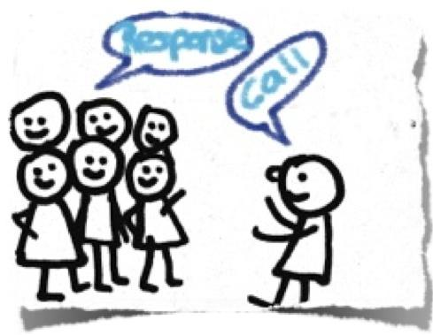
Silent Debate
Listen to this piece of AFRICAN DRUMMING.
How important is CALL AND RESPONSE to this music?
© WWW.MUSICALCONTEXTS.CO.UK

