Slide 1
SAMBA MUSIC

Slide 2

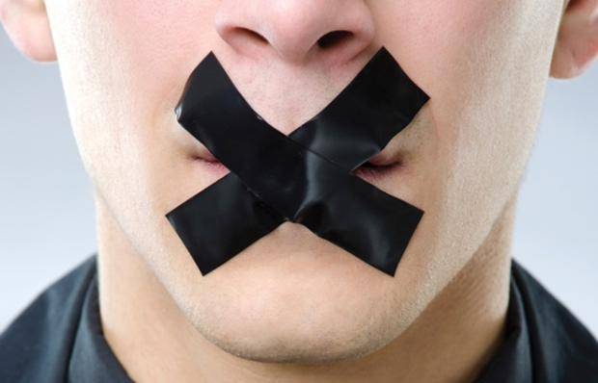
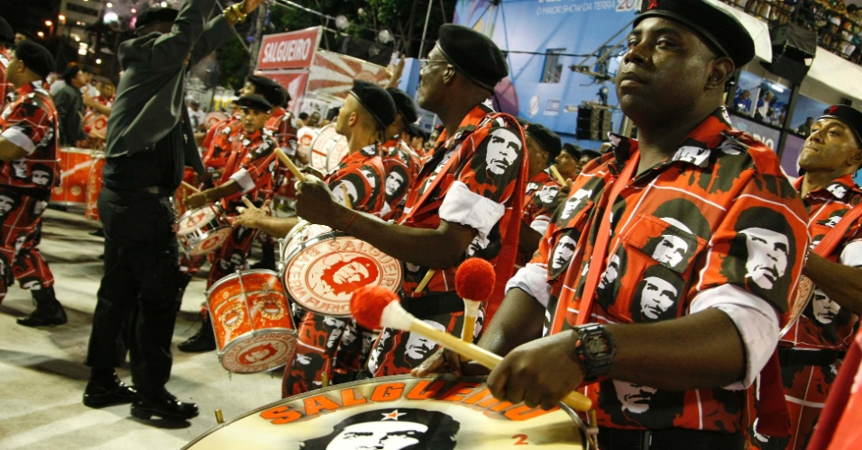

STARTER: SILENT Debate
Listen to this piece of Samba music from BRAZIL.
How important is the RHYTHM to this music?
© WWW.MUSICALCONTEXTS.CO.UK

Slide 3
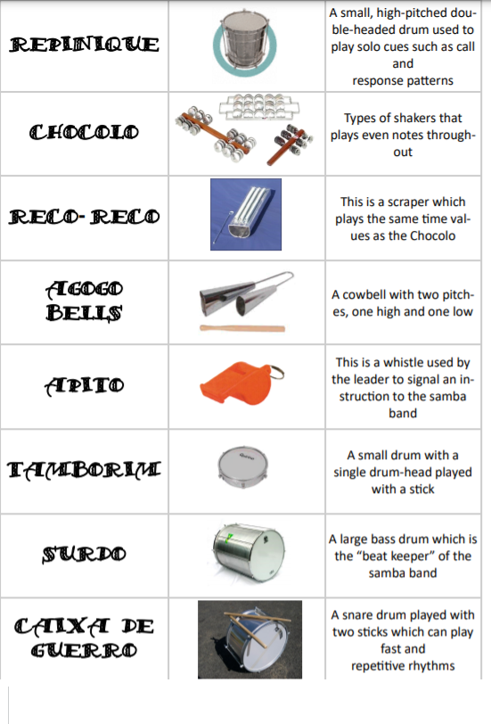

Watch the video clip, read through the information on this slide and then complete the crossword attached to class charts

Slide 4
PLENARY:
Have a look through your exercise books and revise your knowledge of Instruments around the world starting from week 1 – string instruments
Complete the FORMS quiz which tests your knowledge of all the instruments you have learned about this term

