Slide 1
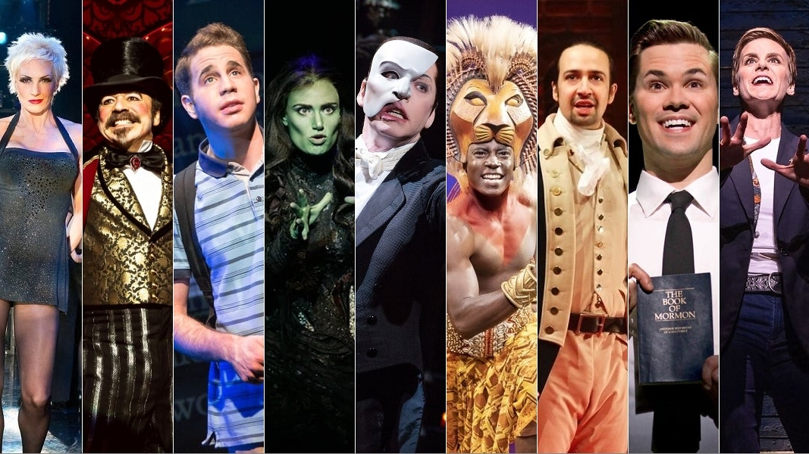
Musicals
Lesson 4

Slide 2
STARTER
1
2
Can you identify the musicals based on the images from this musicals quiz?
In your table pairs, discuss what they could possibly be.
There are 16 in total.
Whoever gets the most correct gets a P2!
3
4
No more than 10 mins

Slide 3
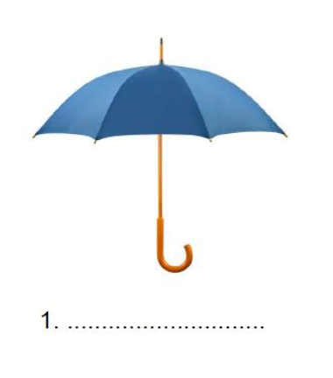
Musical 1

Slide 4
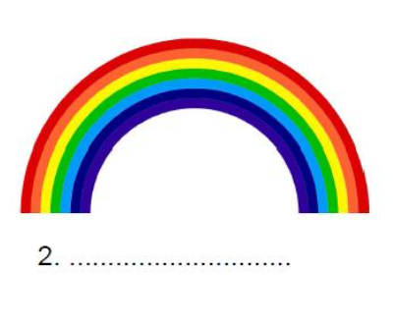
Musical 2

Slide 5
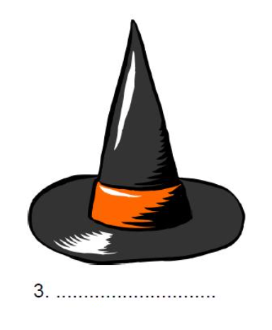
Musical 3

Slide 6
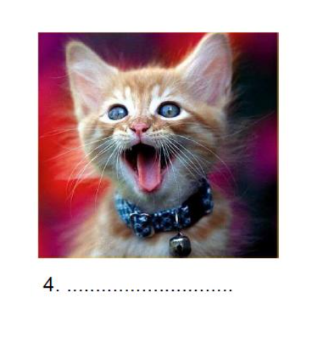
Musical 4

Slide 7
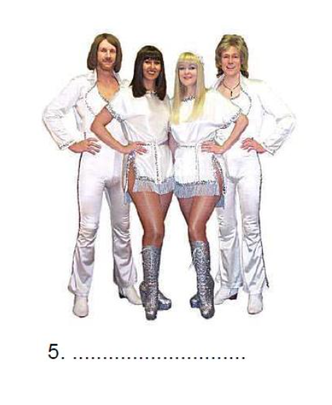
Musical 5

Slide 8
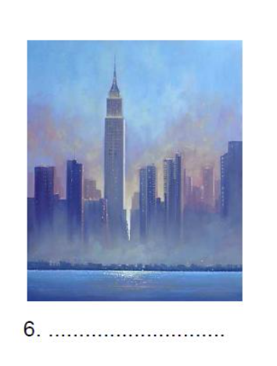
Musical 6

Slide 9
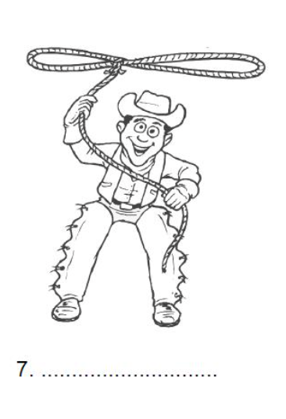
Musical 7

Slide 10
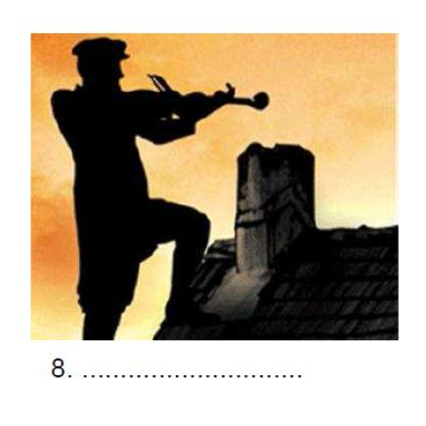
Musical 8

Slide 11
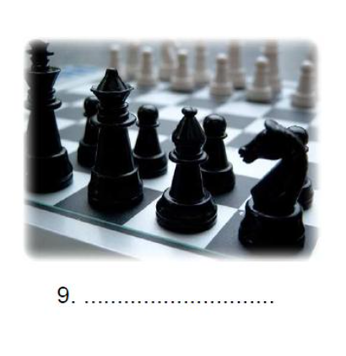
Musical 9

Slide 12
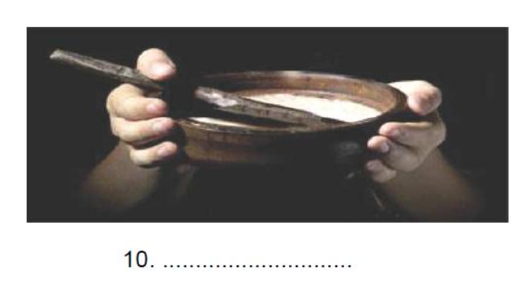
Musical 10

Slide 13
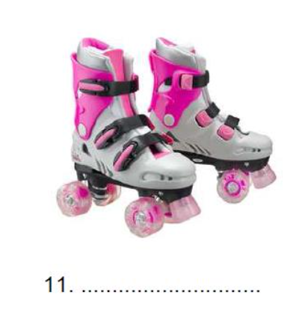
Musical 11

Slide 14
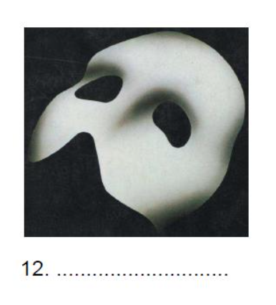
Musical 12

Slide 15
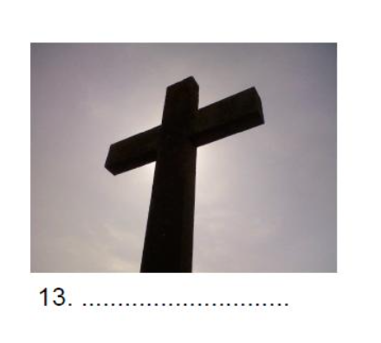
Musical 13

Slide 16
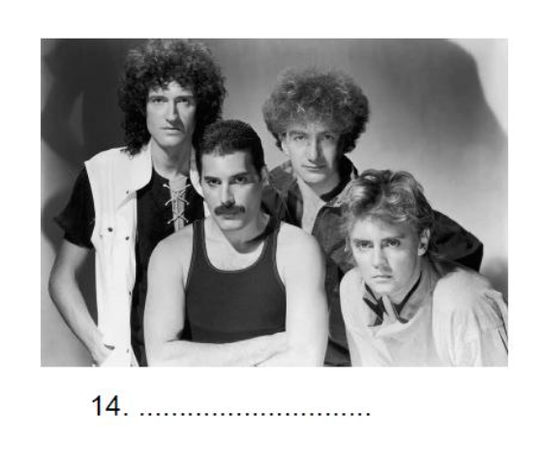
Musical 14

Slide 17

Musical 15

Slide 18
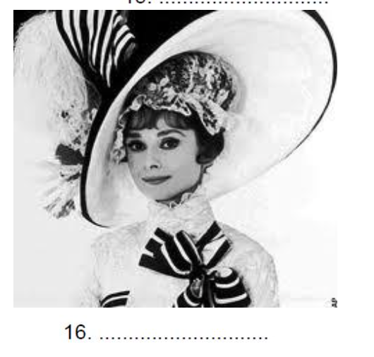
Musical 16

Slide 19
ANSWERS
Singing in the Rain - https://www.youtube.com/watch?v=D1ZYhVpdXbQ
The Wizard of Oz - https://www.youtube.com/watch?v=hHIdLmZc3JI
Wicked - https://www.youtube.com/watch?v=O5V9KwppMfs
Cats - https://www.youtube.com/watch?v=8gd_ohoPzYc
Mamma Mia - https://www.youtube.com/watch?v=DUjB9LTtzGg
Chicago - https://www.youtube.com/watch?v=vVyhM8gHXS8
Oklahoma - https://www.youtube.com/watch?v=O5APc0z49wg
Fiddler on the Roof - https://www.youtube.com/watch?v=RBHZFYpQ6nc
9) Chess - https://www.youtube.com/watch?v=OG3LqkXj9wQ
10) Oliver! Twist - https://www.youtube.com/watch?v=wZxky51fxCg
11) Starlight Express - https://www.youtube.com/watch?v=u-UoGYc906c
12) Phantom of the Opera - https://www.youtube.com/watch?v=XfTgCPUJwRk
13) Jesus Christ Superstar - https://www.youtube.com/watch?v=xX9fLQjqIZA
14) We Will Rock You - https://www.youtube.com/watch?v=_lt1z0RFjBQ
15) The Rocky Horror Show - https://www.youtube.com/watch?v=umj0gu5nEGs
16) My Fair Lady - https://www.youtube.com/watch?v=q5fW7sERw7I

Slide 20
BONUS STARTER (for the main task)
List as many musicals that you know as you can:
Musicals
No more than 2 mins

Slide 21
MAIN
Draw this table into your books
Type of song keyword | Meaning | Examples
Overture | A piece of music to open the musical, often including some of the key themes from the show.
Solo | A song for a single character.
Duet | A song for two characters. This is often male-female, though can be male-male or female-female as well.
Chorus | A number where everyone in the show performs together.
Ensemble | The ensemble is anyone in the cast with a solo line (however short!) An ensemble number will feature only these characters.
Dance | An extended dance number of any type.
Finale | The final piece of music in a musical – usually recycles common themes from throughout the production.

Slide 22
MAIN – Research Musical Theatre vocabulary
No more than 30 mins
TASK 1
Using your phones, you need to find examples of the following types of songs ‘keywords’ from Musicals:
Overture
Solo
Duet
Chorus
Ensemble
Dance
Finale
Find at least one example from a variety of musicals using YouTube or other music resources (e.g. Spotify, iTunes etc.)
DON’T USE THE SAME MUSICAL FOR EACH ONE! There are loads of different musicals
If you don’t have a phone, sit next to someone who does and work on this activity together.
Extension:
Can you find more examples?!

Slide 23

MAIN - Evaluation
No more than 5 mins
TASK 2
Write the following three questions into your books and write your answer:
From your research, what is your favourite example and why?
..........................................................................................................................................................................................................................................
2. Have you discovered a new musical that you hadn’t heard of?
.........................................................................................................................................................................................................................................
3. Will you now listen to more Musical Theatre?
..........................................................................................................................................................................................................................................

Slide 24
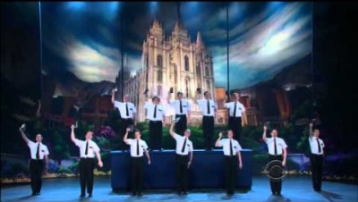
PLENARY
Watch this YouTube video of ‘Hello’ from The Book of Mormon Musical.
Count how many times they say ‘Hello’ in English in the whole musical performance.
What’s your answer?
https://www.youtube.com/watch?v=OKkLV1zE8M0

