Slide 1

Musicals
Lesson 5

Slide 2
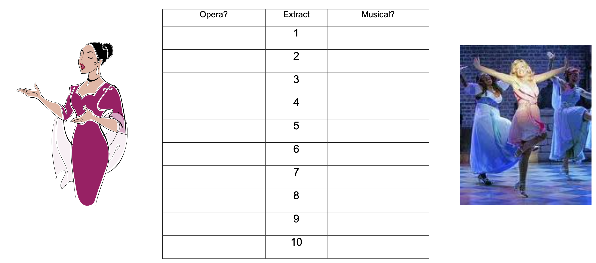
STARTER
Teacher…join in! You’ll be saying your answers afterwards!
Draw the table into your books.
We are going to listen to the following ten songs.
You will decide whether you think they are taken from an Opera or a Musical by ticking the appropriate column – teacher, don’t show it on screen!
1. https://www.youtube.com/watch?v=tSsNFPk2vNA
2. https://www.youtube.com/watch?v=am-eexBY1og
3. https://www.youtube.com/watch?v=Q_hLh4qCqpg
4. https://www.youtube.com/watch?v=i7LYwE5FXF4&list=PLwS7A8zTLxVpeFe-Xvuh2zX_OYHBZZ5e7&index=15
5. https://www.youtube.com/watch?v=M3S9B44dsE4&list=PLwS7A8zTLxVpeFe-Xvuh2zX_OYHBZZ5e7&index=25
6. https://www.youtube.com/watch?v=c-r2vu4t9-g
7. https://www.youtube.com/watch?v=pZcaf9GfyWs
8. https://www.youtube.com/watch?v=7Ff2pJMV9Es&list=PLwS7A8zTLxVpeFe-Xvuh2zX_OYHBZZ5e7&index=29
9. https://www.youtube.com/watch?v=ps52qEFiLbg&list=PLwS7A8zTLxVpeFe-Xvuh2zX_OYHBZZ5e7&index=63
10. https://www.youtube.com/watch?v=0Cd7s2ujr3c&list=PLwS7A8zTLxVpeFe-Xvuh2zX_OYHBZZ5e7&index=91

Slide 3
MAIN
Using the mindmap handout and the internet on your phones, research the questions on the board (on the next few slides) and write down the answers you find.
If you don’t have a phone, partner with someone who does and work on it together.
There are 9 questions

Slide 4
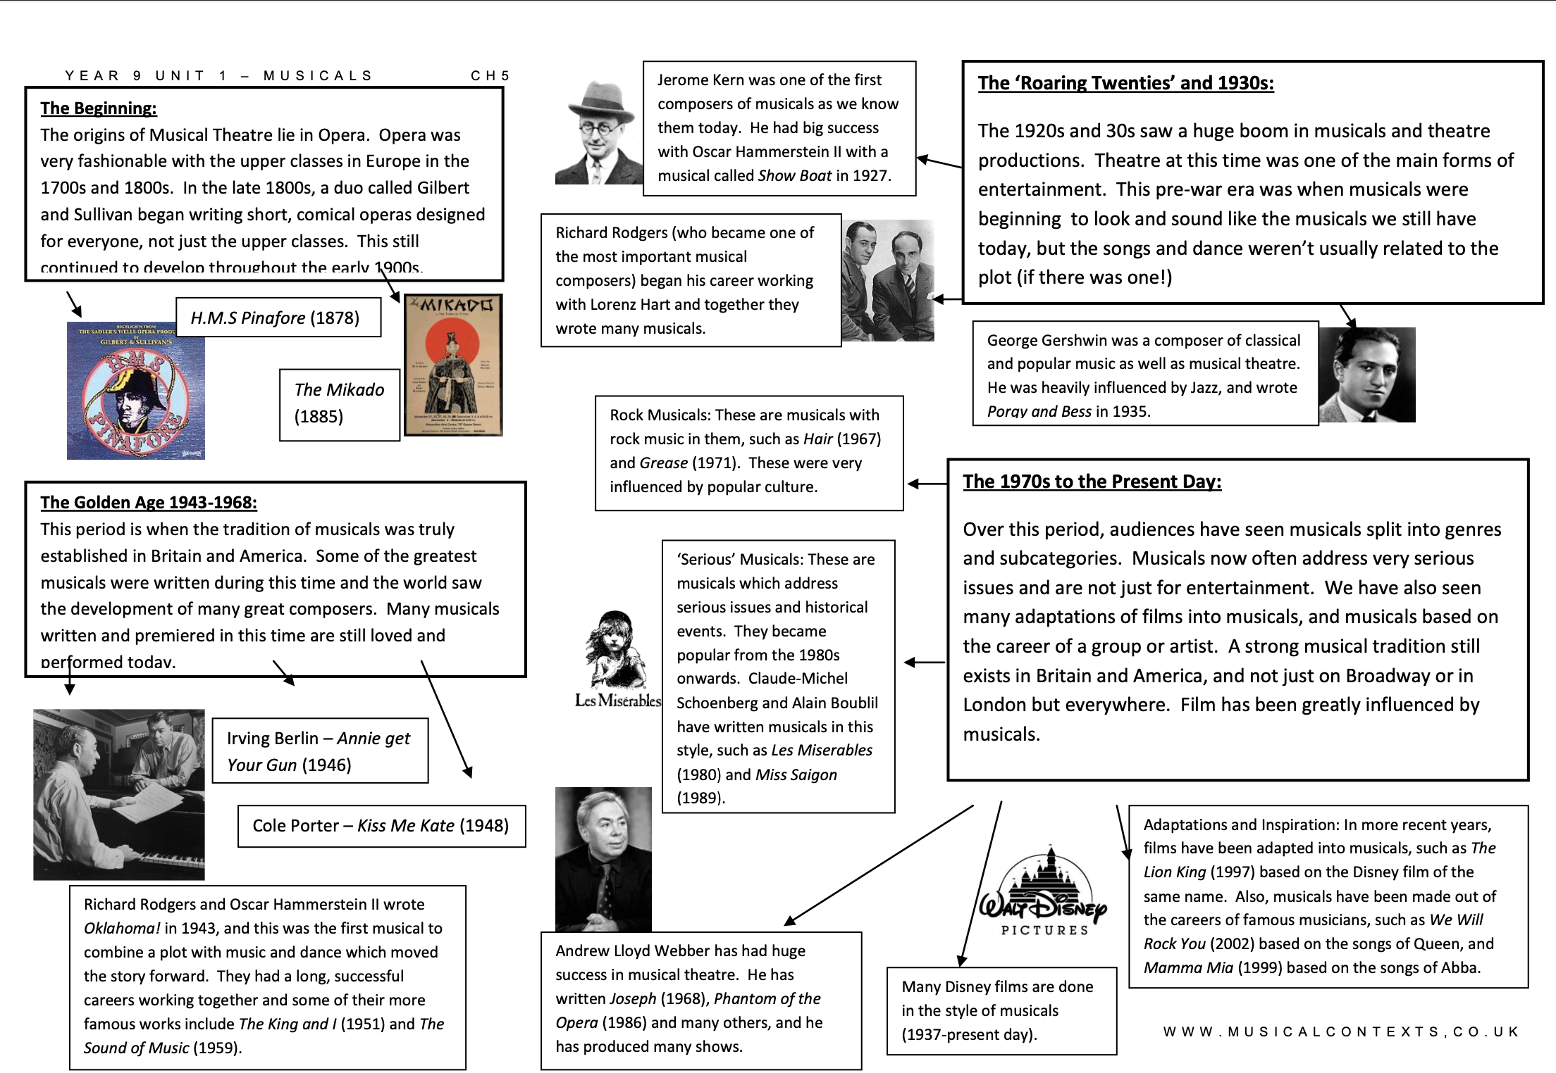
Mindmap

Slide 5
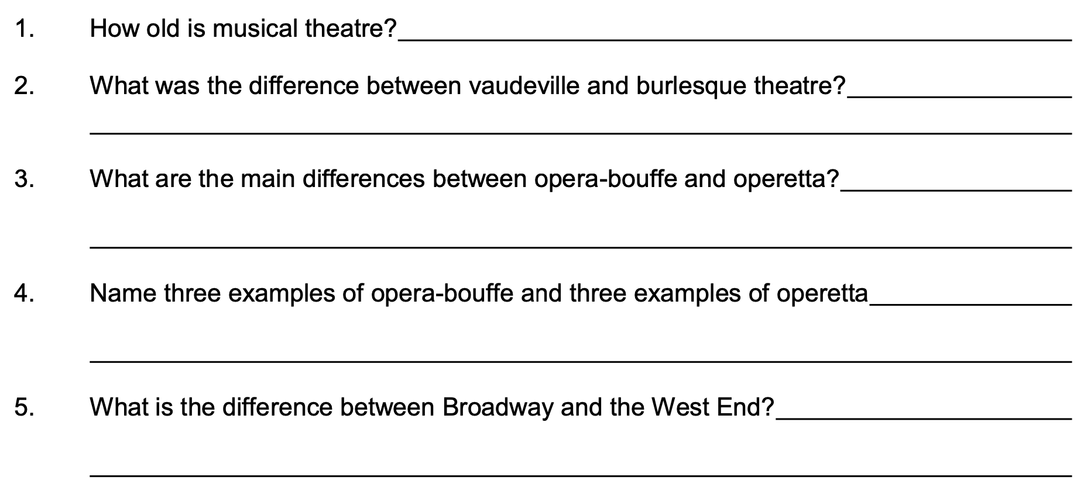

Slide 6
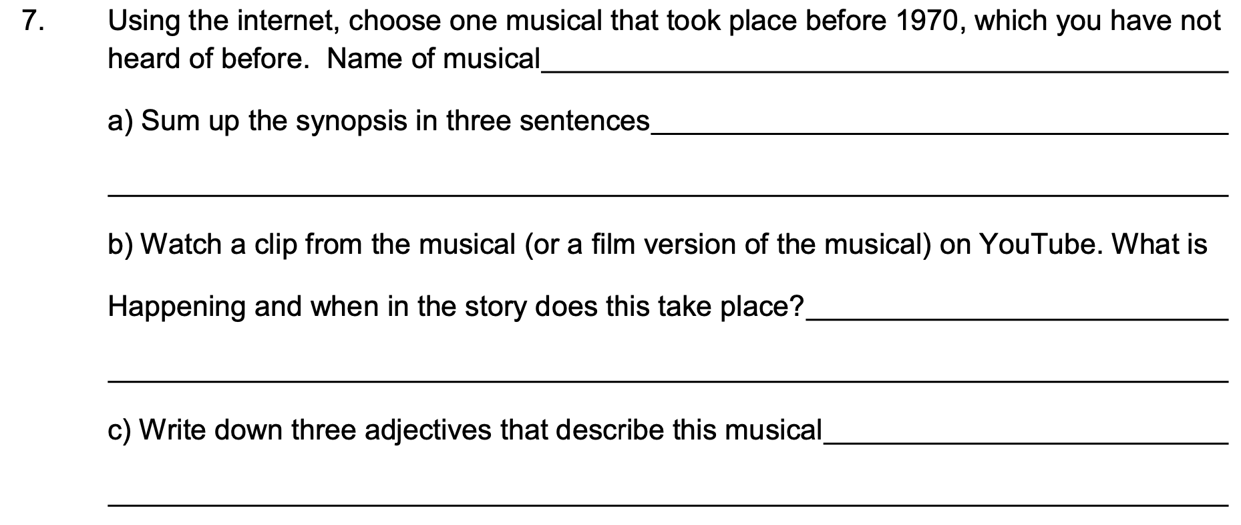
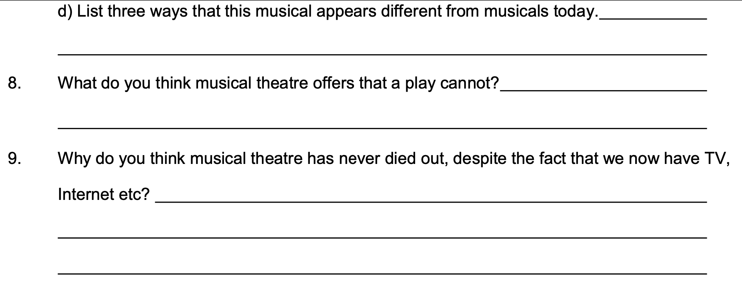

Slide 8
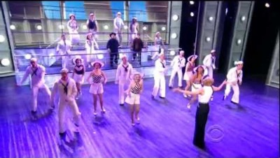
PLENARY
Watch this YouTube video of ‘Anything Goes’ from Anything Goes.
What style of dancing is featured in this song?

