Slide 1
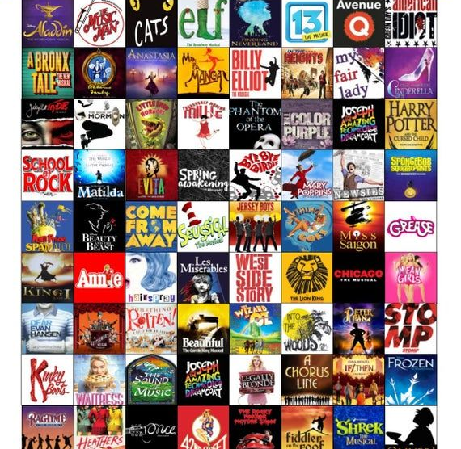
Musicals
Lesson 6

Slide 2
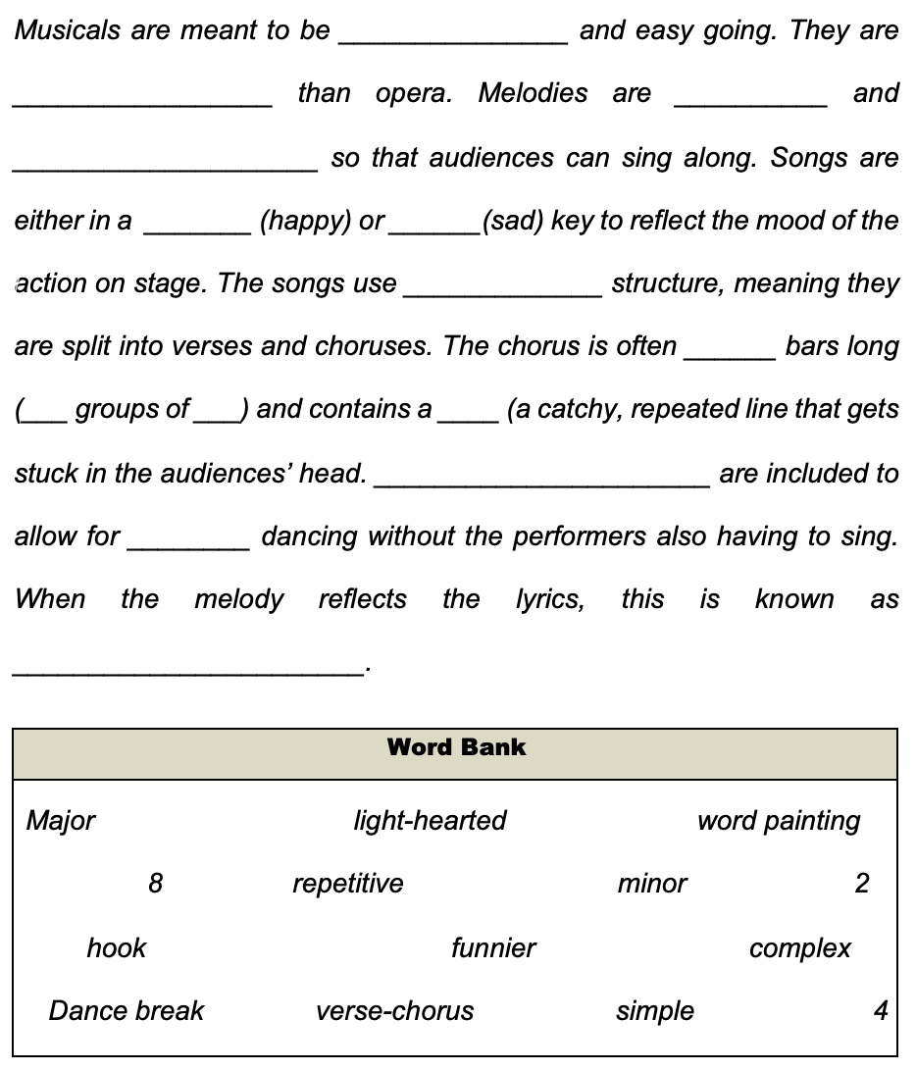
STARTER
In your books, write out the paragraph and fill in the blanks as you go along with the words at the bottom of the slide to help you.

Slide 3
ANSWERS
LIGHT-HEARTED
FUNNIER
SIMPLE
REPETITIVE
MAJOR
MINOR
VERSE-CHORUS
8
2
4
HOOK
DANCE BREAKS
COMPLEX
WORD-PAINTING

Slide 4
Musical Elements
Musical Element | Meaning
Dynamics
 | the organisation of particular sounds by their length
Pitch
 | the way a piece of music is laid out or built
 | the main tune or theme to a piece of music
Instrumentation
 | the speed of a piece of music
Harmony
Let’s see who remembers the basic musical elements!
EXTENSION: What others do we know that are missing from the table?

Slide 5
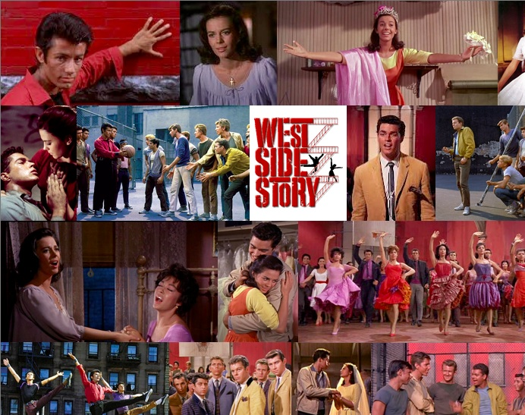
WEST SIDE STORY
Who has seen ’West Side Story’?
Who knows what it is about? Do you know any historical context about it?
Can you name a famous song from West Side Story?

Slide 6
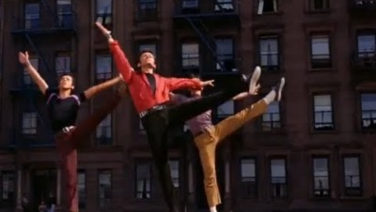
MAIN
We’re going to watch the opening scene from West Side Story twice. (Maybe more if you need it).
The first time, you’re going to familiarise yourself with what you think is going on.
The second time, you are going to answer some questions about it to the best of your ability with as much information as possible.

Slide 7

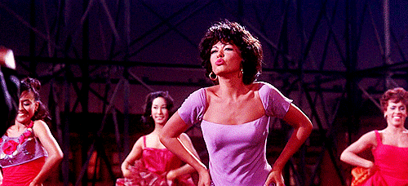
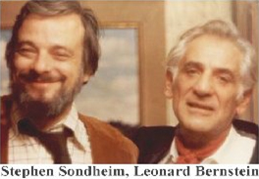
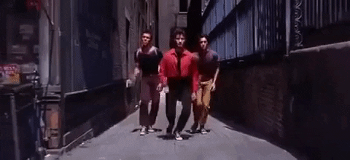
Overview
Key Songs
Maria (Tony),
America (Puerto Ricans),
Tonight (Tony and Maria),
One Hand, One Heart (Tony and Maria),
I Feel Pretty (Maria and Girls),
Somewhere (Company),
Gee, Officer Krupke (Jets),
A Boy Like That (Anita and Maria)
Background information:
Composed in 1959, with music by Leonard Bernstein and lyrics by Stephen Sondheim.
It is a retelling of Romeo and Juliet, where the Jets and Sharks have been reimagined into white polish Americans and Puerto Rican immigrants.
This musical was seen as a turning point in musical theatre due in part to the sophisticated music and focus on social themes.
The Jets and Sharks were originally imagined as Irish and Jewish, but it was felt that the eventual choice was more pertinent.

Slide 8
MAIN - Questions
Questions – Opening Scene
Describe the dynamics at the beginning:
___________________________________________________
After the finger-clicking starts, what is the string playing technique?
___________________________________________________
What rhythmic device is used in this piece?
___________________________________________________
Describe 3 ways that the music mirrors the action on screen:
_______________________________________________________________________________________________________________________________________________________________________________________________________________________________________________________________
Name 2 percussion instruments you hear in this piece:
______________________________________________________________________________________________________
6. Describe the mood of the piece, using musical words to support your description:
_______________________________________________________________________________________________________________________________________________________________________________________________________________________________________________________________
Have a class discussion about the answers

Slide 9
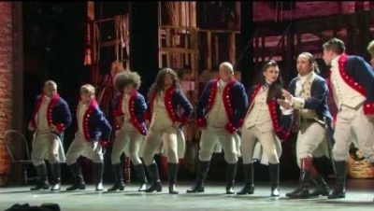
PLENARY
Watch this YouTube video of ‘History Has Its Eyes On You’ and ‘Yorktown (The World Turned Upside Down)’ from Hamilton.
Fast forward to 2:14.
What style of singing is prominent in this performance?
And what is Hamilton about?

