Slide 1

Musicals
Lesson 7

Slide 2
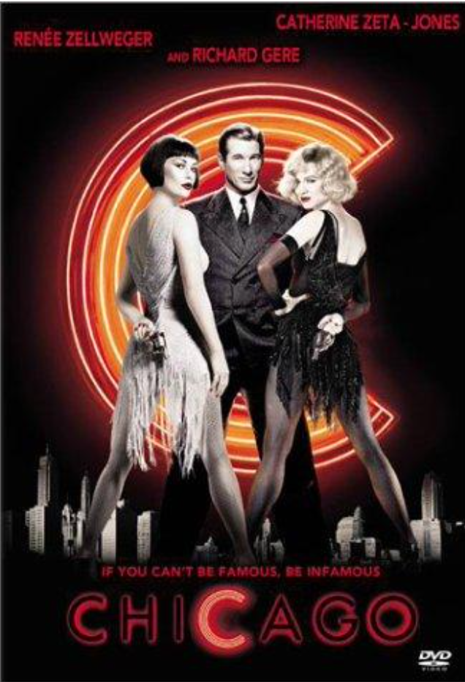
STARTER
We’re going to read the information from the sheets (or the next slide), one sheet between two.
The you will answer the 6 questions at the bottom of the sheet (or on slide 4) – ignore Q7.
You are going to read as a class, one person at a time, aloud. If you are not reading aloud, you need to be quiet so everyone can concentrate.

Slide 3
STARTER – Reading activity
Everyone loves a legend, but in Chicago, there’s only room for one. Velma Kelly (Catherine Zeta-Jones), burns in the spotlight as a nightclub sensation. The musical opens with a performance of Velma singing “All That Jazz”, supposedly appearing as a “sister act” with her sister Veronica whom she has just shot after finding her in bed with her own husband. She shoots them both and lands on Chicago’s famed murderess row, she gets Chicago’s best lawyer, Billy Flynn (Richard Gere) and is the centre of the town’s most notorious murder case, only increasing her celebrity.
Roxie Hart (Renée Zellwegger), seduced by the city’s promise of style and adventure, dreams of singing and dancing her way to stardom. Roxie has a lover, a furniture salesman called Fred Casely, he promises Roxie that he’ll get her an act somewhere in Chicago but soon Roxie realises that he has no connections and Fred tries to walk out on her. She shoots him and, after her husband Amos tries to cover up for her, she ends up in prison too looked after by Matron “Mama” Morton. Billy Flynn, who had previously been helping Velma Kelly try to get out of prison, realises that the people of Chicago are much more interested in Roxie’s new murder case and leaves Velma’s court case to try and help Roxie. Billy turns her crime of passion into celebrity headlines, and in this town, where murder is a form of entertainment; she becomes a genuine star – much to Velma’s hate! Roxie’s news is all over the newspapers and journalist Mary Sunshine keeps the people of Chicago up to date with Roxie’s ongoing news.
As Roxie fashions herself as America’s sweetheart, Velma has more than a few surprises in store and the two women stop at nothing to outdo each other in their obsessive pursuit of fame and celebrity. A new interpretation that takes the award-winning Broadway show into fresh and expansive realms, CHICAGO shifts from reality and intrigue, rivalry and betrayal to spectacular fantasies of music and dance.

Slide 4
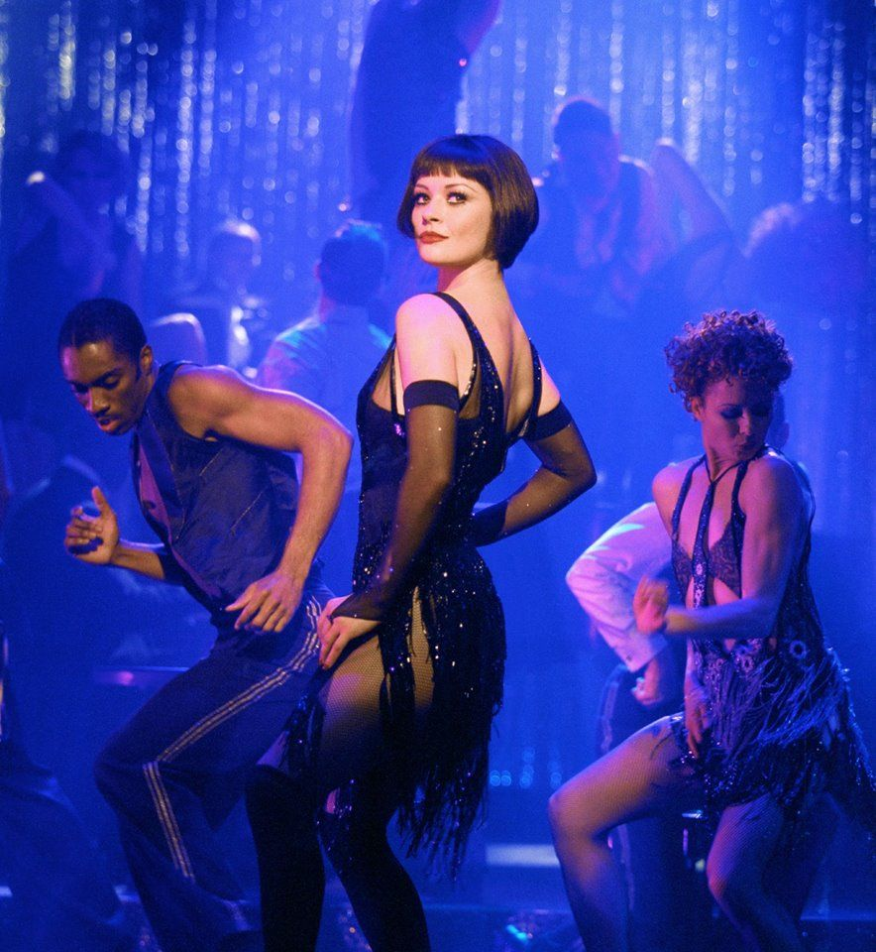
STARTER - Questions
What are the names of the two lead female characters from Chicago?
What is the name of the lawyer in the musical?
Why did Roxie shoot her lover?
What happened to Velma Kelly’s sister?
What is the name of the opening song in the musical?
What is Roxie’s husband called?

Slide 5
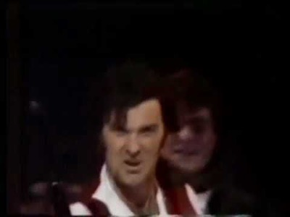
MAIN
Watch the following YouTube performance of the song “One Day More”, from the musical Les Misérables, taken from the 1987 Royal Variety Performance:
Using the handout sheet, you are going to answer the questions to the best of your ability.
https://www.youtube.com/watch?v=kYsrAaat_Qo

Slide 6
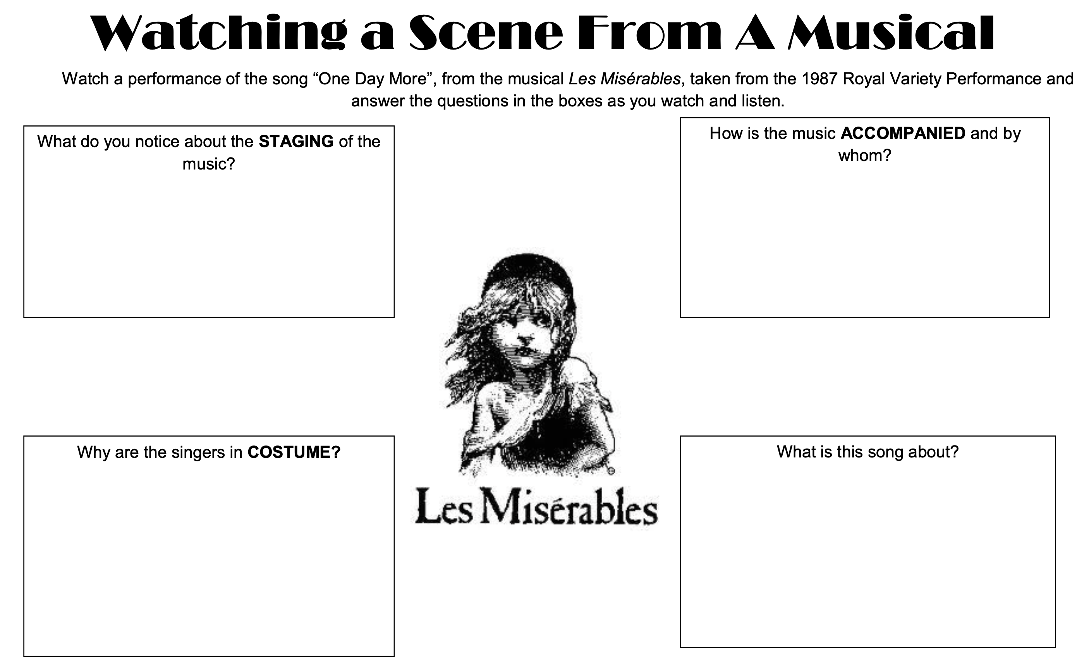

Slide 7
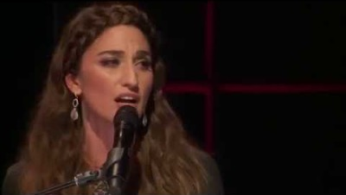
PLENARY
Watch this YouTube video of ‘Opening Up’ from Waitress.
What are they making?
And what is the venue in which the musical is based?

