Slide 1
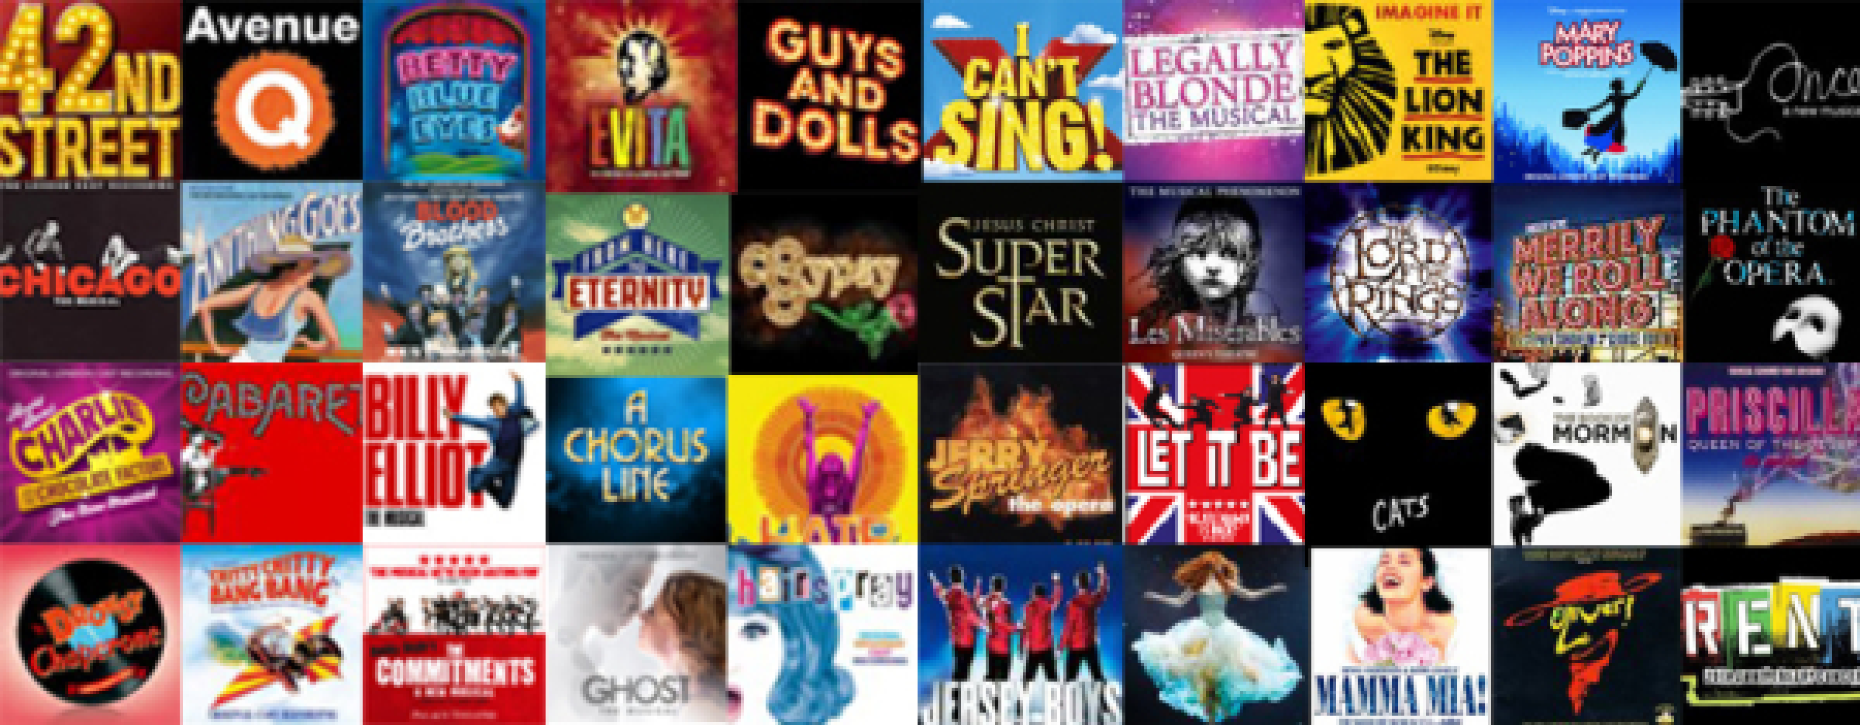
Musicals
Lesson 8

Slide 2
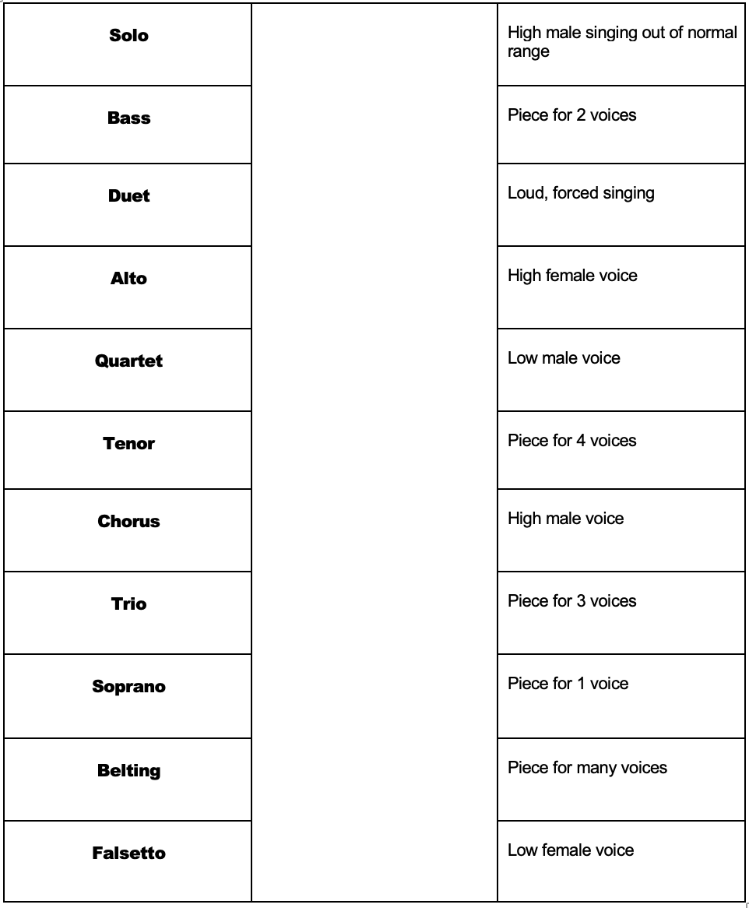
STARTER
Match the key term to the correct definitions using an arrow.

Slide 3
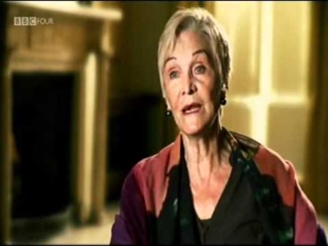
MAIN:
We are going to watch this YouTube video about ‘The Story of Musicals’.
You are going to answer the questions on the sheet as you hear the answers being spoken in the video.

Slide 4
ANSWERS
1. London’s West End
2. Ivor Novello and Noel Coward
3. Oklahoma!, Annie Get Your Gun, Brigadoon, South Pacific, Carousel, and Kiss Me Kate
4. Answer: Love on the French riviera.
Other info: It is an old-fashioned 1920’s musical. Inspired by the dance crazes of the roaring 20’s, with Britain in the grip of a revival of the happier pre-war years, where ‘The Boyfriend’ became a rare British musical success.
5. Broadway in New York, Manhattan.
6. Joan Littlewood
7. Cliff Richard and Tommy Steele
8. West Side Story
9. Oliver Twist! (‘Fings ain’t wot they used t’be’ was BEFORE ‘West Side Story’)
10. Ron Moody

Slide 5
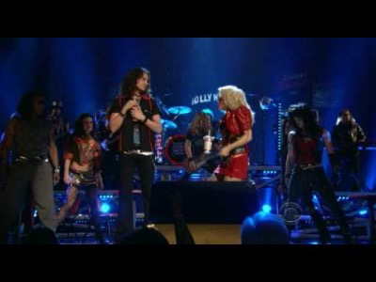
PLENARY
Watch this YouTube video of ‘I Wanna Rock’ and other songs from Rock of Ages.
Who is the famous special guest in the audience?
HINT: She was the lead in Cabaret many years ago…
https://www.youtube.com/watch?v=dBI0DNn0g_c&list=PL2Awype1tGgW6YaX5X2BZQ_lpxjo7lZy4&index=12

