Slide 1
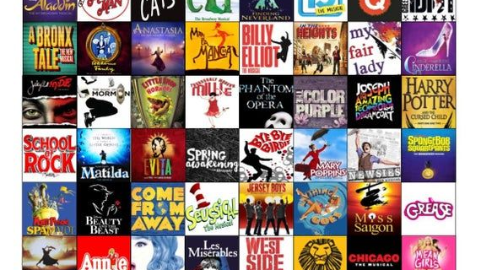
Musicals
Lesson 9

Slide 2
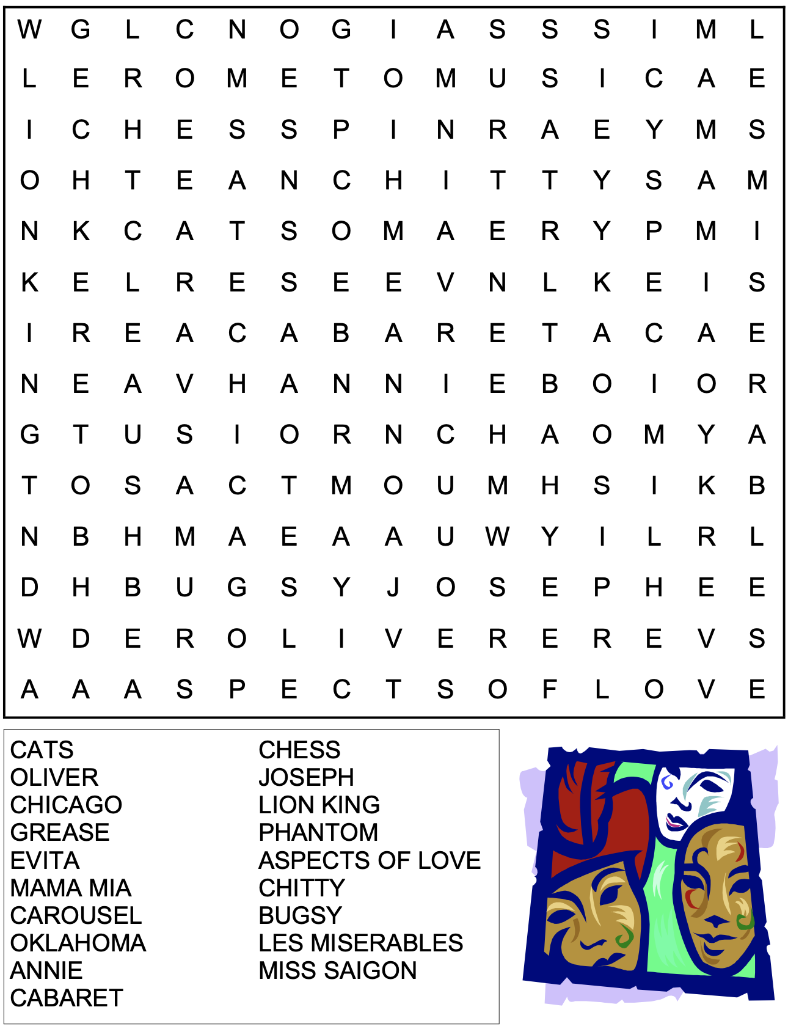
STARTER
Complete the wordsearch

Slide 3
MAIN
QUESTION | ANSWER
What do the performers use as instruments? Can you list a number of individual objects that you recognise?
What musical element is the primary focus here? (Think DR P SMITH) Write out its full definition.
What do they do to make it fun to watch?
How do the performers connect with the audience?
Draw this table into your books

Slide 4
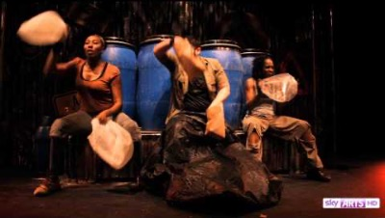
MAIN
Watch this YouTube link of a performance from the musical Stomp.
Listen carefully and answer the questions in the table.
https://www.youtube.com/watch?v=BEtC0s543O4

Slide 5
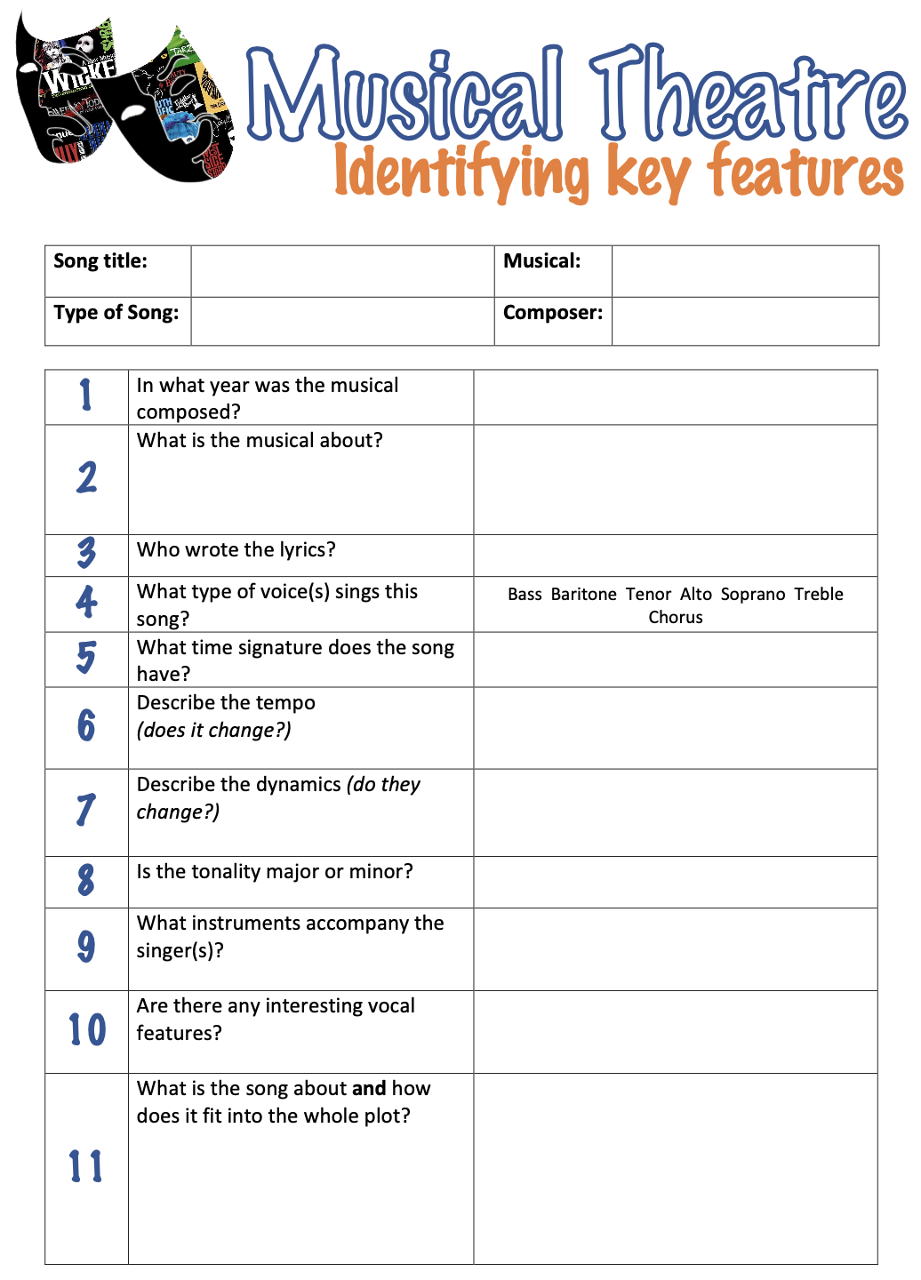
PLENARY
Choose your favourite song from a Musical.
On the sheet provided, write the song title, the musical it is from, the type of song it is (solo, duet etc.), and who the composer was of the song/musical.
Once you have filled this part in, analyse the musical by answering the questions in the table about the music -- you will need to be able to listen to the Musical.

