Slide 1
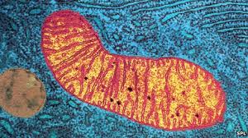
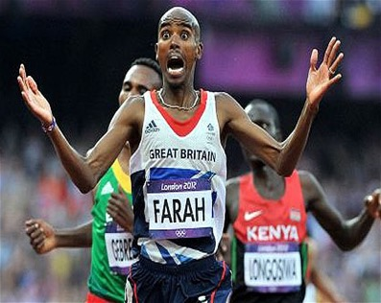
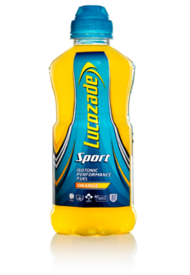
Aerobic Respiration
Key Words: Glucose, oxygen, energy, mitochondria, carbon dioxide
Starter: Unscramble these sentence which have the key points for todays learning. The word in bold starts the sentence.
Ext: What key word best relates to the Lucozade bottle? Explain.
Sentence 1: Plants – food- photosynthesis – make – using
Sentence 2: We – glucose - use – oxygen - make – and - energy - to
Sentence 3: Breathing means – in - taking– gases –

Slide 2

Aerobic Respiration
15th Oct 2015
Sentence 1: Plants make food using photosynthesis.
Sentence 2 : We use glucose and oxygen to make energy.
Sentence 3: Breathing means taking in gases.
Ext: What key word best relates to the Lucozade bottle? Explain.
Glucose because Lucozade contains a lot of glucose.
Notes:
https://www.youtube.com/watch?v=kJacHWNrhwA&safe=active

Slide 3
Keywords: Glucose, oxygen, energy, mitochondria, carbon dioxide
Learning Outcomes:
Recall the aerobic respiration equation
Describe how glucose gets into cells and where respiration happens
Explain how we get rid of CO₂

Slide 4
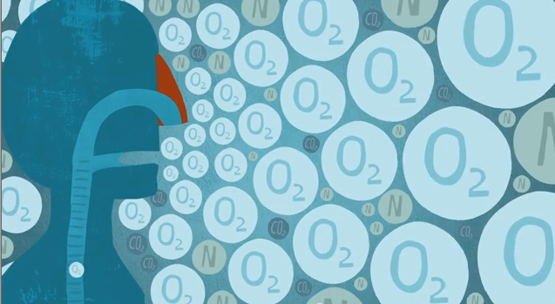
What is the difference between breathing and respiration?
Breathing is the movement of O₂ and CO₂ into and out of the lungs (TAKING IN GASES).
Respiration is using food to make energy (MAKING ENERGY).
Could you list parts of the body to do with breathing
NOSE
MOUTH
THROAT
LUNGS
TRACHEA
Could you list parts of the body to do with breathing
NO _ E
M_ UTH
THRO _ T
L _ _ GS
TRACHE _

Slide 5
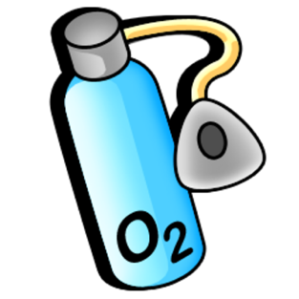
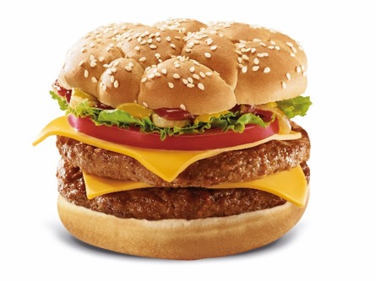
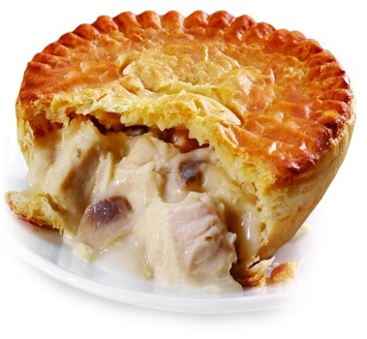
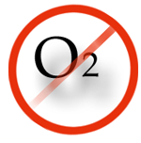
Respiration
Our cells need energy to work. They can’t just use food straight away. They have to convert (change) food into useable energy. There are two process:
With oxygen
Aerobic
respiration
Without oxygen
Anaerobic
respiration

Slide 6
Respiration
The process of converting food
(glucose) into useable energy for our
cells.
Notes:
Image: Energy by Volodin Anton from the Noun Project

Slide 7
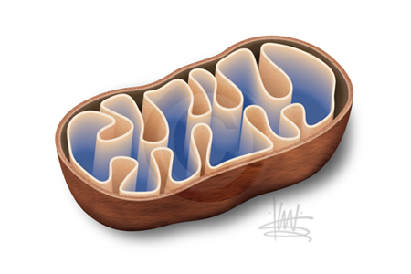
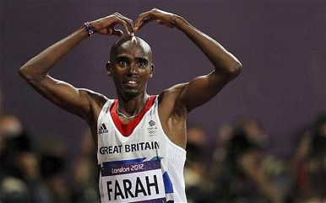
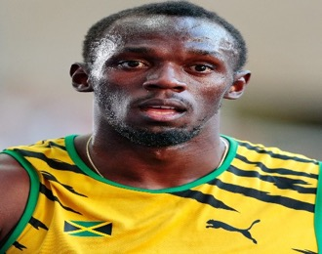
Respiration
Aerobic
Anaerobic
Making energy without oxygen
The use of oxygen to
Make energy
Aerobic resp. happens in the
mitochondria. Anaerobic
happens in the cytoplasm
Oxygen
Glucose
Carbon Dioxide
Water
Energy
Lactic Acid
Energy
Glucose

Slide 8
Write the definition of aerobic respiration below.
“Aerobic respiration is the use of oxygen and glucose
to release energy”
TASK: Use the words in the box to make an equation for aerobic respiration.
Ext: 1. Describe how the equation is similar to photosynthesis?
2. Create a symbol equation for aerobic respiration. Glucose is C₆H₁₂O₆
Aerobic
Oxygen
Glucose
Carbon Dioxide
Water
Energy
……….. + ………….. → ………….. + …………. +………

Slide 9
Review
“Aerobic respiration is the use of oxygen and glucose
to release energy”
Aerobic
Ext: 1. Describe how the equation is similar to photosynthesis?
It is the opposite of respiration
Oxygen
Glucose
Carbon Dioxide
Water
Energy
glucose
oxygen
carbon
dioxide
energy
……….. + ………….. → ………….. + …………. +………
water
6O₂
6CO₂
6H₂O
C₆H₁₂O₆
To balance the equation put a big 6 in front of every compound but glucose.

Slide 10
LOb: Understand the process of aerobic respiration.
Keywords: Glucose, oxygen, energy, mitochondria, carbon dioxide
Learning Outcomes:
Recall the aerobic respiration equation
Describe how glucose gets into cells and where respiration happens
Explain how we get rid of CO₂

Slide 11
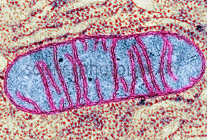
Where does respiration take place?
Respiration occurs in a specific organelle called a ‘Mitochondria’. Mitochondria convert glucose into useable energy.
The inner membrane is the site for respiration to occur.
The mitochondria have enzymes in them that are important for respiration.
Inner membrane is increased in structures called ‘Cristae’.

Slide 12
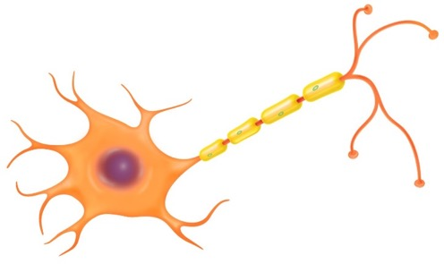
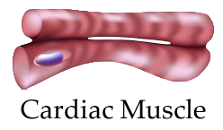


Where respiration happens more?
Skeletal Muscle
Brain Cell (Nerve)
Sperm
Respiration happens more in parts of the body that need more energy for example the brain, and major muscles in the legs and arms and your heart.

Slide 13
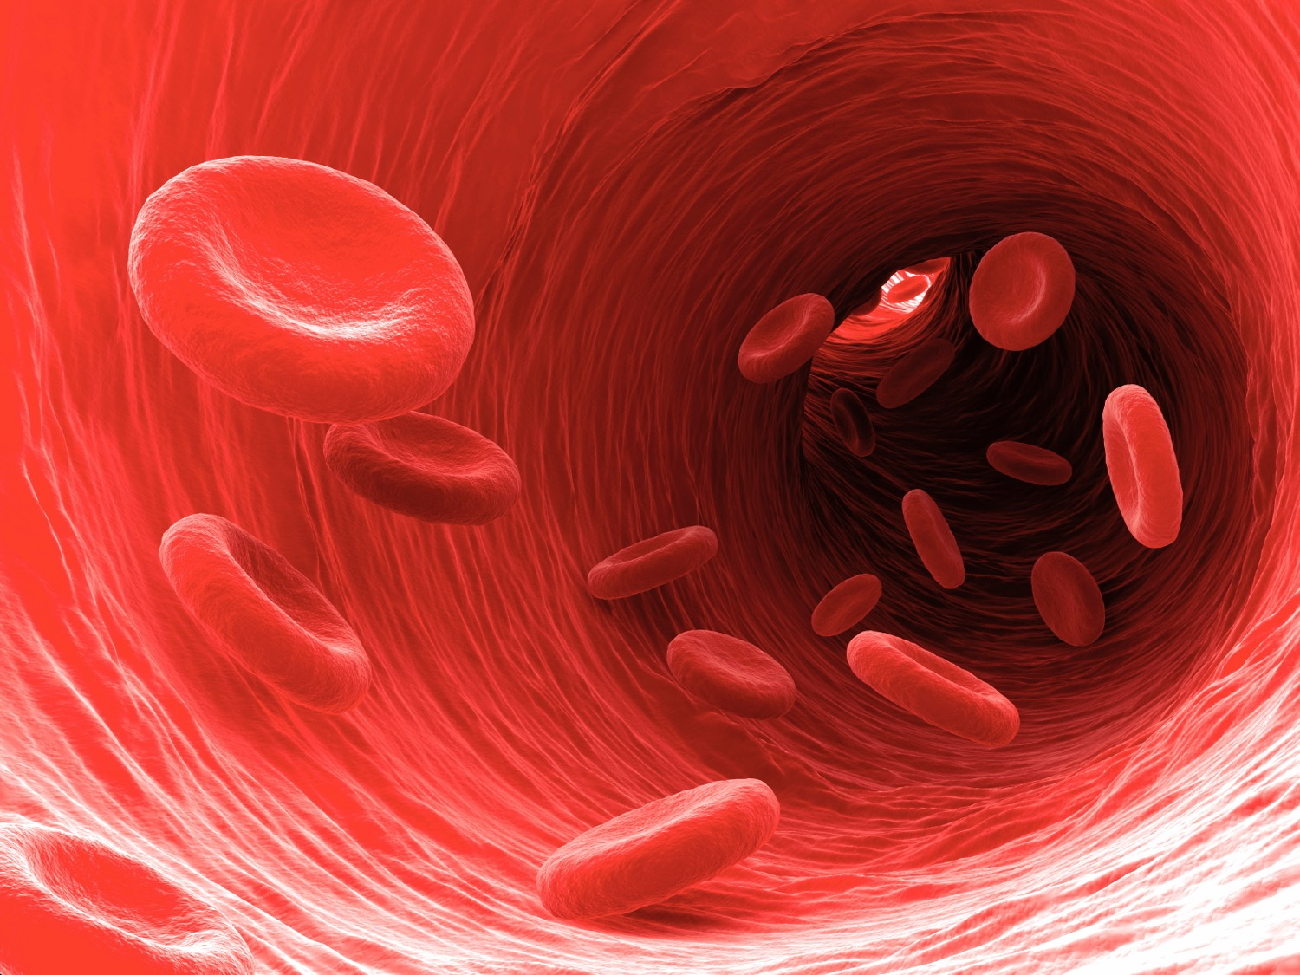
Glucose is dissolved into the blood plasma and travels around your body.
Red blood cells contain
Haemoglobin which carries
the oxygen.

Slide 14
Activity: Match the words on the left to their meaning on the right.
The place where aerobic respiration happens
Surface area
Glucose is dissolved into this and travels around the body
Mitochondria
Oxygen attaches to this molecule located in RBCs
Cardiac muscle
Found in mitochondria that help respiration happen
Enzymes
Plasma
Lots of mitochondria are found here. Another name for the heart
Haemoglobin
The RBCs are donut shaped to help increase this so they carry more O₂

Slide 15
Review
The place where aerobic respiration happens
Surface area
Glucose is dissolved into this and travels around the body
Mitochondria
Oxygen attaches to this molecule located in RBCs
Cardiac muscle
Found in mitochondria that help respiration happen
Enzymes
Plasma
Lots of mitochondria are found here. Another name for the heart
Haemoglobin
The RBCs are donut shaped to help increase this so they carry more O₂

Slide 16
LOb: Understand the process of aerobic respiration.
Keywords: Glucose, oxygen, energy, mitochondria, carbon dioxide
Learning Outcomes:
Recall the aerobic respiration equation
Describe how glucose gets into cells and where respiration happens
Explain how we get rid of CO₂

Slide 17
Watch the video from the 1997 Ironman race. And think about the questions below.
Ironman Race = 2.4 mile swim – 112 mile cycle – Marathon
What part of the aerobic equation isn’t there?
What is stopping there legs from working properly?
https://www.youtube.com/watch?v=MTn1v5TGK_w
Notes:
https://www.youtube.com/watch?v=MTn1v5TGK_w. The Crawl - Sian Welch & Wendy Ingraham (1997)

Slide 18
Review: What did we notice in the video?
They were struggling to produce enough energy because the food (glucose) was in limited supply.
The low energy meant muscles were unable to contract as easily.
Notes:
https://www.youtube.com/watch?v=MTn1v5TGK_w

Slide 19
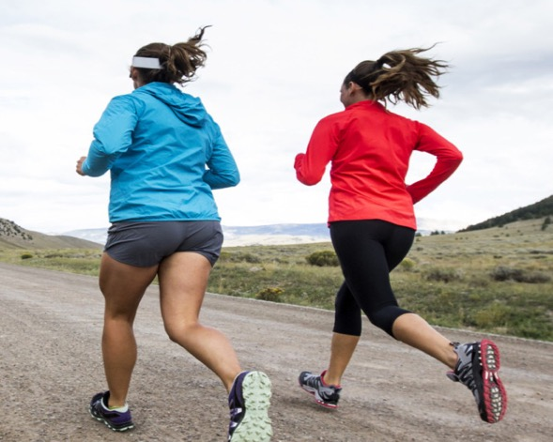
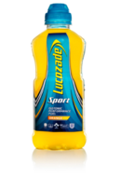
APPLICATION QUESTION: Both athletes will run a marathon. The lady in red has 3 glucose Lucozade drinks during the race. The other has just water. Who is going do better and feel better afterwards? Explain your answer.
The lady who has Lucozade will do _______. The g_______ from the drink will be used with o______ to make e_______
This means the m_______ will be less t_______. The other lady will be s______.
Word to include
Glucose
Oxygen
Energy
Muscle
Tired
Slower
Higher lvl words
Mitochondria
Plasma
Fatigue
Skeletal
Enzymes

Slide 20
Review
The lady who has Lucozade will do better. The glucose from the drink will be used with oxygen to make energy. This means the muscles will be less tired. The other lady will be slower.
Glucose will travel to the mitochondria in the skeletal muscles via the blood plasma. Enzymes inside the mitochondria help respiration happen.
Word to include
Glucose
Oxygen
Energy
Muscle
Tired
Slower
Higher lvl words
Mitochondria
Plasma
Fatigue
Skeletal
Enzymes

Slide 21
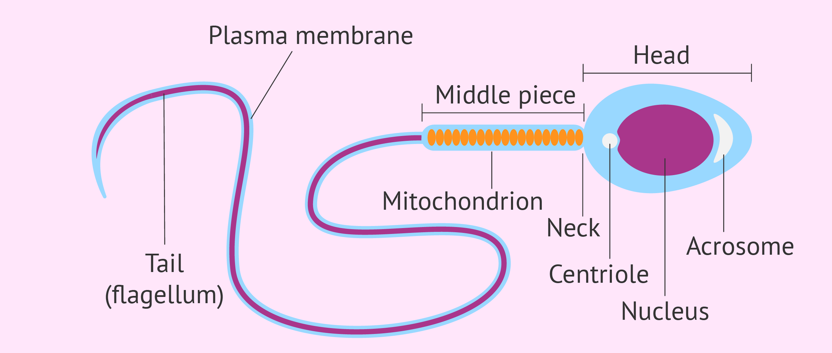
Plenary: Sperm have many mitochondria. Why is this important for the sperm? Explain your answer using knowledge from todays lesson.

Slide 22
Plenary
Make a mini-paragraph using all the key words below.
Keywords: Carbon dioxide, Water, Oxygen, glucose, respiration, mitochondria

