Slide 1
Pop Up Cards Project
2020 – Mrs Arnold

Slide 2
Design Brief
iPOP Cards Ltd are a manufacturer of novelty cards aimed at the teenage market.
You are requested to submit an unusual presentation for a pop up event card aimed at teenagers. Birthdays, religious festivals, or other occasions are all possible events.

Slide 3
Lesson 1 – Pop out Cards
In this lesson you are going to try out making 3 different pop out card designs.
You need to keep these safe as they will help you later in the project.
You will need the following
Handouts
Scissors
Glue
Plastic wallet

Slide 4
Jaws Pop out

Slide 5
Christmas Tree Pop out

Slide 6
Shark Pop out

Slide 7

Pop up evaluation
Now look at each pop up and evaluate it with a WWW and EBI

Slide 8
Lesson 2 – Pop Up Cards
In this lesson you are going to try out making 3 different pop up card designs.
You need to keep these safe as they will help you later in the project.
You will need the following
Handouts
Scissors
Glue
Plastic wallet

Slide 9
Layers
Pop up

Slide 10
Castle
Pop up

Slide 11
BBQ Pop up Invitation

Slide 12
Pop up evaluation
Now look at each pop up and evaluate it with a WWW and EBI

Slide 13
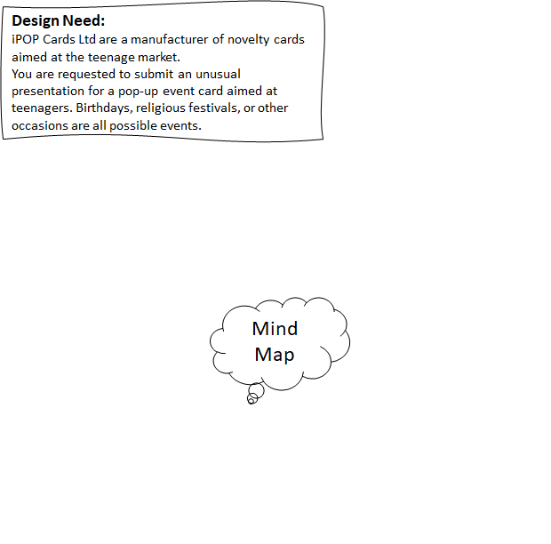
Lesson 3 – Ideas time...

Slide 14
Research Page
Please attach you pop ups form lesson 1&2 on to this page, then evaluate with your thoughts on how you think the trial pop up went. Which of them would you like to uses in your final design?

Slide 15
Lesson 4 – Design time....
Design Ideas:
On this page you need to come up with some ideas for your pop up card, shapes and themes. You don’t have to come up with the final idea of what the card will look like at this stage.

