Slide 1
Pop Up Book
Week 2

Slide 2
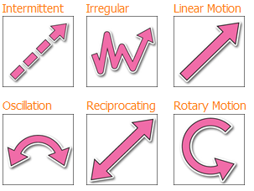
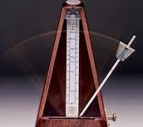
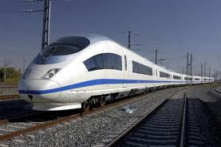
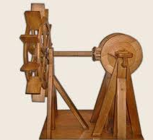
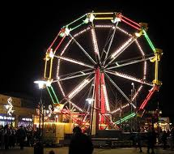
Add the words “linear”, “oscillating”, “reciprocating” and “rotary” to your list of words from last lesson. Try to write a definition for each (include an example!)

Slide 3
Mechanism
Plot
On a clean page in your book, draw a table like the one below and add the types of motion.
Term
Definition
Paper Engineering
Interactive
Drawing
Tools

Slide 4
Make a practice floating layer mechanism…
…..follow this link and watch the video.
Then try it yourself. Can you add extra levels?
https://www.youtube.com/watch?v=hBGLyjraKbs

