Slide 1


Making a Scene...
Learning Objectives
To be able to break an image down into layers
To be able to construct a “floating layer” scene
Success Criteria
To have a completed page using the floating layer mechanism
To have used the self-assessment tips to evaluate your work so far
Extension work
Look at your self assessment, and go back and make any changes that could improve your work

Slide 2

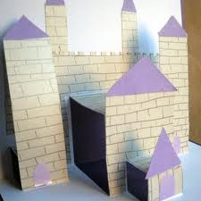
Rotary
Mechanism
Plot
Oscillating
Floating Layers
Linear
< Cutting straight lines across the fold makes things pop up from the surface
Reciprocating
You can create layers of cuts, that make different parts stand out different lengths, creating a whole 3D scene
>
Interactive
Paper Engineering
Title
Drawing
Tools
Perspective

