Slide 1
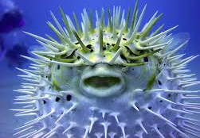
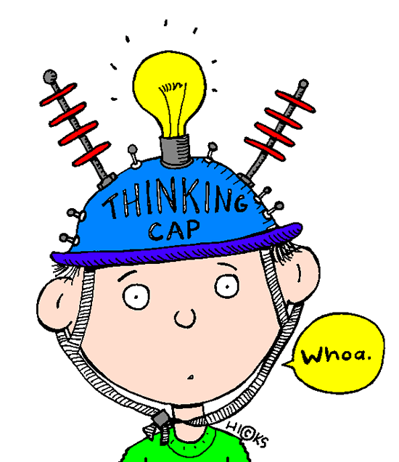
Surprise!
Learning Objectives
To understand the mechanics of the centre fold pop up
To have an understanding of typography, and font choice
Success Criteria
To have created a page for your book, using this method
To have started to add text to your pages, to enhance your story
Extension work
Create a page of lettering – use the word “fish”, and write it using as many different styles of letters as you can think of. Annotate each one to explain what it makes you think of.

Slide 2
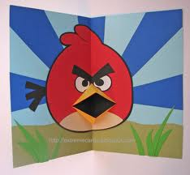
Rotary
Mechanism
Plot
Oscillating
Mouth Mechanism
Linear
Reciprocating
Use the mechanism to create a mouth or feature of a central character
Paper Engineering
Interactive
Drawing
Tools
Perspective
Typography

