Slide 1
Finishing your pop up books

Slide 2
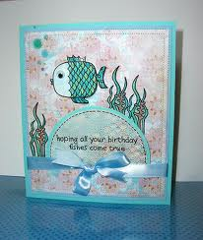
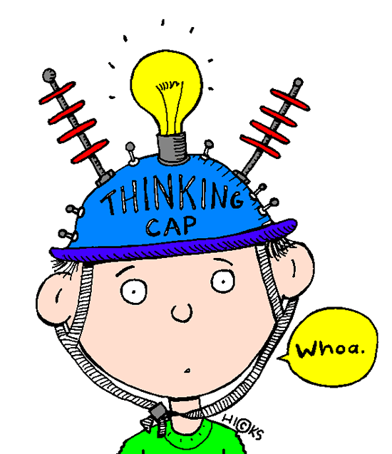
Ready to publish...
Learning Objectives
To understand the mark scheme for this unit of work
To be able to critically assess your own work and that of your peers
Success Criteria
To have created an evaluation page for your book, in the form of the back cover “blurb”
To have chosen a grade for your work, using the mark scheme
Extension work
Consider your book in it’s now finished state. Try to come up with 3 ways in which you could improve your book, and explain why each of these would be a positive change.

Slide 3
Put all your pop up pages in order….then
Wrap a piece of paper around the outside and trim it to shape.
https://www.wikihow.com/Make-a-Pop-up-Book
Look at part 3 of this wiki for instructions on how to do it– its BRILLIANT.

