Slide 1
Year 8 Design and Technology
Branding Week 1

Slide 2

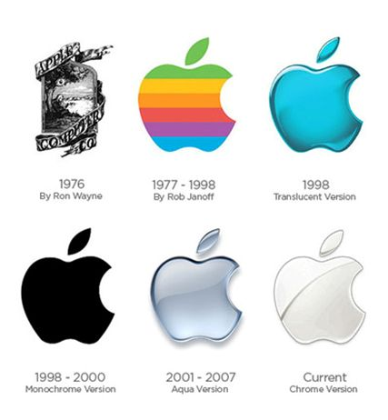
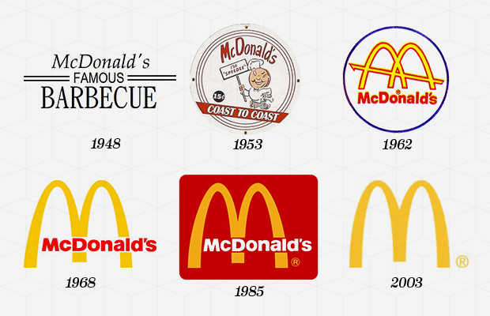
Logos over time…….

Slide 3





What’s in a logo?
Can you find the meanings behind these logos?

Slide 4

Design Brief
You have been asked to design the branding of a new café experience in the city.
You will need to come up with a design identity that is suitable for use across all products, interiors, uniforms and packaging.
You need to be able to present a range of different ideas for people to be able to evaluate and help you decide which is the most effective.
The company would like you to make sure that you are showing their commitment to being careful about the environment, resources and carbon footprint.

Slide 5
Task 1 – Name your café!

Slide 6
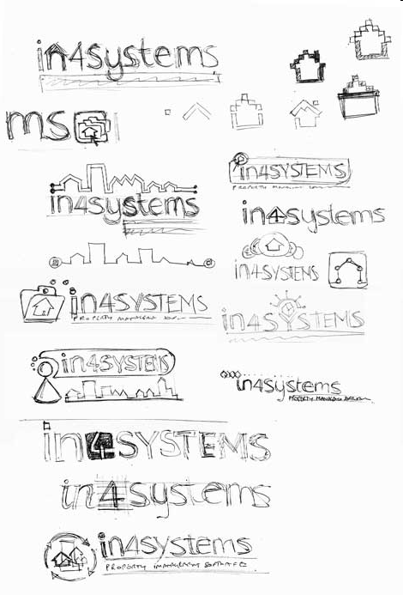
Start with a word
Ideas spring from other ideas so start by doodling!
Look at the example – the designer starts by experimenting with the name
The house shape might suggest building – as in building computer systems
Try and spot how many different ideas have been used
Look at the final design and see where this design originated

Slide 7
Design and Technology: Branding
Logo – Initial Ideas
Date:
On this page come up with your first possible ideas for the logo and name that you are using for the café. Each design should be in a different styles and include different features so that you can compare and choose the best parts.

