Slide 1
Year 8 Design and Technology
Branding Week 3

Slide 2
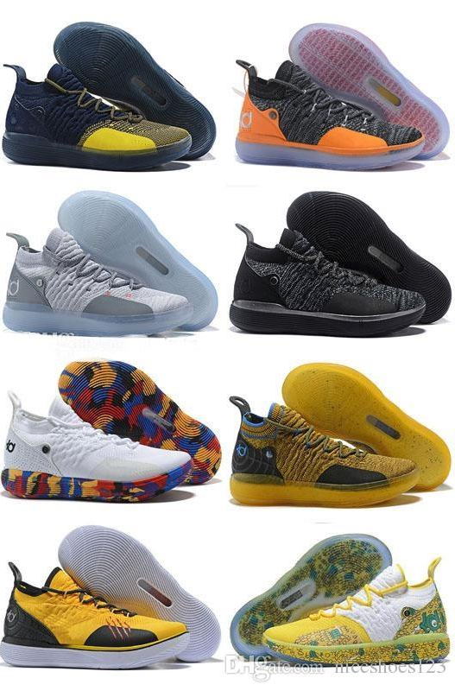
Trainer design
This lesson you need to think about how the organisation might apply their branding to a pair of trainers- These are important to make staff comfortable, but you should also think about incorporating environmentally friendly materials and parts- You might consider the use of ‘ocean plastics’. These are bits of plastic that are floating around in the ocean and are then collected and turned into recycled materials and products.

Slide 3
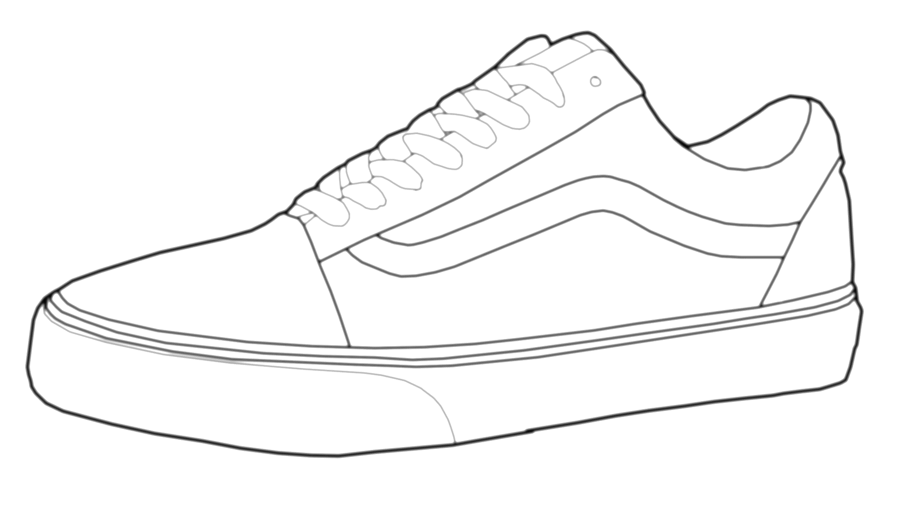
Design and Technology: Branding
Trainer Design
Date:
On this page you need to think about how the organisation might apply their branding to a pair of trainers- These are important to make staff comfortable, but you should also think about incorporating environmentally friendly materials and parts- You might consider the use of ‘ocean plastics’. These are bits of plastic that are floating around in the ocean and are then collected and turned into recycled materials and products.
Design 1: | Design 2: | Design 3:

