Slide 1
Year 8 Design and Technology
Branding Week 4

Slide 2
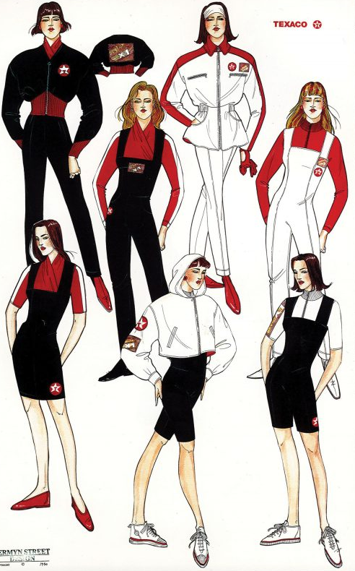
Uniform design
This lesson you need to think about how the organisation might apply their branding to a modern and interesting staff uniform. The line ‘mannequin's’ might help you to layout your uniform. It is up to you to consider how casual or smart you make the uniform but remember that you need to include all branding, logos and colour decisions from your previous design sheets.

Slide 3
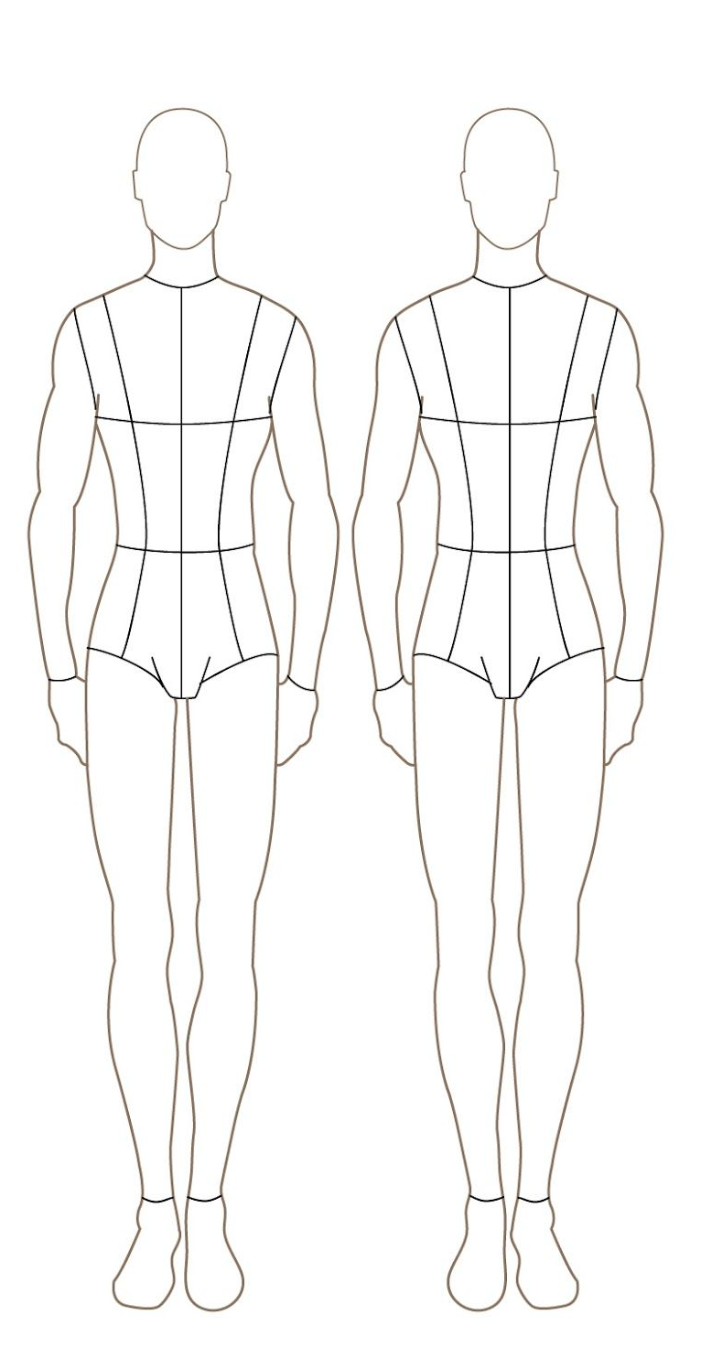
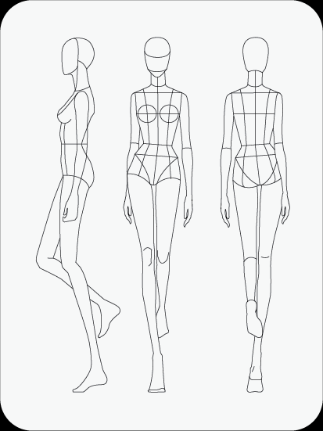
Design and Technology: Branding
Uniform Design
Date:
On this page you need to think about how the organisation might apply their branding to a modern and interesting staff uniform. The line ‘mannequin's’ below might help you to layout your uniform. It is up to you to consider how casual or smart you make the uniform but remember that you need to include all branding, logos and colour decisions from your previous design sheets.
Design 1: | Design 2: | Design 3:

