Slide 1
Year 8 Design and Technology
Branding Week 5

Slide 2
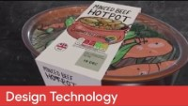
Food Labelling

Slide 3
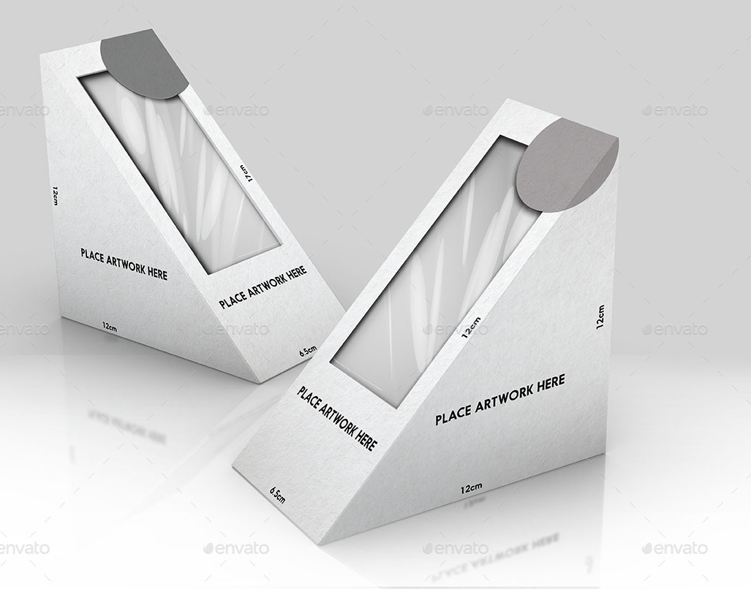
Food and Drinks branding
On your page you need to think about how the organisation might apply their branding to a drinks can, bottle and sandwich box - you will need to stick with your previous logo design but you should now try to design some space for important information but also include the branding in an eye catching way. You might want to focus on a particular food/drink to help adapt the label style and colour.

Slide 4
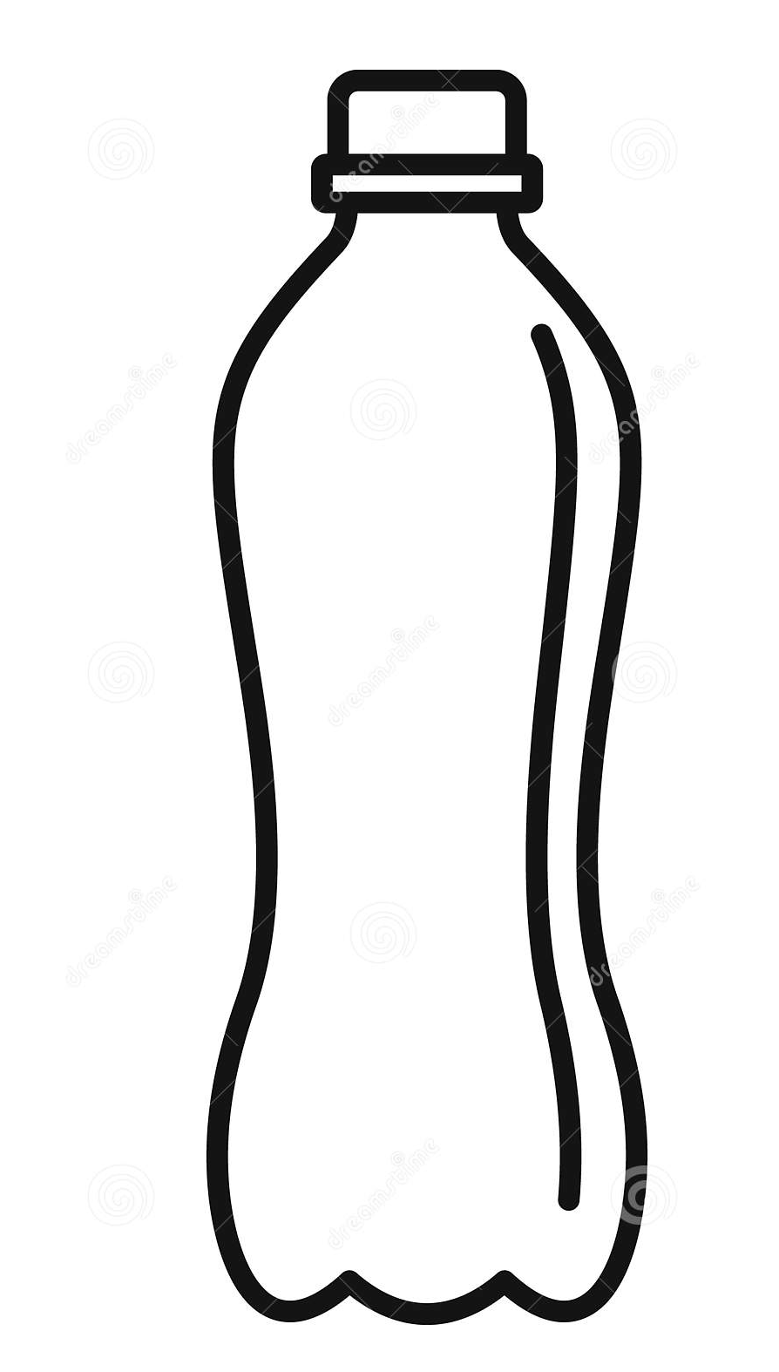
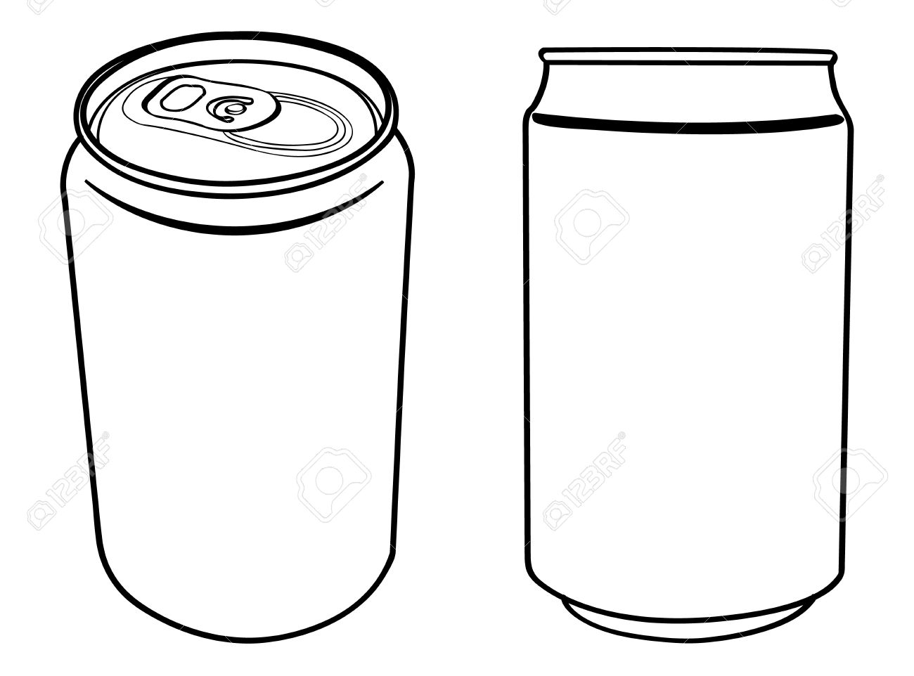
Design and Technology: Branding
Food Labelling
Date:

