Slide 1
Year 8 Design and Technology
Branding Week 6

Slide 2
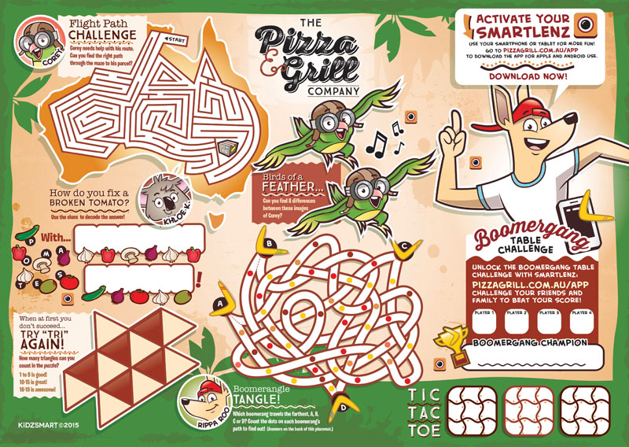
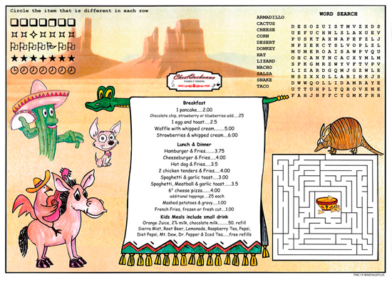
Menu Design
This lesson you need to come up with some designs for a menu that includes the branding that you have used in the previous sheets.
You need to capture the children's attention- but don’t forget that you need to encourage healthy eating and also the message about being environmentally friendly and reducing waste and reliance on unsustainable materials.
Things to include:
The name of your café
The food and drink you will serve (you may want to inclide the ones you designed last lesson)
Activities to entertain children, such as the ones in the example below

Slide 3
Design and Technology: Branding
Menu Design
Date:
On this page you need to come up with some designs for a menu that includes the branding that you have used in the previous sheets. You need to capture the children's attention- but don’t forget that you need to encourage healthy eating and also the message about being environmentally friendly and reducing waste and reliance on unsustainable materials.

