Slide 1
Year 8 Design and Technology
Branding Week 7

Slide 2
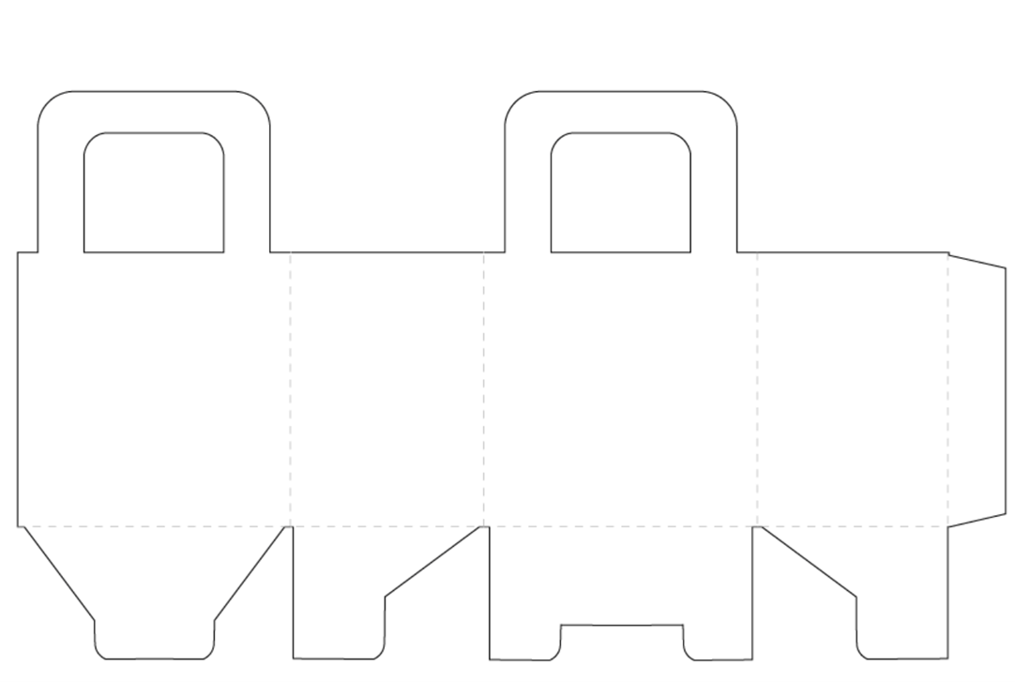
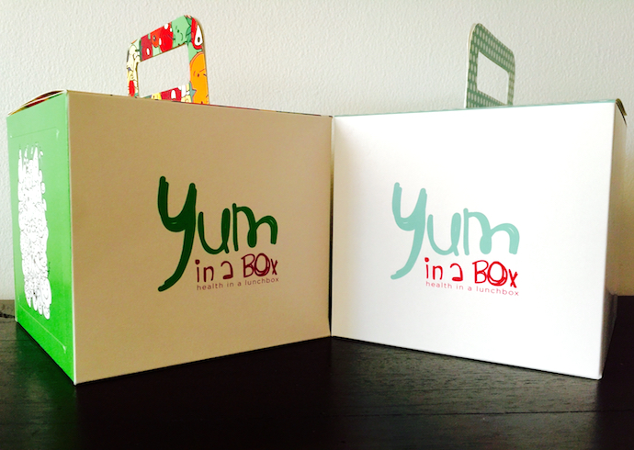
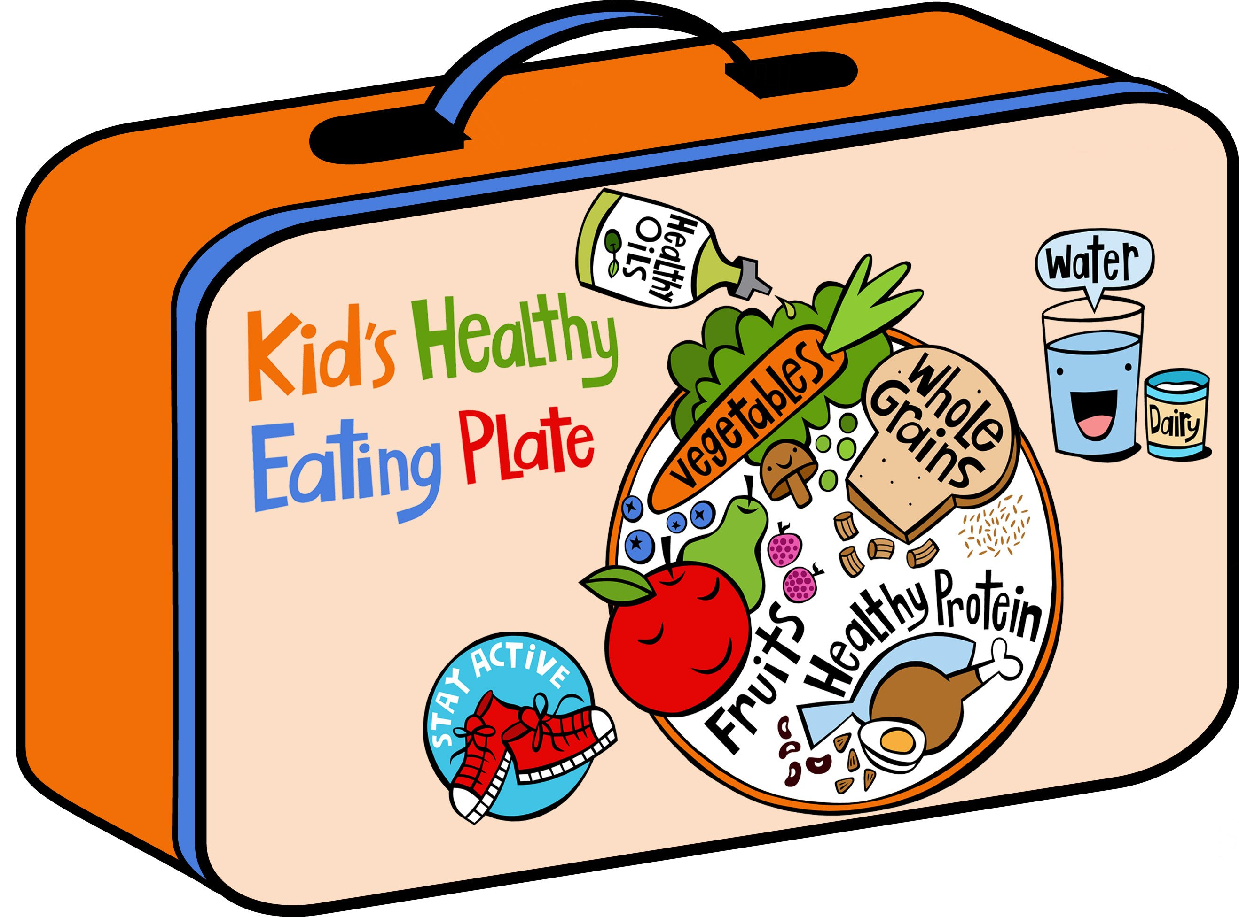
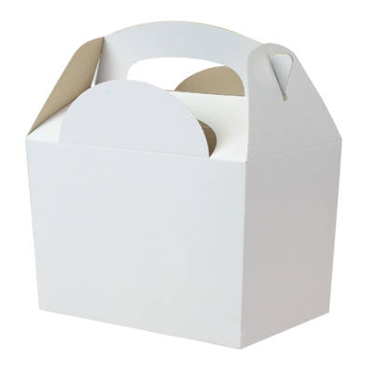
Lunch kit
On this page you need to think about how the organisation might apply their branding to a children’s meal deal lunch box.
You will need to make sure that the packaging includes images that are appealing to young people- you might want to think about coming up with a character that can be used to encourage children to eat healthily- don’t forget to think about how the design works around the all sides of the box.
CHECKLIST: Have you included…
Your logo?
A character?
The contents of the box?
An activity?

Slide 3
Design and Technology: Branding
Lunch Kit
Date:
On this page you need to think about how the organisation might apply their branding to a kids meal deal lunch box.
You will need to make sure that the packaging includes images that are appealing to young people- you might want to think about coming up with a character that can be used to encourage children to eat healthily- don’t forget to think about how the design works around the all sides of the box.

