Slide 1
Year 9 Food
Planning a Practical

Slide 2
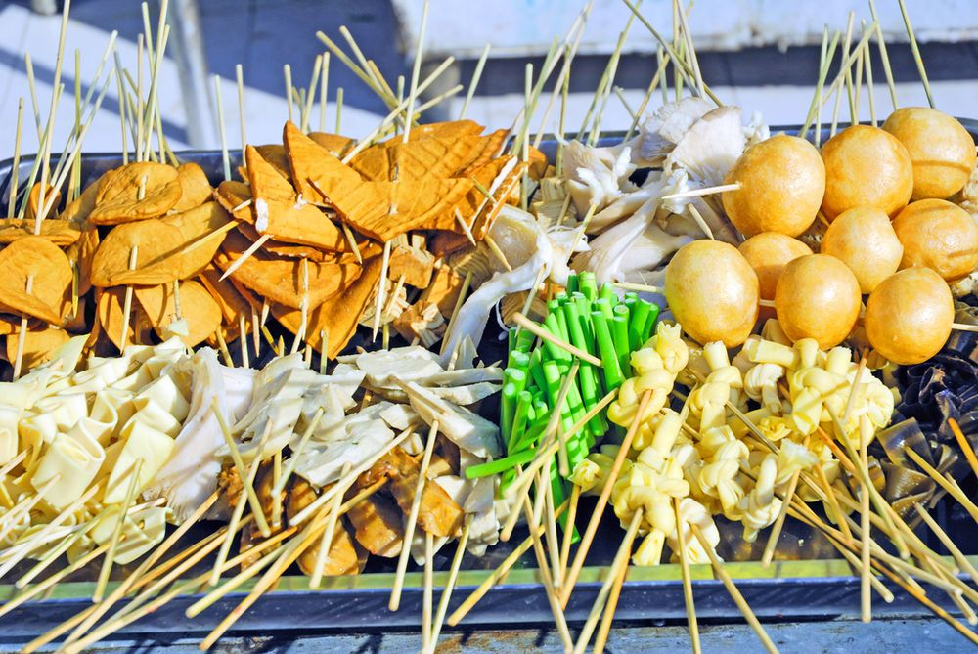
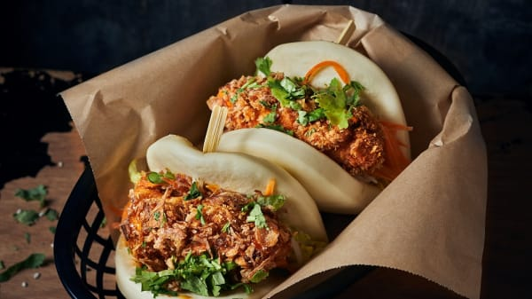
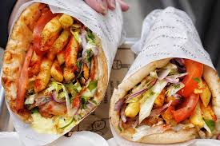
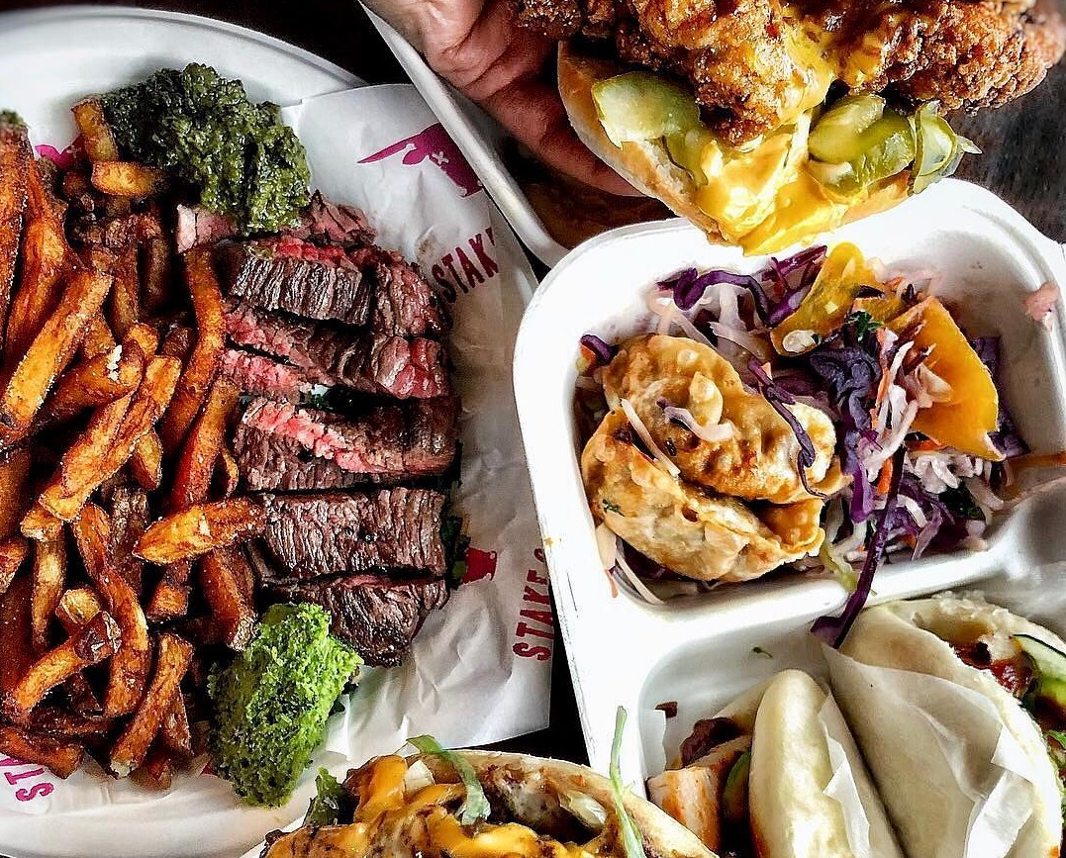
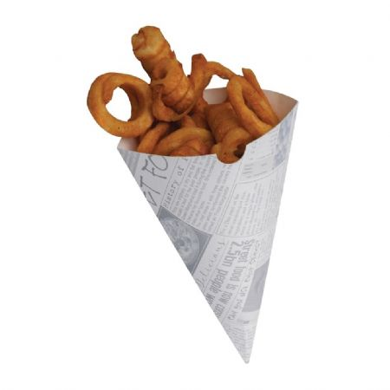
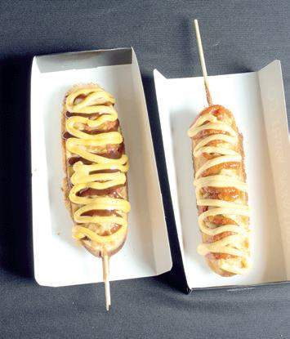
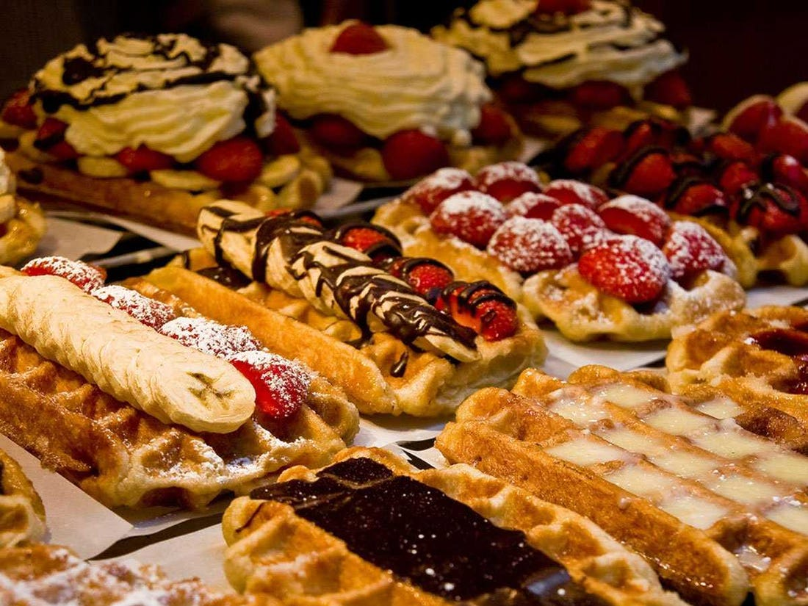
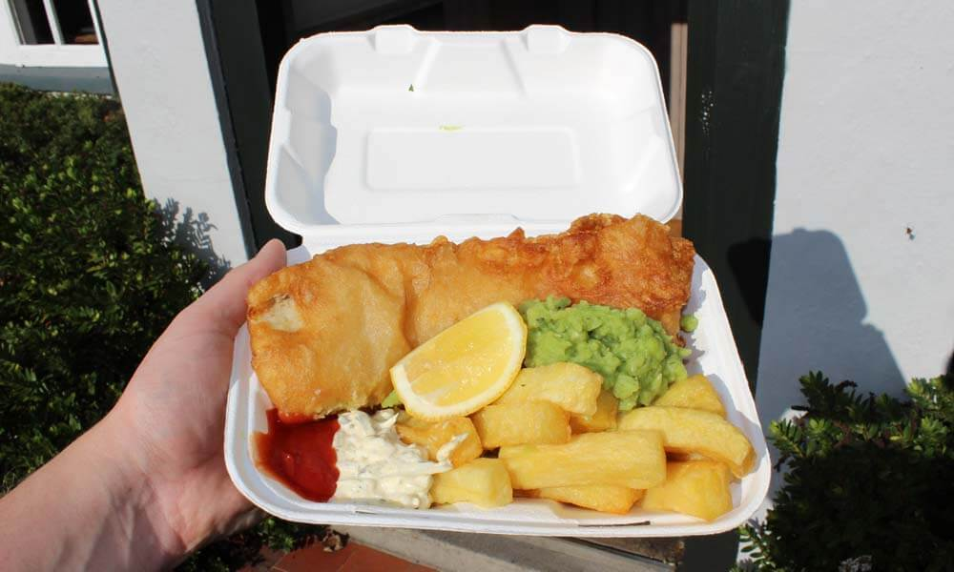
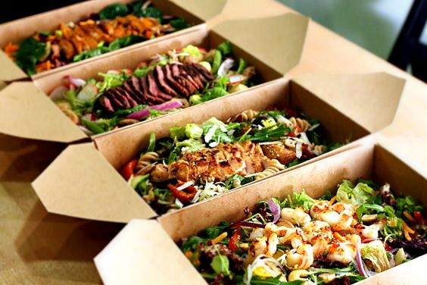
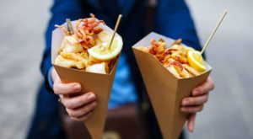
Street Food

Slide 3
Exact instructions challenges
Peanut butter and jelly sandwich: https://www.youtube.com/watch?v=cDA3_5982h8
Quesadillas: https://www.youtube.com/watch?v=PlWAFPGN5W0&t=416s
Ramen: https://www.youtube.com/watch?v=UNbzNyZcm-Y
Year 9 Food and Nutrition - The Food Preparation Project
Task 8 – Things to watch:

Slide 4
Year 9 Food and Nutrition - The Food Preparation Project
Task 8 – Time Plan
Use the skills list to identify and highlight the skills you are using at each step
Fill this in first – use the method from the recipe
Be specific - you may need to add more detail
Time | Task | Equipment needed | Health, Safety and Hygiene | Skills demonstrated
Work out the time you will need to start doing each step, considering the timings of the session
What steps are you going to take to ensure you are working safely? How will you make sure your food is safe to eat?
If you are making more than one dish you may want to colour code each dish to make it clearer

