Slide 1
Textiles Year 7
Monster Keyrings
Week 1

Slide 2

Why is it important to be precise when writing instructions?

Slide 3

Making a cup of tea
Learning Objectives
Work through a process
Understand the difference between materials and equipment in a process
Today the aim is
Be able to organise a process in the correct stages.
Document those stages so that someone unfamiliar with the process could follow it.

Slide 4
Task:
Write a list of instructions of how you would make a cup of tea
When you have done, check against the answers on the next two slides

Slide 5
Making a cup of tea
Materials
Equipment
Milk
Tea bag
Water
Sugar
Tap
Kettle
Cup
Spoon

Slide 6
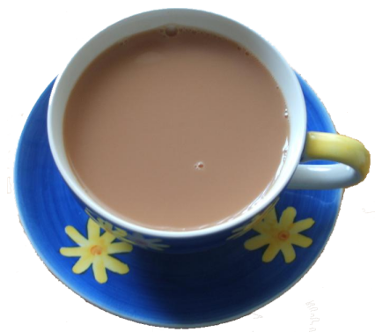
Take kettle off stand
open kettle lid
Turn tap on
Fill kettle up to desired amount
Turn tap off
Place kettle on stand
Turn kettle on
Place tea bag in cup
When kettle has boiled take kettle off stand
Fill cup up to desired point with boiled water
Put kettle back on stand
Take spoon
Stir teabag in water
wait 3 minutes
Take teabag out of cup using spoon
Poor milk into cup to desired amount
Take spoon
Fill spoon with sugar
place sugar in cup
Repeat 18 and 19
Stir tea
take spoon out
Tea Complete

Slide 7

Making a cup of tea…
What questions will you need to ask to make sure you are making it right?
These are known as ‘Quality Control Checks’
Your questions should have a YES or a NO answer. If the answer is YES, you can move onto the next stage. If the answer is NO, you must repeat the previous stage
Add the quality control checks into your instructions in a different coloured pen

Slide 8
Possible questions…
Is there enough water in the kettle?
Is it the right type of teabag?
Has it brewed for long enough?

Slide 9
Making a Flow Chart…
Start / Finish
Quality Control:
How are you going to check it’s right?
Process:
What are you going to do?

Slide 10
Task:
Have a go at turning your cup of tea instructions into a flow chart
Use the correct shapes for each step

