Slide 1
Textiles Year 7
Monster Keyrings
Week 2

Slide 2
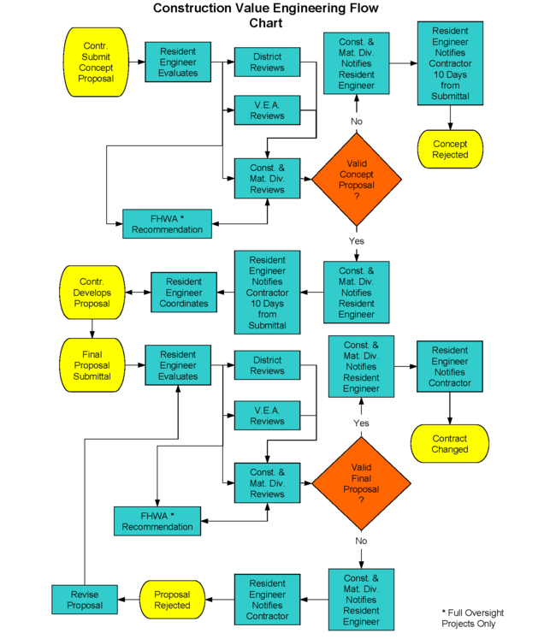
Task: Writing a making plan…
Think about how you are going to make your keyring
What tools and equipment are you going to need at each stage? How are you going to ensure it is high quality?
Draft out instructions on how to make your product
Check these with someone else – are they accurate?
Three chillies…
A flow chart explaining how to make your keyring, including quality control checks
One chilli…
A list of instructions explaining step by step how you will make your monster keyring
Two chillies…
A table detailing how you will make your monster, the equipment you will need at each step
Step | Instructions | Equipment
1
2
3
4

