Slide 1
Textiles Year 7
Monster Keyrings
Week 3

Slide 2
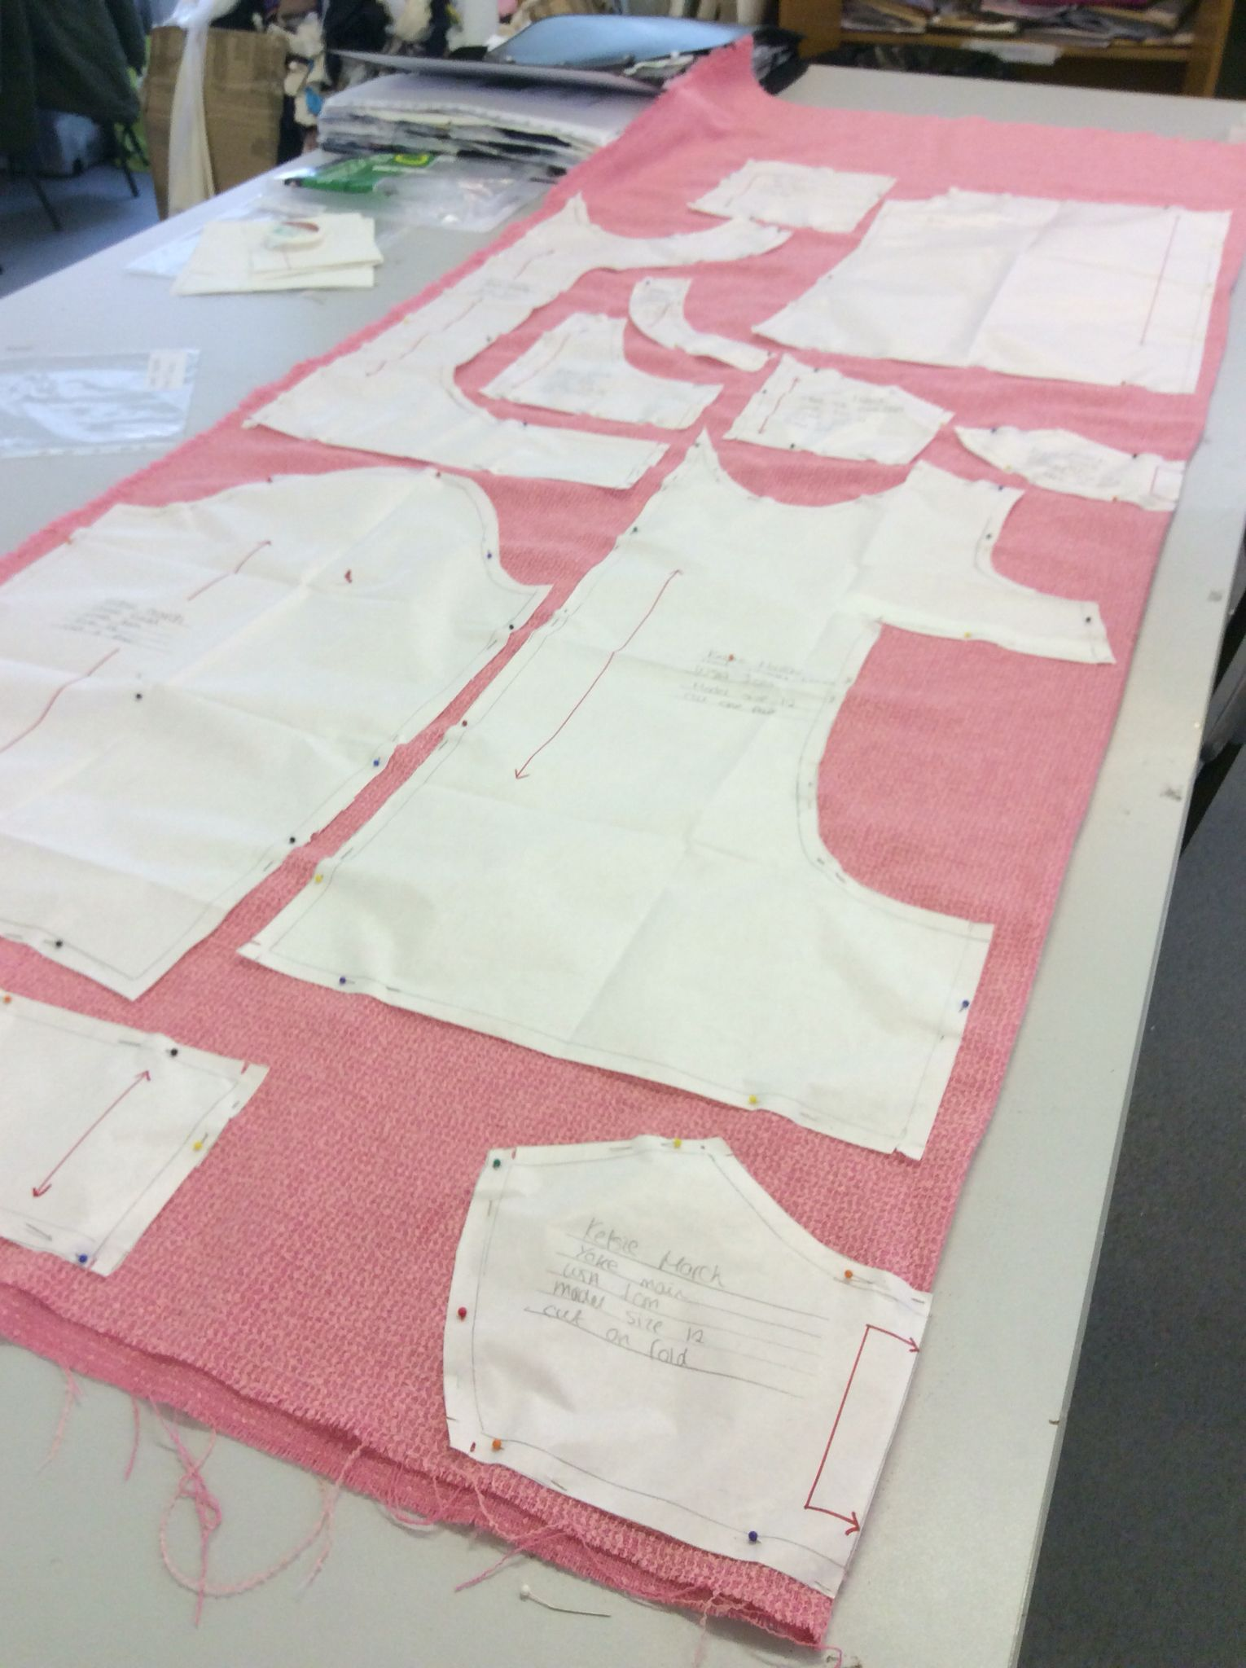
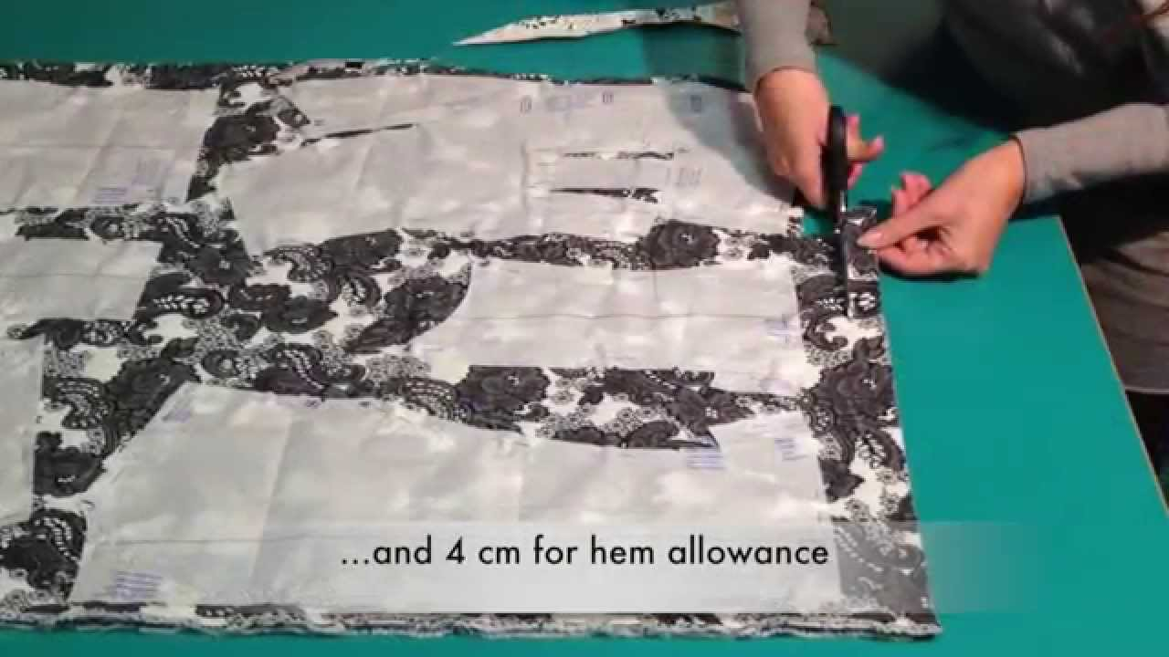
Pattern Pieces
A pattern piece is a piece of paper you use to help cut out your fabric
It is especially important when making something complicated like a piece of clothing
TASK:
Draw out the pattern pieces on paper that you will need to make your monster
Cut them out carefully

