Slide 1
Year 7 Textiles
Preparing for practical

Slide 2
Task 1: Checklist
Have you got…
a completed design?
pattern pieces planned?
a plan of making?

Slide 3
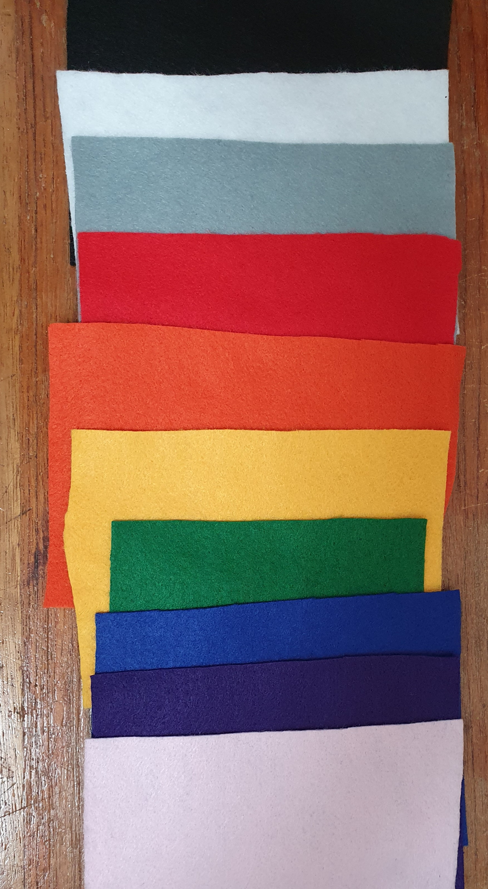
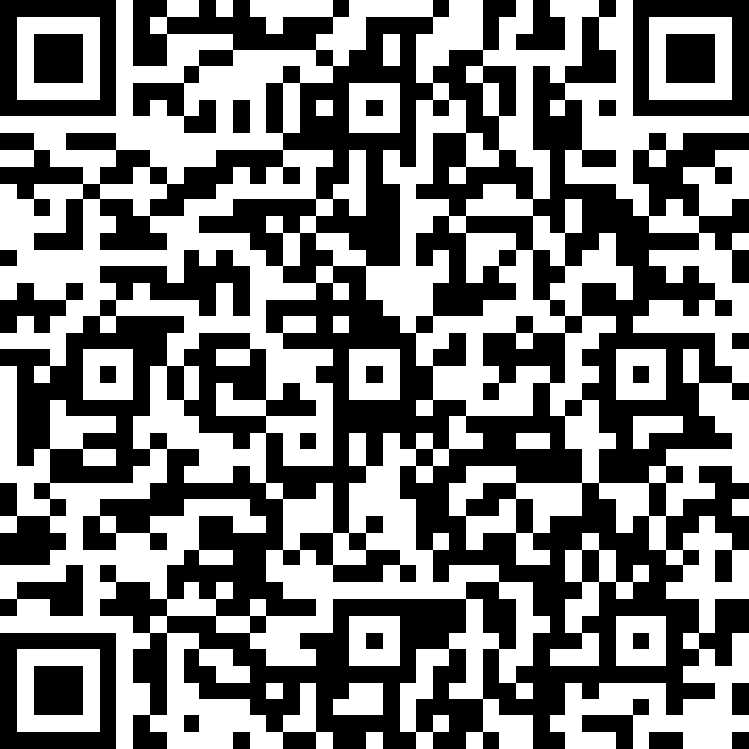
Task 2: Fabric choice
https://forms.office.com/Pages/ResponsePage.aspx?id=ayU9EVqymUaKdjDv2tH8N0cmmGNvE4VMuhh0B6pjvXdUQUc1Mkg0VU1FUzAwMTMzM0owU05NTlBLUC4u

Slide 4
Task 3 – Draw out pattern pieces
Use a different piece of paper from the design sheet
Draw out your pieces
Cut them out if you have somewhere to keep them safe
Bring them to next lesson!

