Slide 1
Remote Learning
Term 5 Week 2
Year 7

Slide 2
Recap
What does Devising mean?
  When you make up your own piece of drama
What do we need to help us with ideas?
  A stimulus
5 Ws – What are they and why are they important?
- Who, What, Where, When, Why
Notes:
Lesson 2

Slide 3
Learning Objectives
To consider structure when devising
Outcome
To devise a piece of theatre using a picture as a stimulus
Lesson 2

Slide 4

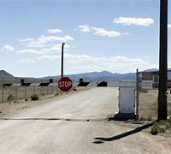
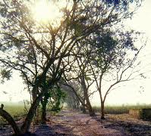
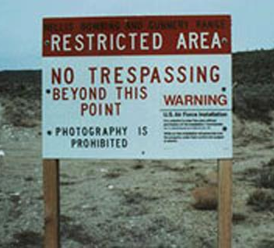
Picture Stimulus
What do you see?
What ideas pop into your head?
First word you think of whilst looking at the pictures?

Slide 5

5ws
Who – who are your characters?
What – what are they doing?
Where – where are they?
When – when they got there and when they are leaving?
Why – why are they there?

Slide 6


Structure of a devised performance
(Beginning) Exposition
(Middle) Conflict
(End) Denouncement
Your are going to Draw out and write a summary of 3 Freeze-frames to show the overall plot of your drama. (Remembering to show the 5Ws)

Slide 7
Beginning (Exposition)
What must happen in the beginning?
  Introduce the characters
  Make it clear where they are and what they are doing

Slide 8
Conflict
What does conflict mean?
Some kind of argument?
  The conflict does not necessarily mean a fight, in fact, there must not be a fight scene. The conflict can be a disagreement between two people, it can be a problem caused by a prop (a really heavy bag that nobody can lift) or it can be a situation (someone getting lost)

Slide 9
Denouncement
The End!
Usually people run out of steam when they get to the end of the piece especially when it is a comedy because once they get past the funny bit they stop or don’t know how to end it
However, to devise a good piece of drama you must have a strong ending
You must make sure the conflict from the middle sections is resolved in some way.

Slide 10

Task
Your are going to Draw out and write a summary of 3 Freeze-frames to show the overall plot of your drama. (Remembering to show the 5Ws)
Beginning
Middle
End

Slide 11
Turning Freeze-frames into 3 Scenes!
Write out a brief summary or a script for the 3 scenes
Remember 5Ws
Structure (Beginning, Middle & End)
Be Creative!!

Slide 12

Email your completed work to your Drama Teacher
Mrs Lake
Mrs Hawkins
Miss Jefferies

