Slide 1
Remote Learning
Term 5 Week 3
Year 7

Slide 2
Recap
What does structure mean?
What are the 5Ws?
What was the stimulus last lesson?

Slide 3

Learning Objectives
To devise and consider structure when devising of piece of drama using a theme
Outcome
To devise a piece of theatre using a Theme as a stimulus
Lesson 3
Notes:
Lesson 2

Slide 4

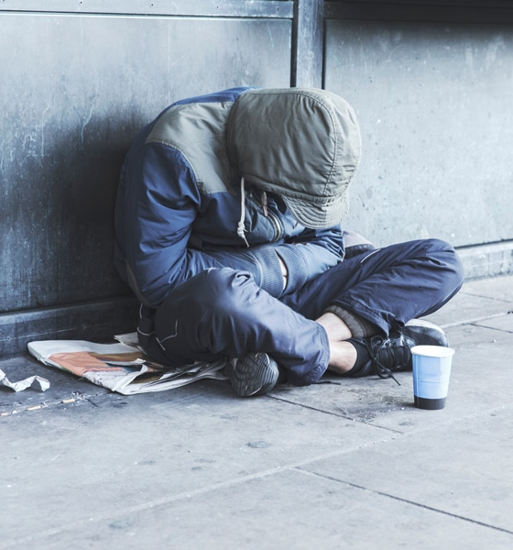
Homelessness – Theme Stimulus
What people find themselves homeless?
Who are they? Where are they? Why are they there?
Do they have family?
This Photo by Unknown Author is licensed under CC BY

Slide 5
Task
Draw out or write out a description of four Freeze-frames showing 4 different peoples lives living ‘on the streets’.
Choose one freeze-frame to focus on and write a scene. The performance must begin with that freeze-frame.

Slide 6
Scene
Now write out a short scene to show why the character(s) have become Homeless.
What is the situation?

Slide 7

5ws – Are they Clear??
Who – who are your characters?
What – what are they doing?
Where – where are they?
When – when they got there and when they are leaving?
Why – why are they there?

Slide 8
  You need to decide on the order of your scenes but they must show the following:
All four freeze-frames of Homeless’
The short scene using one of the freeze-frame – Add in Thought tracks
The scene showing why they are in this situation – Flash-back scene
An additional scene / Flash-forward scene – What happens to the character?

Slide 9

Email your completed work to your Drama Teacher
Mrs Lake
Mrs Hawkins
Miss Jefferies

