Slide 1
Remote Learning
Term 5 Week 6
Year 7

Slide 2
Learning Objectives
To design a set for your Devised drama from the lyrics Lucky Star
To design a costume for your main character for your devised drama

Slide 3
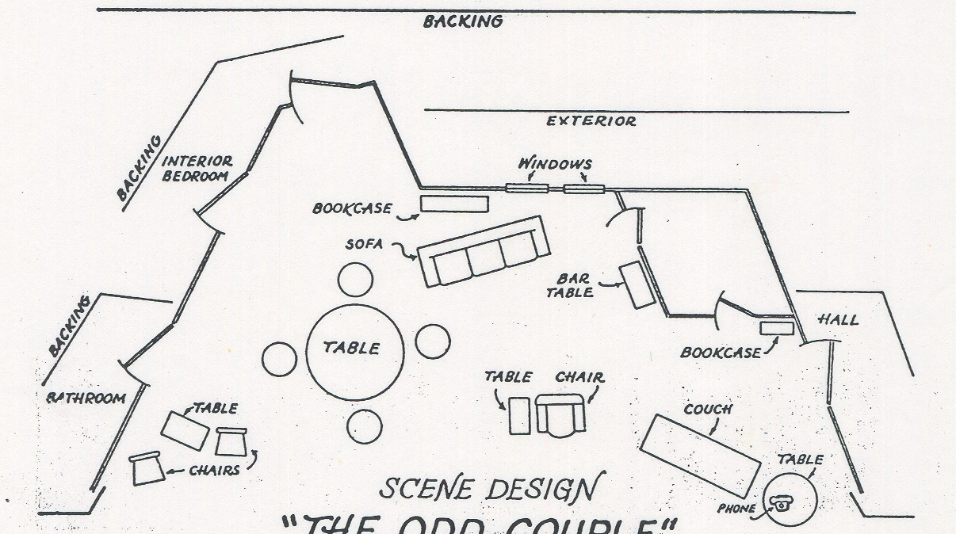
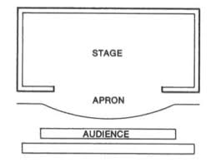
Your task: to draw a set design for your devised piece of drama from the song Lyrics Lucky Stars
Make sure to label your design
Consider its practicality (can the actors move any of it?)
What props might be on stage?
            Is there anything on the back wall?
            What colours are you using?

Slide 4
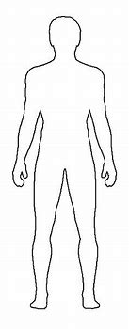
Design a costume for your main character
Colour​
Colour is a very important aspect of a costume, it can convey a symbolic idea or reveal something about the character wearing the costume.​
It can also help the audience see the similarities or differences between characters. For example, where two families are feuding, the performers may be dressed in different colours to help the audience differentiate.​
Condition​
The condition of the costume can convey information about the characters circumstances to the audience. For example, a street beggar may wear dirtier, more worn clothes and appear dirty​
Cut​
The way a costume is cut refers to the shape of fabric pieces used to construct it. For example, a suit can be cut in different ways to help change the performer’s physical appearance.​
Fabric​
The most appropriate fabrics to suit the character, setting and style of the production should be considered.​
Fit​
The fit of the costume refers to how the clothing fits, it can reveal a character’s personality or the context of the play.​
Remember to Label your Design

Slide 5

Email your completed work to your Drama Teacher
Mrs Lake
Mrs Hawkins
Miss Jefferies

