Slide 1
Year 8
Remote learning Term 5
Week 2

Slide 2
Starter : Recap
What does Devising mean?
  When you make up your own piece of drama
What do we need to help us with ideas?
  A stimulus
  5 Ws – What are they and why are they important?
- Who, What, Where, When, Why
Notes:
Lesson 2

Slide 3
Lesson 2 Recap and Apply Brecht
ALL: To explore the Brechtian technique.
MOST: To develop and apply the Brecht techniques to a performance.
SOME: To lead and direct a piece of drama using Brecht Techniques.

Slide 4
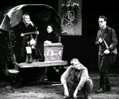
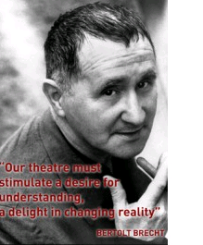
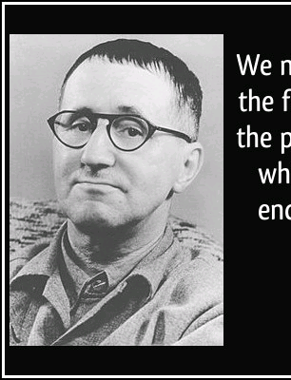
BRECHT
RECALL
ESSENTIAL INFORMATION
WAYS IT APPLIES TO DEVISING
WAYS TO USE IT

Slide 5
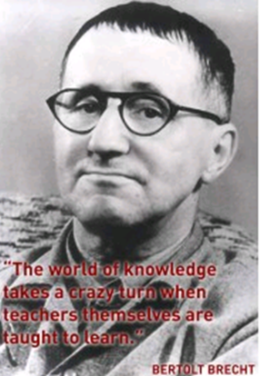
BRECHT
Technical techniques
LIGHTS: flood with bright light regardless of time of day
COSTUME: use a single item to represent. Make changes visible
STAGE: bare stage. All workings seen. Fragments of scenery to represent location & use
Brechtian theatre offers exercises that allows the director to adapt the given ideas by using the techniques to make the political & social message clearer on stage
Some of the techniques can be used during rehearsal but are more focused on realising the performance in a Brechtian style
Ideas for theatre
His work was deeply influenced by the social, political & cultural events that surrounded him. He was clearly influenced by the world he was growing up in: Germany defeated in 1918, the treaty of Versailles, rise of fascism
He wanted to distance the spectator from the action – for them to always know they are watching theatre. This was knows as EPIC THEATRE - a dramatic form intended to provoke rational thought rather then create illusion
He wanted to disrupt the notion of the FOURTH WALL. This was done by direct address by the actor to the spectator
He wanted to make the spectator think. The plays were DIDACTIC contain a political or moral message to teach the spectators about certain aspects of society, politics or economy.
Key exercises used by Brechtian actor:
V-effect: actor attempts to detach themselves from becoming lost in the circumstance. Can be achieved by speaking stage directions, changing roles, speaking in third person.
Narration & Direct address
Multi-role – this can be effective when playing contrast roles. Could be effective in making the audience consider the significance of the 2 contrasting ideas
Placards
Gestus – finding an action that sums the characters social standing. This is a contrast with Stanislavski’s inner life of the character.
Externalise emotions: creating exaggerated responses
Choral & ensemble

Slide 6
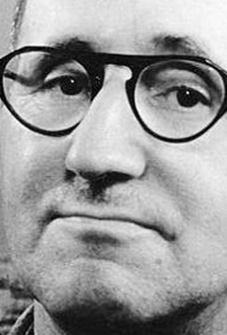
Why would Brecht want to make theatre like this?
He believed that while the audience believed in the action onstage and became emotionally involved, they lost the ability to think and to judge.
He wanted his audiences to remain objective and distant
Epic Theatre was didactic. This means it was based on morals and made the audience think.
This Photo by Unknown Author is licensed under CC BY-NC-ND

Slide 7

Task
Think of a fairy tale that has a clear moral (the ugly duckling, the emperor’s new clothes, Rumpelstiltskin
You write a scene using a fairy tale story or moral and but it must include:
speaking in the third person
Use of placards.
Notes:
Rehearse and then perform – working in groups of 4-5

Slide 8

Email your completed work to your Drama Teacher
Mrs Lake
Mrs Hawkins
Miss Jefferies

